Slide 1
Yaşlıda Parkinson Hastalığı
Tedavisi
Prof. Dr. Sibel Ertan
Koç Üniversitesi Tıp Fakültesi Nöroloji Anabilim Dalı
17 Ekim 2025, Bodrum

Slide 2
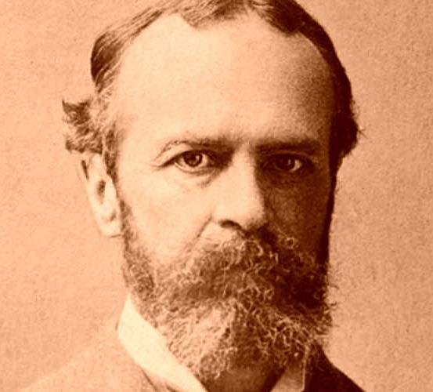
Geriatrik popülasyonda AD sonrası görülen en sık nörodejeneratif hastalık PH
James Parkinson 1755 - 1824
2050 yılı itibariyle tüm dünyada 25.2 milyon kişinin PH hastası olacağı ve bu rakamın 2021 verilerine göre %112’lik bir artıșı tekabül edeceği öngörülmektedir
Su D, Cui Y, He C, Yin P, Bai R, Zhu J, Lam JST, Zhang J, Yan R, Zheng X, Wu J, Zhao D, Wang A, Zhou M, Feng T. Projections for prevalence of Parkinson's disease and its driving factors in 195 countries and territories to 2050: modelling study of Global Burden of Disease Study 2021. BMJ. 2025 Mar 5;388:e080952. doi: 10.1136/bmj-2024-080952. PMID: 40044233; PMCID: PMC11881235
Notes:
Asclepius, son of Apollon, tip tanrisi (saglik ve sifa tanrisi). Aslinda Apollon salginlara neden olabiliyor
Sabahat Tezcan

Slide 3
Hastalık şiddeti
PRODROMAL DÖNEM
KLİNİK SÜREÇ
Düşmeler
Donmalar
Disfaji
Akinezi
Düşmeler
Donmalar
Disfaji
Akinezi
Motor komplikasyonlar
Fluktuasyonlar
Diskineziler
Postüral instabilite
Motor komplikasyonlar
Fluktuasyonlar
Diskineziler
Postüral instabilite
Tremor
Bradikinezi
Rijidite
Motor
Hafif motor belirtiler
Zaman
-15
KLASİK TEDAVİ ALANIMIZ
+20
Uyku sorunları
(RBD, GAU)
Hipozmi
Konstipasyon
Hipotansiyon
Üriner ve cinsel işlevler ile ilgili sorunlar
Anksiyete
Depresyon
Ağrı
Yorgunluk
Apati
↑Dizotonomi
PD -MCI
Non- Motor
↑Dizotonomi
PD -MCI
PDD
PD -Psikoz
PDD
PD -Psikoz
Hastalık şiddeti
Notes:
Patients with PD experience not only motor symptoms, non-motor symptoms also significantly affect their quality of life. Health-related quality of life is reducedin early, advanced, and palliative stages of PD. As the onset of PD is frequently in the 50s, many patients reach the characteristically advanced disease milestones at an older age, such as gait disorders, complications as a result of the
treatment, cognitive decline, and psychiatric disorders
Treatment of PD consists of physical therapies, oral, transdermal, and subcutaneous medications, as well as invasive advanced therapies at later stages of the disease [8, 9]. Besides complex symptoms in advanced PD, typical geriatric comorbidities complicate the optimal treatment. Parkinson’s disease medications at advanced stages frequently comprise a challenging polypharmacotherapy . Often patients and physicians have to prioritize treatment goals on the most affecting symptoms and the safest treatment where advanced disease stages are concerned.

Slide 4
Geriatri polikliniğinde karşımıza çıkan hasta
Daha genç yaşlarda hastalığı başlamış İleri yaş ileri evre sorunları ile
Şiddetli motor semptomlar
Motor komplikasyonlar
Düşmeler
Donmalar
Yutma güçlükleri
Dizotonomi
Parkinson demansı
Parkinson psikozu
Depresyon
Uyku sorunları
Henüz hastalık belirtileri yeni başlamış İleri yaş erken evre sorunları ile
Hafif motor belirtiler
Anksiyete
Depresyon
Apati
Ağrı
Uyku sorunları
Hafif dizotonomi

Slide 5
İçerik
Geriatrik PH hastalarının tedavisinde dikkat edilmesi gereken durumlar
Geriatrik PH hastalarında tedavi algoritması
PH’da kullanılan ilaçların etki, yan etki ve ilaç etkileşimleri
PH’da egzersizin yeri

Slide 6
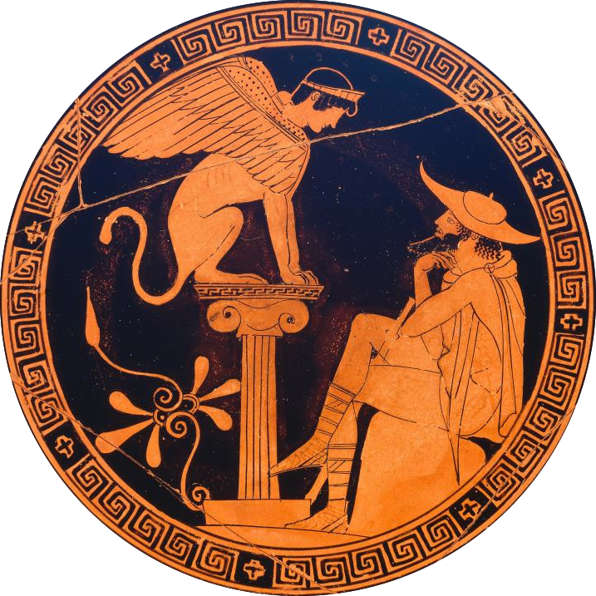
Geriatrik PH hastalarının tedavisinde dikkat edilmesi gereken durumlar
Sık rastlanılan komorbiditeler ve PH’nın non-motor semptomları

Slide 7
Hospitalize edilmiş PH hastalarının >%30’unda >5 komorbidite var
Geriatrik PH hastalarında multimorbidite oranı %92
En sık görülen komorbiditeler
Demans
Hipertansiyon (%30-%63)
Diabet (%8 -18)
Kardiyovasküler hastalıklar
Anksiyete, depresyon
Zayıflık ve sarkopeni (%35)
Osteoporoz
Tiroid hastalıkları
Anemi
Retinal hastalıklar
Cilt rahatsızlıkları
Erkeklerde prostat hipertrofisi
Serebrovasküler hastalıklar (%44)
Polinöropati (%8)
Demans
Tip 2 DM olanlarda PH riski %50 daha yüksek
Yaş uyumlu kontrollere göre PH hastalarında serebrovasküler hastalık prevalansı daha yüksek
ABD’de kontrollere göre PH hastalarinda kalp yetersizliği
prevalansi 2 x yüksek
Vasküler risk profili yüksek PH hastalarında postural
instabilite ve kognitif yıkım sıklık ve şiddeti yüksek
Kardiyovasküler hastalıklar
Zayıflık ve sarkopeni
Hou JG, et al. Assessment of appropriate medication administration for hospitalized patients with Parkinson’s disease. Parkinsonism Relat Disord. 2012;18:377–81.
Zesiewicz TA, et al. Heart failure in Parkinson’s disease: analysis of the United States Medicare current beneficiary survey. Parkinsonism Relat Disord. 2004;10:417–20.
Hong CT, Hu H-H, Chan L, Bai C-H. Prevalent cerebrovascular and cardiovascular disease in people with Parkinson’s disease: ameta-analysis. Clin Epidemiol. 2018;10:1147–54.

Slide 8
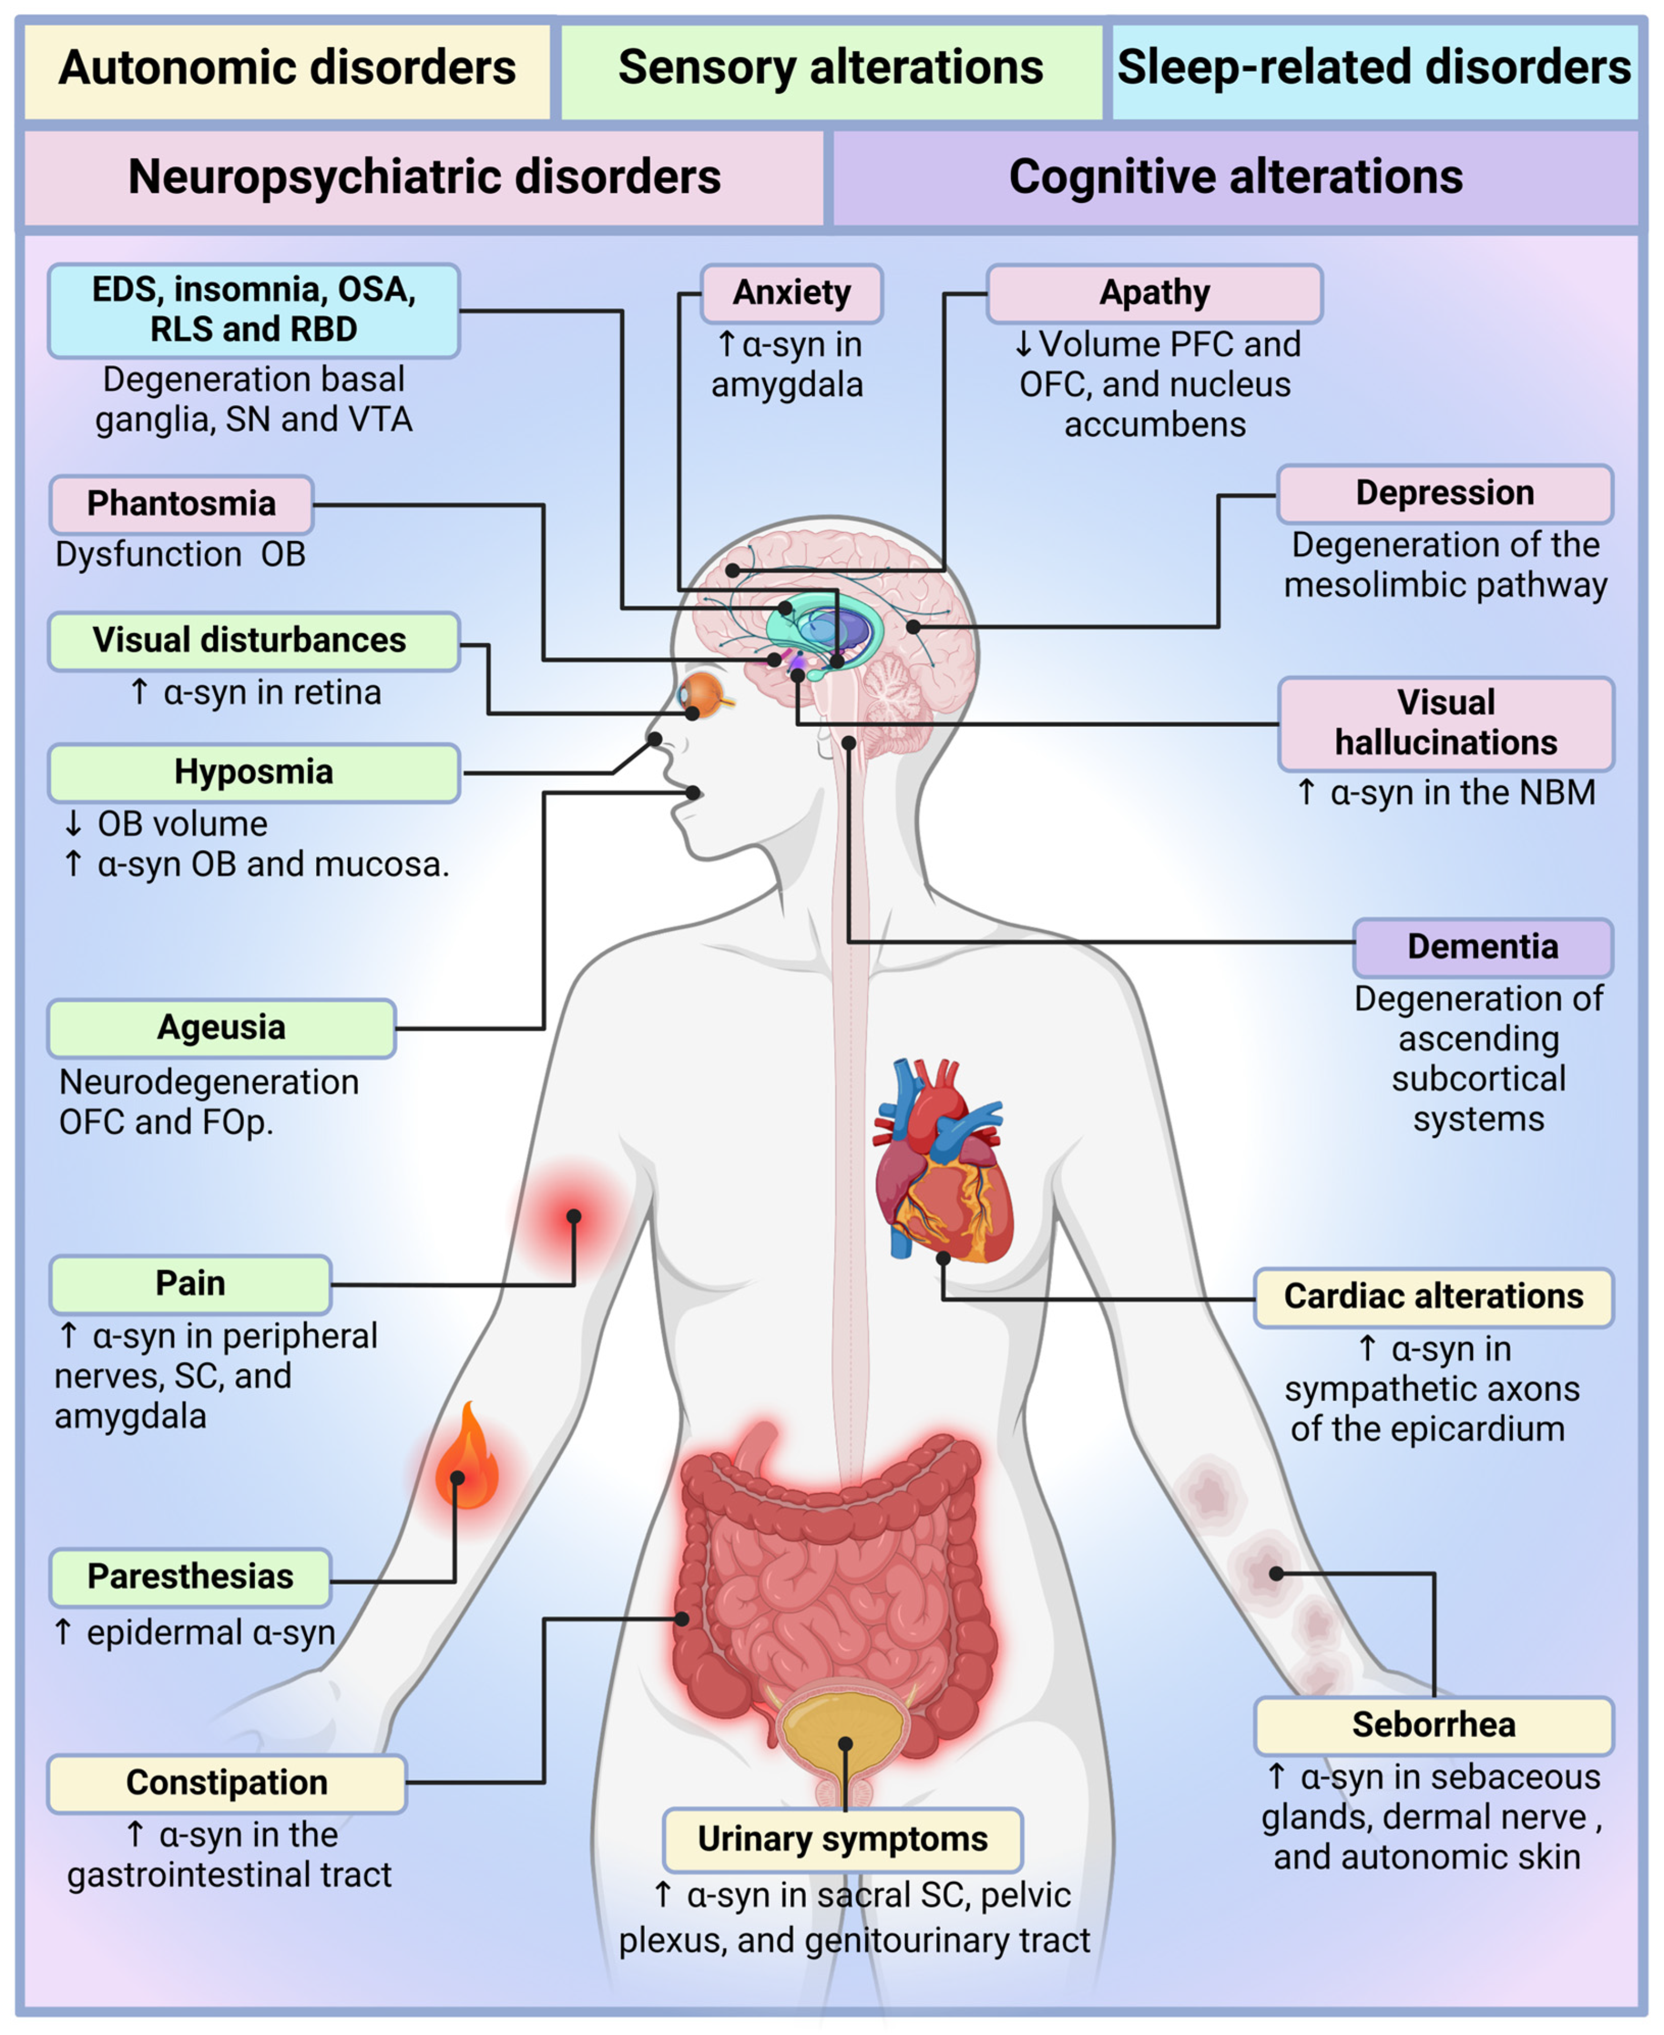
PH multisistem bir hastalık
gibi ele alınmalı!!
Peña-Zelayeta, Let al. Redefining Non- Motor Symptoms in Parkinson’s Disease. J. Pers. Med. 2025, 15, 172.
https://doi.org/10.3390/jpm15050172

Slide 9
PH poliklinik hastalarının >%50 psikiyatrik ve kognitif semptomlar görülüyor
Hafif bilişsel etkilenme tanı sırasında %35, 5. yılda %50 hastada var
  En sık non- amnestik ve tek alanda
Yürütücü işlevler, psikomotor hız, vizyospasyal yetiler, dikkat
  PH demansı yıllar içinde PH hastalarının tamamına yakınında gelişiyor
  PHD’ye sıklıkla apati, depresyon, PH psikozu, dizotonomi özellikle OH ve üriner semptomlar öncelik ve eşlik ediyor
  PHD hastalarında multidisipliner konsültasyon olması gerektiği gibi gerçekleştirilemiyor
Psikotik semptomlar genellikle vizüel halüsinasyonlar, pasaj halüsinasyonları, birisi varmış hissi
ve ilüzyonlar şeklinde
  > 65 yaş, ileri yaş hastalık başlangıcı olan, hastalık süresi >6 yıl, yüksek doz dopamine agonist kullanan,
  aksiyel parkinsoniyen belirtileri şiddetli, görme keskinliği azalmış ve kognitif sorunları olan hastalarda sık
Depresyon en sık rastlanılan psikiyatrik semptom
  38300 PH hastası içeren bir metaanalizde Depresyon prevalansı ∼%40, major depresyon %17
  Depresyon ve anksiyete genellikle birarada seyrediyor, motor semptomlara öncülük edebiliyor
  İleri evre hastalarda depresyon oranı %60
  Depresyonu olan ve >76 yaş hastalarda ≤65 yaş hastalara oranla bakım yükü 4 kat daha fazla
Pigott JS et al. The Care Needs of Patients With Cognitive Impairment in Late-Stage Parkinson's Disease. J Geriatr Psychiatry Neurol. 2024 Sep;37(5):355-367.
Riedel O et al. Dementia and depression determine care dependency in Parkinson’s disease: analysis of 1,449 outpatients receiving nursing care in Germany. Nervenarzt. 2011;82:1012–9.
Connolly B, Fox SH. Treatment of cognitive, psychiatric, and affective disorders associated with Parkinson's disease. Neurotherapeutics. 2014 Jan;11(1):78-91.
Wang Z, Wei H, Xin Y, Qin W. Advances in the study of depression and anxiety in Parkinson's disease: A review. Medicine (Baltimore). 2025 Mar 7;104(10):e41674.
Notes:
Through a meta-analysis encompassing 129 trials with a total of 38,304 participants, it was found that the prevalence of depression in PD patients was 38%. Major depression was found in about 17% of PD patients.^{[3]} Up to 70% of outpatients with mid- to late-stage PD have no dementia and are seen to be depressed with other neuropsychiatric symptoms.^{[4]}The characteristics of depression in PD are as follows: depression and anxiety disorders frequently coexist and can precede motor symptoms in PD.^{[5]} The prevalence of depression increases faster than anxiety in the early stages of the disease, increases with age and duration of the disease, and increases in prevalence throughout the course of the disease and with age^{.[6]} In patients with advanced disease, the prevalence of depressive symptoms occurs in approximately 60% of patients with advanced disease.^{[7]} Depression and PD are often interdependent, with the severity of symptoms in one affecting the course of the other. Depression in PD is associated with age, gender, freezing of gait, anxiety, fatigue, apathy, daytime sleepiness, higher doses of levodopa, higher pain scores, severity of illness, and cognitive decline.^{[8]} Patients with a PD duration of more than 10 years are at increased risk of comorbid depression.

Slide 10
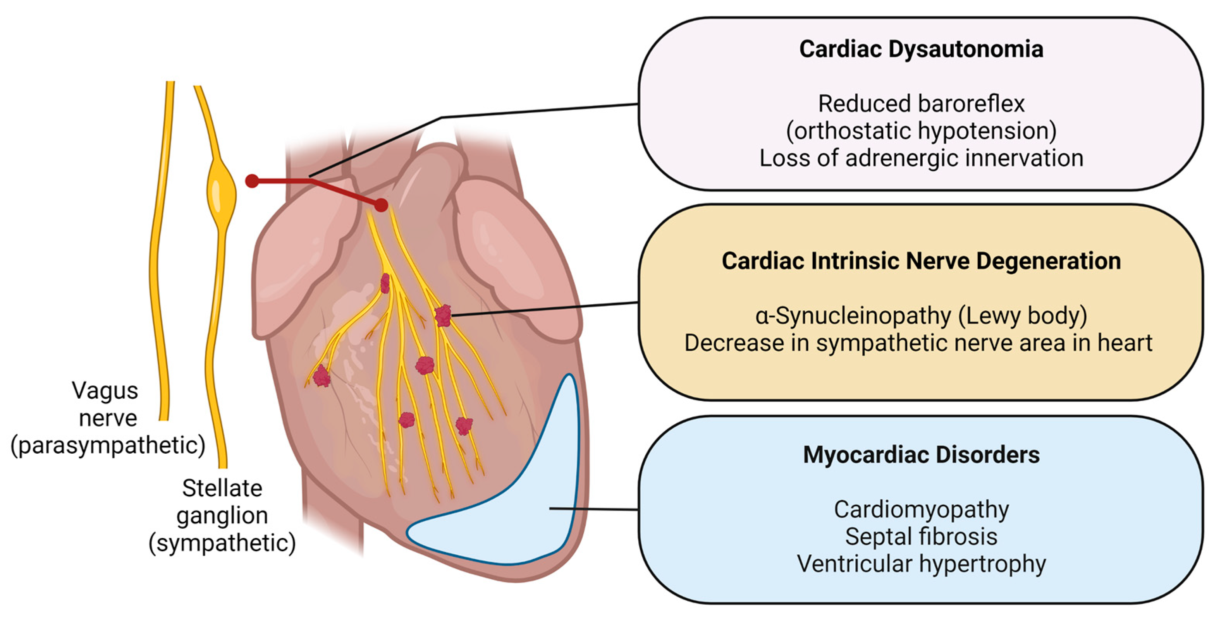
Kardiyovasküler bozukluklar PH hastalarının yaklaşık %80’inde saptanıyor
Uygulanan tedaviler kardiyovasküler yan etkilere neden olabiliyor
Hastalığa bağlı yaşam şekli kardiyovasküler riski ayrıca arttırıyor
En sık OH (%30 - %50)
Kardiyomiyopati
QT ve PR araliklarında uzama
Sol ventrikül hipertrofisi
Atriyal fibrilasyon
Diyastolik disfonksiyon
KY’ne bağlı ölüm PH hastalarnda ana ölüm sebeplerinden biri
prevalans genel populasyonun 2 katı
Lee Bonn et al. Int. J. Mol. Sci. 2023
Hastalığın en erken aşamasından itibaren
bu değişiklikleri erken tanımak ve takip etmek önemli!!
Cuenca-Bermejo L. et al. Int. J. Mol. Sci. 2021
Gonçalves et al. The Neuroscientist 2022

Slide 11
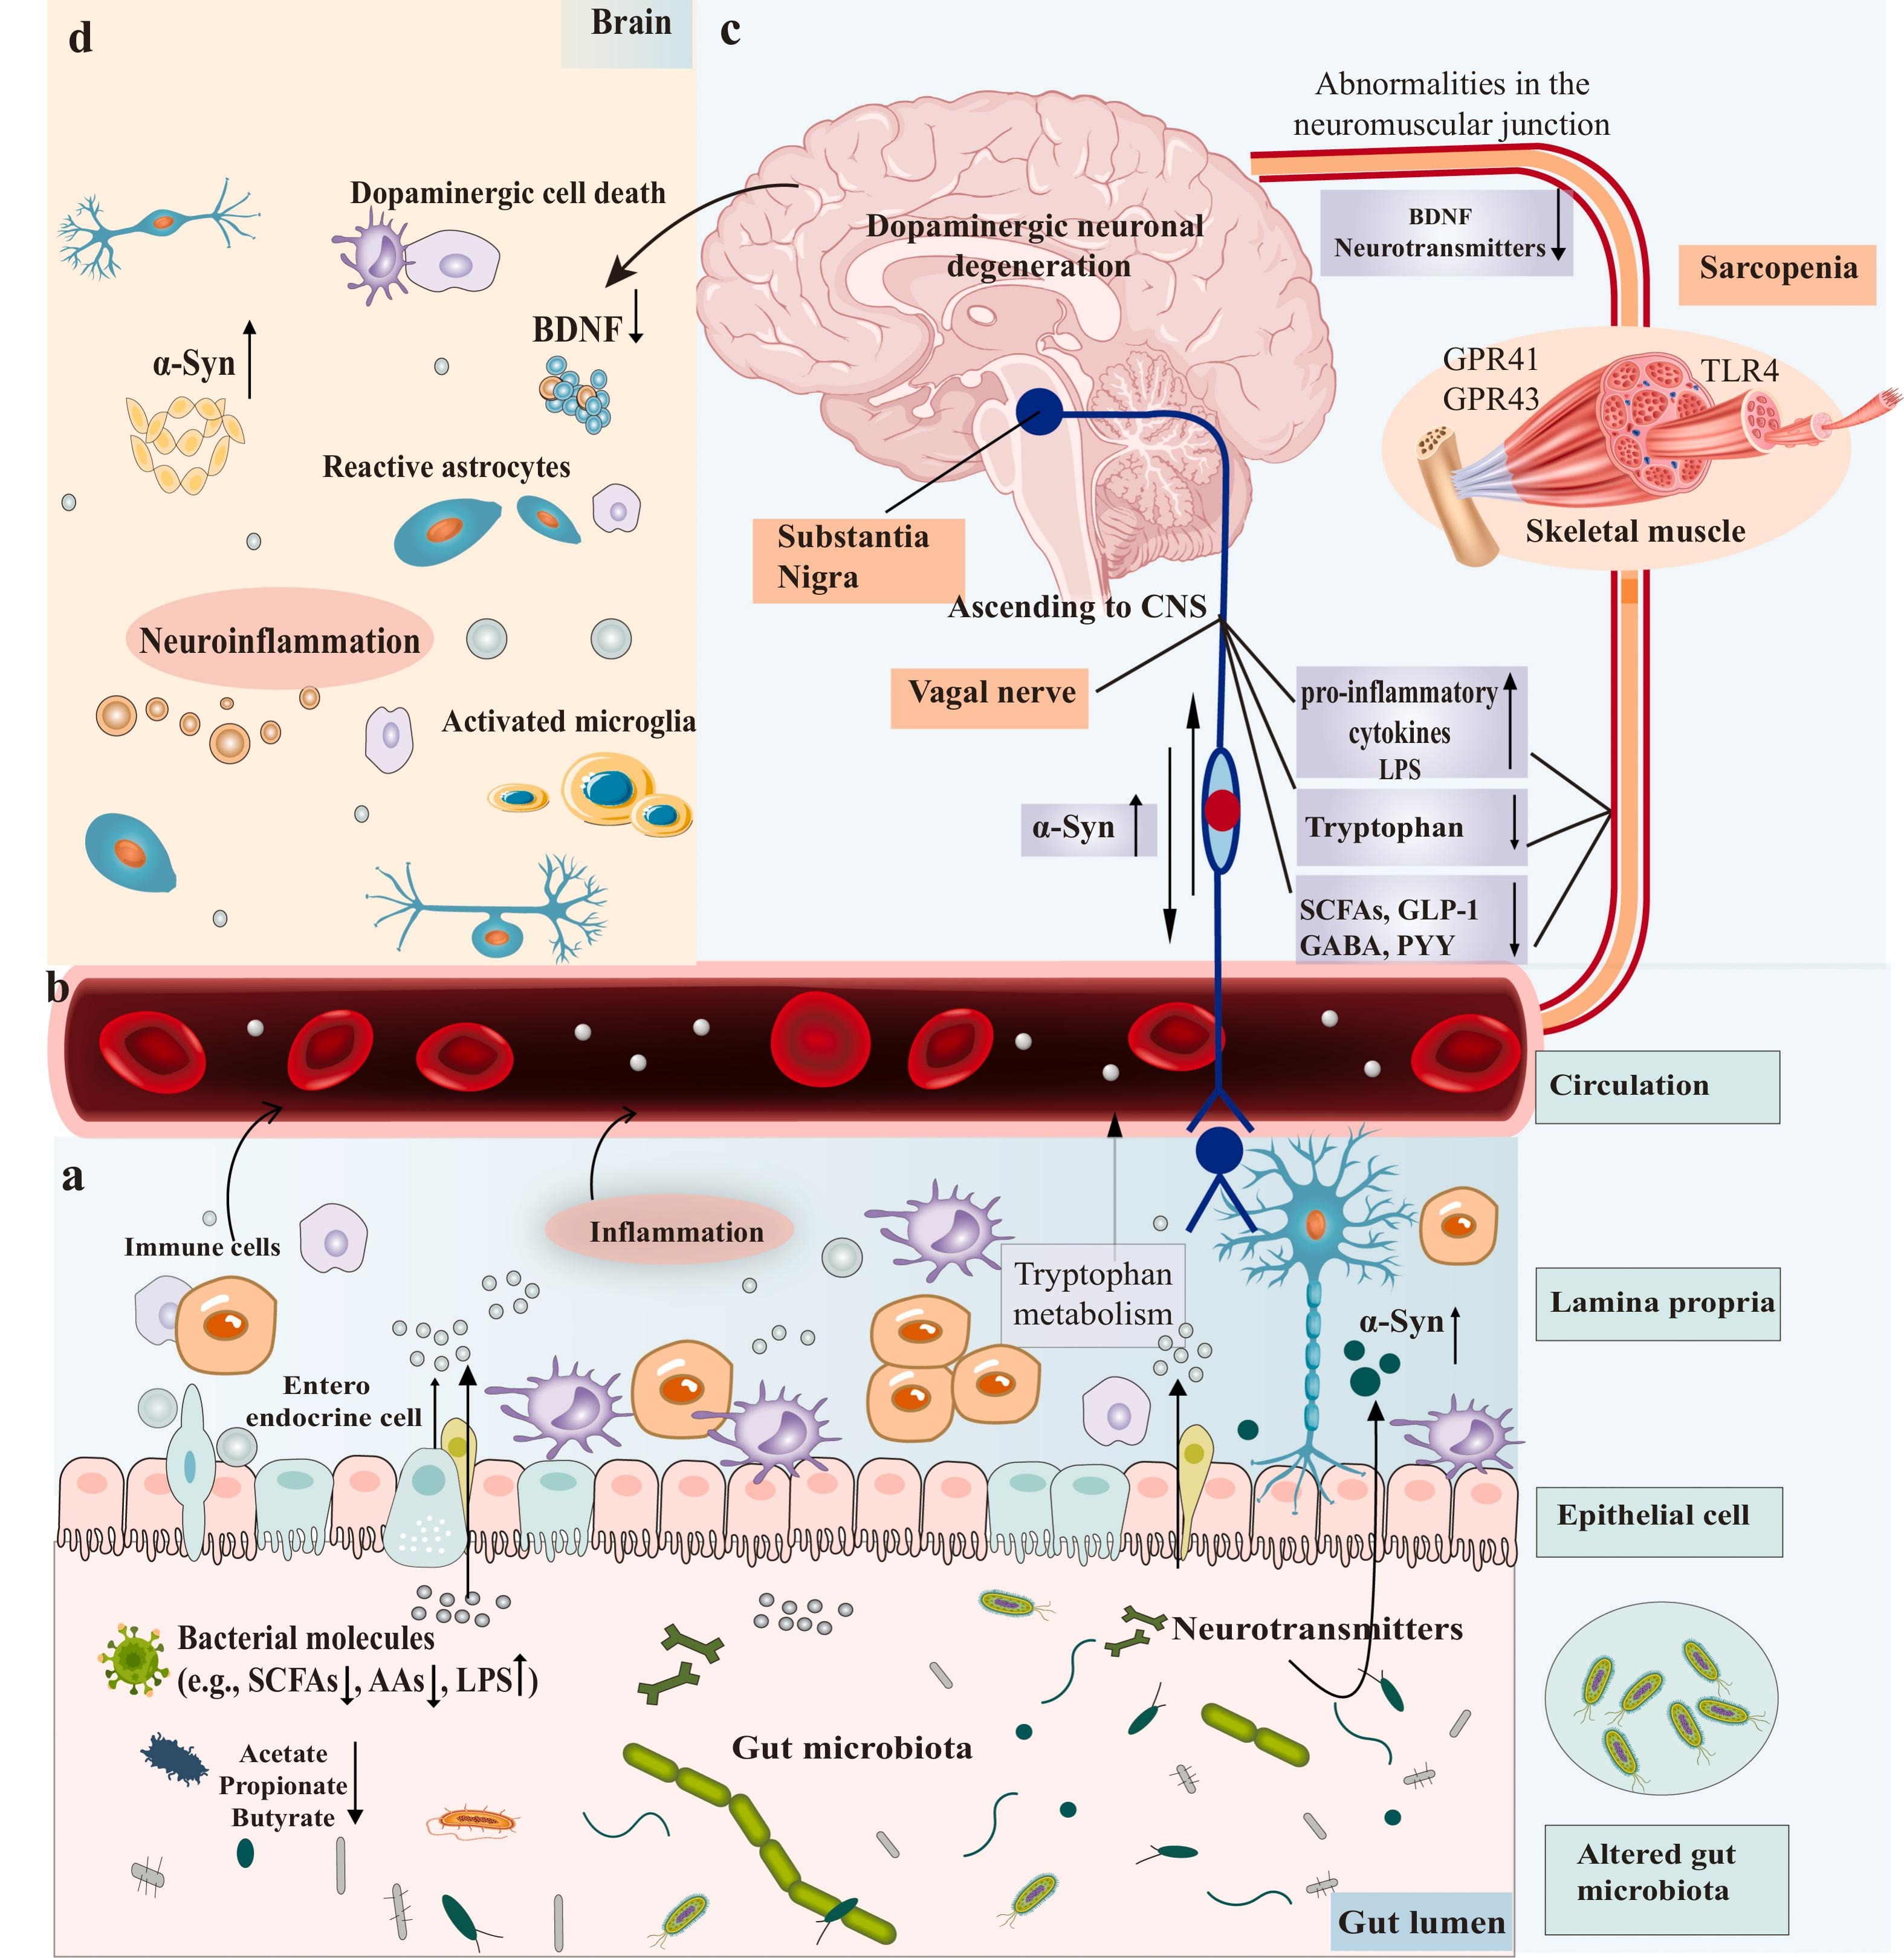
Zayıflık ve sarkopeni PH hastalarında sık ve PD dışı hareket sorunlarına neden olabilir
Sarkopeni kontrollere göre PH hastalarında 5 x daha fazla
Sarkopeni ve zayıflık ileri evre, motor skorlarda kötüleşme, sık düşmeler ve yaşam kalitesinde bozulma ile ilişkili
Malnütrisyon, kilo kaybı
Azalan fizik aktivite
Uyku sorunları
İskelet kasında ‘𝛂-syn’ birikimi
Enflamatuar sitokinler ve oksidatif stress
Peball M. et al. Prevalence and associated factors of sarcopenia and frailty in Parkinson’s disease: a cross sectional study. Gerontology (2019) 65 (3): 216–228
Gui M, Lv L, Hu S, Qin L, Wang C. Sarcopenia in Parkinson's disease: from pathogenesis to interventions. Metabolism. 2025 Aug;169:156272. doi: 10.1016/j.metabol.2025.156272. Epub 2025 Apr 19. PMID: 40258411.
Notes:
Mechanisms of crosstalk between microbes, gut, muscle and brain in PD. Disturbed gut microbes play a role in the pathogenesis of PD and sarcopenia
through microbiota metabolites, immune factors, and inflammatory responses. a. Alterations in intestinal microbes and their metabolites can leave the gut in an inflammatory state. These substances can cross the damaged intestinal barrier, activate mucosal immune cells, induce the release of pro-inflammatory cytokines, and promote misfolding and aggregation of α-Syn. b. Increased gut permeability allows microbial products and metabolites to enter systemic circulation, causing systemic and neuroinflammation. c. Misfolded α-Syn in the gut can be transferred to the brain through intercellular transmission via the vagus nerve, and this transmission may be bidirectional. Decreased butyrate and other SCFAs also decrease the gut mucus layer. Increased intestinal permeability is likely to expose the intestinal neural plexus to toxins like LPS and bacterial antigens, causing systemic inflammation, neuroinflammation and neurodegeneration, and to cause abnormal aggregation of α-Syn fibrils, thus promoting PD dyskinesia. A similar mechanism occurs in skeletal muscle, forming a microbiota-gut-muscle axis that leads to increased protein hydrolysis and decreased synthesis, thereby promoting sarcopenia. This is accompanied by NMJ dysfunction, reduced amino acid availability, and decreased BDNF, which may further exacerbate neurodegenerative processes. d. The damaged blood–brain barrier and vagal pathways allow pathological products and α-Syn to enter the brain, activating microglia and astrocytes, resulting in neuroinflammation, and ultimately leading to the loss of dopaminergic neurons and the development of PD. AAs: amino acids; α-Syn: α-Synuclein; BABA: gamma-aminobutyric acid; BDNF: brain-derived neurotrophic factor; CNS: central nervous system; GLP-1: Glucagon-like peptide-1; GPR41: G protein-coupled receptor 41; GPR43: G protein-coupled receptor 43; LPS: lipopolysaccharide; PYY: Peptide YY; SCFAs: short- chain fatty acids; TLR4: toll-like receptor 4.

Slide 12
Geriatrik PH hastalarında tedavi algoritması

Slide 13
PH’da tam iyileșme sağlayan bir tedavi yöntemi yok
Her hastada tedavilere yanıt farklılıklar gösterebilir
Mevcut semptomatik tedavilere yanıt beklentisi yaklaşık %40 -%70 civarlarında olmalı
PH’da ana patoloji, özellikle SNpc ventrolateral bölgesindeki progressif dopaminerjik nöron kaybı ve Lewy cisimciği veya nöriti olarak bilinen α-syn içeren intrasellüler agragatların birikimi olmakla birlikte, PH hastalarındaki her semptom dopamine yanıtlı değildir
Çoklu n/transmitter etkilenmesi !!
Ko-patolojiler !!
Notes:
The core pathological features of PD are progressive loss of dopaminergic neurons and the formation of α-synuclein-containing intracellular aggregates, known as Lewy bodies and Lewy neurites, especially in the ventrolateral region of the substantia nigra pars compacta

Slide 14
İŞLEVSEL KISITLILIĞI MİNİMAL VEYA OLMAYAN İLERİ YAŞ HASTA
ŞİDDETLİ İŞLEVSEL KISITLILIĞI
OLAN
İLERİ YAŞ HASTA (+/- Komorbidite)
Minimum effektif dozda
L-Dopa/DDİ
Egzersiz
’bekle gör’ yaklaşımı
Yetersiz yanıt
L-dopa doz arttIr
GERİATRİK HASTADA
TEDAVİ ALGORİTMASI
Yetersiz yanıt
Tanı ??
L-Dopa/DDİ dozunu arttır
Veya COMT İ* veya MAO-B İ* ekle
(Dirençli tremor FUS)
COMT İ*
MAO-B İ*
Amantadin*
Adenosine A2a res. Antagonist
Cihaz destekli tedaviler
(Infüzyon terapileri)
Motor komplikasyonlar
*İlaç etkileşimleri
Açısından dikkat !

Slide 15
Geriatrik PH hastalarında kullanılan ilaçların
etki, yan etki ve ilaç etkileşimleri

Slide 16
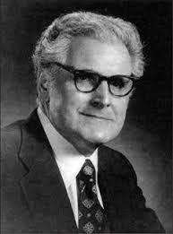
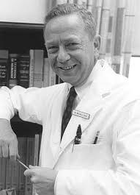
L-Dopa
Arvid Carlsson
(1923-2018)
Farmakoloji laboratuarı
Göteborg Üniversitesi, 1981
Reserpin ve Levodopa üzerine çalışmalar
Motor işlevlerde dopamine rol oynayabilir
Oleh Hornykiewicz
(1926-2020)
Farmakoloji enstitüsü Viyana 1962
Parkinson hastalarında striatal dopamine eksik
Birkmayer ile birlikte hastalara L-dopa enjeksiyonu
George Cotzias
(1918-1977)
1967 yılında PH hastalarında L-Dopa tedavisini uyguladı
Melvin D. Yahr
(1917-2004)
L-Dopa ile ilk çift kör klinik
çalışmaları başlattı
Notes:
The story starts with Carlsson, who became interested in studying the mechanism of reserpine’s sedative effect, now recognized as a drug-induced par- kinsonian state. A key experiment in 1957 showed that levodopa (L-dopa) could alleviate the immobility induced by reserpine in animals. Carlsson then showed that reserpine depleted brain dopamine, and that L-dopa restored it. Carlsson developed a sensitive fluorescent technique to measure dopamine levels, and his labora- tory also showed the distribution of dopamine in animal brain to be highest in the striatum. Within a year, Carls- son postulated that dopamine appears to play a role in motor function. His proposal that dopamine serves as a neurotransmitter in brain was met with much skepti- cism, but he persisted and continued to study brain dopamine, eventually leading to being awarded the Nobel Prize in Medicine in 2000.
Hornykiewicz also went into pharmacology research after graduating from medical school. Fortuitously, his assigned first project was on the blood pressure effects of dopamine, recognized as a precursor of norepinephrine. When he completed his postdoctoral studies, Carlsson’s work on the reserpinized animal and on the regional distribution of brain dopamine was published. This inspired Hornykiewicz to determine dopamine levels in patients with Parkinson’s disease. He obtained postmortem material, and his 1960 paper showed a marked depletion of dopamine in the striatum in this disorder. He went on in subsequent papers to correlate severity of parkinsonian features with the amount of striatal dopamine depletion. In the meantime, after his discovery of low dopamine in brains of patients with Parkinson’s disease, Hornykie- wicz persuaded Walther Birkmayer to inject L-dopa into patients. They reported success and continued this treatment, usually combining it with the use of a mono- amine oxidase inhibitor. However, the response was lim- ited in duration, and subsequent trials by others were not achieving similar success, and many failed to find any benefit.
The fulfilment of the L-dopa story stemmed from the hypothesis held by Cotzias that Parkinson’s disease was caused by loss of brain neuromelanin in the substantia nigra. Although Cotzias’s research had been in pharmacology, he also headed a clinical phar- macology research group at a federal laboratory on Long Island, New York, USA. He decided to try to restore this pigment in patients, not animals, and one of the three drugs he tried was D,L-dopa. As reported in his 1967 article, D,L-dopa proved to be dramatically successful in reversing the symptoms, but at extremely high dosages and with considerable hematologic adverse effects. Cotzias immediately tested L-dopa and found the same benefit with half the dosage and with- out the hematologic problems.
Yahr was a clinical neu- rologist who had been treating patients with PD with available therapy and also headed a federally financed research group investigating the disorder. Always on the lookout for potential new treatments, he was initially skeptical about L-dopa when studies with low doses were being reported. Seeing videos of patients pre- sented by Cotzias, however, he realized that the results needed confirmation through a double-blind controlled clinical trial. He proceeded to develop and execute such a trial with L-dopa, duplicating Cotzias’s success. Both Cotzias and Yahr had encountered motor fluctuations and dyskinesias, but the amelioration of bradyki- nesia, rigidity, and tremor was so pronounced that these adverse effects did not prevent regulatory approval of L-dopa, and almost 50 years later L-dopa remains the most effective pharmacologic agent for treating Parkinson’s disease. This article relates the per- sonal stories of these four pioneers and how they achieved their success.

Slide 17
L- DOPA
Altın standart ilacımız
Hastalığın tüm evrelerinde etkili en güçlü semptomatik ilaç
Etki/ yan etki oranı yüksek
L-Dopa her zaman ilk seçim ilaç !!!
Notes:
L-dopa tedavisi ile hastaların sağkalım süresi 12 yıl kadar uzamıştır.
Levodopa was consistently shown to be superior to placebo and, more importantly, to most, if not all, other available PD medications, improving the motor Unified Parkinson’s Disease Rating Scale (UPDRS) score by a mean of 8.8 points (where the minimal clinically important differ- ence in UPDRS is ≥ 3.25 or an improvement of 30% from baseline) (Table 1) [29–35]. The total UPDRS score improved by approximately 2 to 12 units, with the best result often seen when a dose of 600 mg/day or more is taken [34–37]. However, in Western Pacific studies, PD patients exhibit symptomatic benefits with a lower dose of levodopa, at 375 to 413 mg/day, compared with European and North American counterparts

Slide 18
L- DOPA
Sık görülen yan etkiler
  Bulantı (LCE %30; LD %20)
  OH (%3.5)
  Dizziness %12
  Uykuya meyil (%7.5)
  Periferik ödem (%9)
  Cilt döküntüsü (%5)
  Halüsinasyon (%4,5)
  Diare (LCE%17 vs LC %7)
  Konstipasyon (%3,6)
  Anksiyete (%7)
  Depresyon (%13.5)
  Başağrısı (%7).
L – Dopa /Benserazid | ®Madopar / ®Madopar HBS ® Domirpa/ ® Domirpa HBS
L- Dopa /Karbidopa | ®Dopadex SR ®Duodopa (intestinal jel infüzyon)
L-Dopa /Karbidopa/ Entakapon | ®Dopalevo/ ®Antipar
Erken dönemde psikiyatrik ve kognitif yan etkilerinden
dolayı L-dopa’yı bırakma oranı %1 (PD MED study)
ANN NEUROL 2010;68:18–27
Notes:
Cilt kanseri %3.2.
Tremor %7
Rash %5.1

Slide 19
L- DOPA
Sorunlar
  Yarılanma ömrü kısa
  Aç alınması gerekiyor
  Dopamin disregülasyonu
  “Punding”
  Motor dalgalanmalar ve diskineziler ile ilişkili
Sıklıkla gençlerde
Notes:
Punding stereotipik, kompleks tekrarlayıcı davranışlar, Hobizm benzeri. Amaçsız.
DDS:
Early-onset Parkinson’s disease (67%) and
male gender (83%) were common.
Past substance and psychiatric history was present in 15.3% and 10.2% of cases. Comorbid impulse control disorders (61%), psychosis (32%) and panic attacks (14%) were common. A large variety of management strategies were used; only 56% of cases resolving. Sodium valproate
was successful in 5/5 cases. The response to deep brain stimulation varied.
390 article, 98 vaka sonucu.
Punding is a complication associated with ICDs and dopamine medication usage that typically features stereotyped and repetitive movements or simple behaviors, such as arbitrary rearrangement of objects or repetitive grooming/cleaning behaviors [5]. Clinicians may often mistake punding for an ICD or obsessive-compulsive disorder (OCD); however, punding behaviors are distinct from ICDs, not phenomenologically compatible with compul- sions as observed in OCD, and there is not a clear obsessive component to punding. Patients with punding may become irritable if distracted from the behavior [6], but the actions entailed are not performed to

Slide 20
DDS
%8
Erken başlangıç (%67)
Erkek cinsiyet (%83)
Madde kullanımı ve psikiyatrik öykü (%15 vs %10)
Dürtü Kontrol Bozukluğu (DKB) (%60)
Psikoz (%30)
Panik atak (%14)
Tedavi stratejilerine yanıt %56
Valproat (5/5)
DBS değişen yanıt
Warren N, et al. J Neurol Neurosurg Psychiatry 2017

Slide 21
PUNDING
%10-14
Sıklıkla DKB ile birlikte
Stereotipik, tekrarlayıcı, kompleks davranışlar
Hobizm taklit eden işlevler
Tedavide
  Amantadin
  L-dopa dozu azaltılabilir
  Ketiyapin
Notes:
Though not sta- tistically signi!cant, an earlier age of onset was found in Punding Group as compared with PD-controls. Also, punders were more likely to experi- ence REM behavior disorder (RBD) (56% vs. 37%, p b 0.05).
Twenty-four out of 25 (96%) punding patients were in treatment with DA agonists, compared to 68% in PD-controls (p b 0.01), and re- ceived signi!cantly higher DA agonists LEDD (Table 1). Lower antide- pressant use was found in the punding group (4% vs. 20%; p b 0.05).
Compared to PD controls, patients with punding scored signi!cantly higher on the SCOPA-PC, particularly in paranoid ideation and compul- sivity items (Table 2). They had higher levels of impulsivity, higher SHAPS scores, and higher incidence of bipolar disorder as measured by MDQ. No other signi!cant differences emerged when comparing groups, in particular depressive and anxiety symptoms were compara- ble across groups.

Slide 22
L-DOPA MOTOR KOMPLİKASYONLAR
Hastalık başlangıç yaşı
Hastalık süresi ve şiddeti
Dopaminerjik ilaç dozu (> 400 mg/gün)
Dopaminerjik ilacın yarı ömrü
Cinsiyet (K>E)
Vücut ağırlığı (<75 kg)
Belli genetik formlar (Parkin, DJ-1,PINK-1)
Hastalık başlangıç yaşı | 5 yıl içinde Diskinezi gelişme riski
<50 | %50
60 -69 | %26
>70 | %16
Hastalık başlangıç yaşı 10 yıl arttıkça, diskinezi (DK) riski %20-%30 azalıyor
Notes:
Several studies have shown that YOPD is an independent risk factor for the development of levodopa-related motor fluctuations and dys- kinesia [10,125,127]with a shorter latency from treatment onset in patients with YOPD compared to those with LOPD [5,8,128,129]. In two population based studies, the prevalence of dyskinesia was re- ported to decrease with advancing AAO; the 5-year risk was 50% with AAO before 50, 26% with AAO between 60 and 69, and 16% with AAO after 70 [130]. The authors suggested that the risk of dyskinesia was reduced by 20%–30% for each 10 years of older AAO [131]. To our knowledge, no data has been published reporting a difference in the nature or the severity of LID between YOPD and LOPD. While the use of levodopa is frequently reported as a risk factor for the development of motor fluctuations the notion of delaying levodopa therapy has been challenged [132,133].

Slide 23
L-DOPA MOTOR KOMPLİKASYONLAR /1. basamak yönetim
Motor fluktuasyonlarda
Beslenme şekli,sıvı alımı, konstipasyon yönetimi
Sık aralıklar ile diskinezi tetiklememek için düşük dozlarda L-dopa alımı
Uzun etkili L-dopa formları veya entakapon içeren 3’lü preparatlar
(DK tetikleyebilirler!!)
MAO- B inhibitörü eklemek (rasajilin, safinamide)
Diskinezilerde
Total L-dopa dozunu düşürmek, sık aralıklar ile düşük dozda vermek
MAO-B inhibitörünü kesmek, entakapon dozunu azaltmak veya kesmek
NMDA reseptör antagonisti ve dopamine geri alım inhibitörü Amantadin eklemek
Notes:
As mentioned earlier, amantadine should not be
administered with additional QTc-prolonging drugs because
of the risk of life-threatening ventricular arrhythmias [133,
206, 207]. Although this is a well-known serious interac-
tion, amantadine is often combined with antipsychotics and
tricyclic and tetracyclic antidepressants [

Slide 24
  AMANTADİN KULLANIMINDA DİKKAT !!
  Dopaminerjik ve antikolinerjik yan etkiler!!
  (Ağız kuruluğu, bulantı, iştah azalması, uykusuzluk, OH, konstipasyon, düşmeler
  ve vizüel halüsinasyonlar, deliryum, psikoz)
  QT uzamasına neden olan ilaçlar ile birlikte yaşamı tehdit eden ventriküler aritmiler
  Tiazid diüretikleri amantadine atılımını azaltıp toksik birikimine neden olabilir
  Kalp yetersizliği ve kardiyak aritmilerde düşük dozda kullanılmalı
  Renal atılımlı!
  Memantin ile kombine edilmemeli

Slide 25
L-DOPA MOTOR KOMPLİKASYONLAR /2. basamak yönetim
Ani ‘off’ durumlarında kurtarıcı inhale L-dopa veya sc apomorfin enjeksiyonu
Uygun hastalarda sc apomorfin infüzyonu
Apomorfin ve amantadin QT uzamasına ve kardiyak disritmiye neden olabilir, birlikte kullanılmamalıl
Apomorfin çok güçlü bir emetik (tekrarlayan kusmalar ve elektrolit dengesizliğine neden olabilir)
Oral ilaç alımı ile yönetilemiyen şiddetli motor fluktuasyon ve diskinezileri olan, şiddetli demansı olmayan ve diğer hasta seçim kriterlerini dolduran hastalarda intrajejunal L-dopa/karbidopa sürekli infüzyon tedavisi veya foslevodopa/foscarbidopa sc sürekli infüzyon tedavisi
Şiddetli motor fluktuasyon ve diskinezileri olan 70 yaş altı, kognitif açıdan sağlam, aktif psikiyatrik sorunu olmayan postural instabilite geliştirmemiş ve diğer hasta seçim kriterlerini dolduran hastalarda DBS (STN veya Gpi)
Notes:
Apomorfin ve amantadin QT uzamasına ve kardiyak disritmiye neden olabilirler, birlikte kullanılmamalılar
Apomorfin çok güçlü bir emetik (tekrarlayan kusmalar ve elektrolit dengesizliğine neden olabilir)

Slide 26
L- DOPA – İlaç etkileşimleri
Opioid ilaçlar ve tipik antipsikotikler L-dopa etkisini azaltır
Klozapin ve Ketiyapin D2 reseptör affiniteleri düşük, ekstrapiramidal yan etkileri
daha az PH psikozunda tercih ediliyorlar
Demansı olan geriatrik hasta popülasyonunda artan mortalite ile ilişkili bulunmuşlar
‘Invers agonist /antagonist’ Pimavanserin’in doz ilişkili motor yan etkisi yok
Pimavanserin de demansı olan yaşlı hastaların psikozunda artan mortalite ile ilişkili ancak dozdan bağımsız
Notes:
As levodopa affects the CNS, interactions generally con-
cern other CNS-active drugs [23]. Most levodopa interac-
tions result from a combination with opioids, neuroleptics,
benzodiazepines, and antidepressants [23]. Applying opioids
or typical antipsychotics simultaneously reduces the effect
of levodopa [57–59].
The atypical antipsychotics clozapine and quetiapine have
lower dopamine ­ D2-receptor antagonism and cause fewer
extrapyramidal symptoms, compared with typical antipsy-
chotics [60]. For this reason, they should be preferably used
for the treatment of psychosis in PD [61]. However, atypical
neuroleptics also block striatal ­ D2 receptors in higher doses,
which are often necessary for the treatment of psychosis in
PD. These drugs are associated with a higher mortality rate
in elderly people with dementia [62].
A new therapeutic option for psychosis in PD is pima-
vanserin, an inverse agonist/antagonist at the 5-HT2A recep-
tor [63]. Pimavanserin has no influence on motor function
owing to the high specificity to its receptor. The application
for PD-associated psychosis has been approved in USA,
although the product information of pimavanserin includes
the same warning for the increasing mortality rate in the
elderly experiencing dementia-associated psychosis.
Another common interaction in PD results from the
combination of levodopa with MAO inhibitors, especially
MAO-A inhibitors [23, 64]. The simultaneous treatment
with irreversible MAO-A inhibitors, e.g., tranylcypromine,
can lead to a hypertensive crisis and should be avoided. In
contrast, MAO-B inhibitors such as rasagiline and selegiline,
prolong the activity of levodopa and, therefore, result in a
lower dopamine requirement [65]. The application of these
substances allows the delay of levodopa therapy in the early
stages and is a possible therapeutic option for levodopa-
related motor complications (e.g., fluctuations and dyskine-
sias) in a more advanced stage [66].

Slide 27
L- DOPA – Geriatrik hastada dikkat edilmesi gereken diğer durumlar
Özellikle geriatrik kadın hasta popülasyonunda ilaç yarılanma ömrü uzun ve plazma
konsantrasyonu yüksek
L-dopa tedavisi B12 ve Folik asit seviyelerinin düşmesine ve hiperhomosisteinemiye neden olabilir
Hiperhomosisteinemi osteoporoz, kardiyovasküler hastalıklar ve polinöropati açısından risk
Polinöropati varlığı ve şiddeti yaş, PH şiddeti ve LD dozu ile ilişkili
OH ve neden olabileceği düşmeler ve senkop açısından özellikle dikkat edilmeli
Hastalığa bağlı dizotonomi ve OH gelişimine ek olarak L-dopa tedavisinin OH yan etkisi
Tedavi oldukça düşük doz ile başlanmalı ve yavaş bir titrasyon ile istenilen doza ulaşılmalı
L-dopa gastrik boşalmayı geciktirebilir, konstipasyon tetikleyebilir veya şiddetlendirebilir
Motor fluktuasyonların şiddetlenmesine veya ‘no-on’ gelişimine neden olabilir
Demir takviyesi, kafein ve protein içeriği yüksek gıdalar LD biyoyararlanımını azaltır

Slide 28
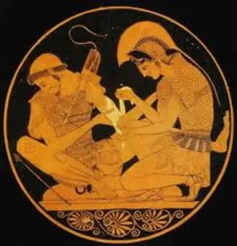

Dopamin agonistleri
Dr. Donald B. Calne
(1936- )
1974 yılında motor komplikasyonları olan PH hastalarında L-dopa’ya ek olarak bromokriptini kullandı

Slide 29
Dopamin agonistleri
Semptomatik etkileri L-dopa’ya göre daha zayıf
Non – motor ve psikiyatrik yan etkileri
  Periferik ödem (erken veya geç; %14 vs %5.6)
  Uyku meyli/Ani uyku atağı (%32 vs %17)
  OH, Yorgunluk
  Bulantı, kusma
  Halüsinasyonlar (%17 vs %3)
  Dürtü kontrol bozukluğu
Postür bozukluğun (kamptokormi)
Dopamin agonist geri çekilme sendromu
Erken dönem yan etkilere bağlı tedavi bırakma oranı yüksek
Motor komplikasyonların yaşanmasını öteliyorlar
Monoterapide 3-5 yıl süre ile semptom kontrolu
Yarı ömürleri uzun/uzun salınımlı formlar mevcut
Tedavi uyumu iyi (tek doz, açlık gerekmiyor)
Oral dışı uygulama yolları (Transdermal, sc, sl…)
Tremor ve depresyona L-dopadan daha etkililer
Geriatrik PH hastalarında özellikle
yüksek psikiyatrik ve non-motor yan etki risklerinden dolayı
kullanılmaları sakıncalı
Pramipeksol | ®Pexola/ ®Parkyn/ ®Parkipex/ ®Ramipex ®Pexola ER/ ®Parkyn ER/ ®Pexa XR/ ®Parkipex ER | 1.5 – 4.5 mg /g
Ropinirol | ®Requip/ ®Requip XL | 4-24 mg/ g
Piribedil | ®Trivastal | 50- 300 mg/ g
Apomorfin | ®Epamor (subcutan) ®Kynmobi (Sublingual) | 3- 6 mg rescue inj. 10-15-20-25-30 mg
*Rotigotin | ®Neupro (transdermal) | 2- 8 mg

Slide 30
DOPAMİN AGOINİSTLERİ– İlaç etkileşimleri
Sedatifler, antipsikotikler ve antidepresanlar ile kombinasyonları gün içi uyku hali ve
ani uyku atağı insidansını arttırıyor
Pramipeksol ve amantadin aktif tubuler sekresyon aracılığı ile böbrek atılımlı
Japon PH popülasyanunda kombinasyonlarında Pramipeksol kan konsantrasyonunda %25 artış
Ropinirol karaciğerde CYP1A2 aracılıklı metabolize oluyor
CYP1A2
İnhibitor etkisi olan ilaç ve gıdalar:
  Florokinolonlar, Verapamil, Amiodaron, Kafein, Valproat
  İndüksiyon etkisi olan ilaç ve gıdalar:
  Tütün, Brokoli, İnsülin, Modafinil, Omeprazole, Karbamazepin
Notes:
Like levodopa, most interactions of DA occur in combi-
nation with CNS-active drugs [23]. The combination of
DA, mainly of pramipexole or ropinirole, with sedatives,
antipsychotics, antidepressants, or alcohol enhances the
incidence of sleepiness during daytime and sudden sleep
attacks [111–114].
Pramipexole is eliminated primarily via the kidney by
active tubular secretion using the same mechanism such as
amantadine [115, 116]. A Japanese population pharmacoki-
netic study revealed a 25% increase in pramipexole blood
concentrations due to the combination with amantadine
[117]. This is based on the decreased renal tubular secre-
tion of pramipexole induced by competitive elimination of
amantadine [115].
In contrast to other DAs, ropinirole is metabolized by
the liver [118]. The enzyme primarily responsible for the
inactivation of ropinirole is the cytochrome (CYP) P450
isoenzyme CYP1A2 [119]. There are several drugs and
foods that act as CYP1A2 inhibitors (fluoroquinolone, flu-
voxamine, verapamil, amiodarone, caffeine, valproate) or inductors (tobacco, broccoli, insulin, modafinil, omeprazole,
carbamazepine) and, therefore, influence the elimination of
ropinirole.

Slide 31
DOPAMİN AGONİSTLERİ– Geriatrik hastada dikkat edilmesi gereken diğer durumlar
70-79 yaş arası popülasyonun yaklaşık 1/5’i ve >80 yaş popülasyonun %50’sinde GFR düşüyor:
  Pramipeksol ve ropinirol kullaniminda dikkar edilmeli
  Rotigotin böbrek fonksiyonlarından etkilenmiyor
Yaşlıda karaciğer işlevleri de bozulabilir
  Ağır karaciğer yetersizliği olan hastalara rotigotin ve ropinirol verilmemeli
Apomorfin ve amantadin QT uzamasına ve kardiyak disritmiye neden olabilirler, birlikte kullanılmamalılar
Apomorfin çok güçlü bir emetik (tekrarlayan kusmalar ve elektrolit dengesizliğine neden olabilir)
Notes:
The prevalence of
impaired renal function correlates with age [120]. A Ger-
man investigation estimated that 20.7% of 70- to 79-year-
old participants and 46.6% of > 80-year-old participants
had a reduced glomerular filtration rate [121]. An adjust-
ment of the dose is required for pramipexole for patients
with reduced renal function, ropinirole only for patients with
hemodialysis [115, 116, 122]. Generally, ropinirole is not
approved for patients with a severe renal disease without
hemodialysis. On the contrary, renal function has no effect
on the pharmacokinetics of rotigotine [123]. Elderly individ-
uals have a decline in liver function, [124] hence, rotigotine
as well as ropinirole should not be administered to patients
with severe liver insufficiency [118, 125]. Ropinirole prob-
ably even affects the liver function itself [126].
A useful feature of the DA apomorphine is the possibility
of subcutaneous application in managing acute ‘off’ states
as a result of its fast resorption and elimination [127, 128].
Apomorphine, as well as the N-methyl-d-aspartate (NMDA)
receptor antagonist amantadine, can prolong the QT time
and cause cardiac dysrhythmia [129–131]. Therefore, these
PD medications should not be administered together or with
any other QT-prolonging drugs [132–134]. New canine
models suggest a weaker effect of intravenous apomorphine
in cardiac electrophysiology [135]. However, apomorphine
should be administered carefully in geriatric patients with
cardiac disease.
Furthermore, the significant emetic potential limits the
use of apomorphine in geriatric patients. Apomorphine is the
most effective, centrally acting emetic and was utilized for
the treatment of acute poisoning [136–138]. Repeated vom-
iting can lead to an electrolyte imbalance (hyponatremia,
-kalemia, -calcemia, and -volemia). These conditions might
not only increase disease-specific symptoms, such as consti-
pation, adynamia, and tremor, but also have life-threatening
consequences (cardiac arrhythmia, epileptic seizures, cer-
ebral edema).

Slide 32

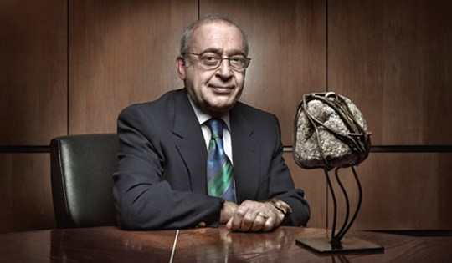
Selektif MAO-Bİ
Moussa B. H. Youdim
(1940- )
Peter Franz Riederer
(1942-)
1974 yılında PH hastalarını selegiline ile tedavi etmeye başlıyor
MAO -BI’lerinin PH’da kullanılabileceği fikrini ilk olarak öne sürülüyor

Slide 33
Günümüzde MAO – Bİ’leri
Geri dönüşümü olmayan MAO-Bİ’leri:
Selejilin 1980’lerde, yaklaşık 20 yıl kadar sonra Rasajilin
Geri dönüşümlü MAO-Bİ:
Safinamid 2015
yılından beri PH tedavisinde kullanıma girmiştir
FDA onayı:
Selejilin - 1989
Rasajilin - 2006
Monoterapide ve kombine tedavi olarak
Safinamid - 2017
Motor fluktuasyonlarda L-dopa’ya ek
Notes:
MAO-B inhibitors have been shown to have excellent efficacy and safety dur- ing the early stages of PD as well as when used as adjunctive therapy in advanced illness [11–13]. Clinical studies have shown that a longer duration of MAO-B inhibitor exposure was associated with a reduction in levodopa consumption and a slower rate of clinical decline [14, 15]. Currently approved MAO-B inhibitors include the irreversible inhibitors, such as selegiline and rasagiline, and the reversible inhibitor, safinamide [10–16].
Selejilin - 1974
Razajilin - 1995
Safinamid - 2015

Slide 34
MAO-Bİ özellikle depresyon, uyku bozuklukları, ağrı ve yorgunluk semptomlarına iyi gelebiliyor
Kognitif kayıp ve koku duyusu kaybında etkili gözükmüyorlar
Notes:
Randomize kontrollu çalsmalar uykuyu desteklemiyor ancak uyku için etkili gibi

Slide 35
MAO –Bİ
Monoterapötik ajan olarak erken
dönemde > 1 yıl etkili olabilirler
(ek ilaç ihtiyacı 2-3 yıl içinde %60 hastada)
İyi tolere ediliyorlar
Yarı ömrü uzun
Günde tek doz alım kolaylığı (rasajilin)
Aç alınmaları gerekmiyor
Semptomatik etkileri zayıf
Tansiyonda dalgalanmalara neden olabilir
SSRI kombinasyonundan kaçınılmalı
İrreversible MAO-B İ (Rasajilin, *Selejilin)
Selejilinin amfetamin benzeri metabolitlerine bağlı kardiyovasküler yan etkileri !!
Rasajilin | ®Azilect /®Rasalas / ®Etkinia / ®Nervogil/ ®Azipar/ ®Rajil / ®Parlin / ®Saglis / ®Trepar | 1 mg
*Selejilin | ®Moverdin / ®Seldepar | 5-10 mg
●Safinamide | ®Xadago | 50-100 mg
✩Zonisamide | Excegran / *®Zonegran | 25-50 mg
* Türkiye’de yok
✩2009’dan beri Japonya’da antiparkinsoniyen ilaç olarak kullanılıyor
●Motor fluktuasyonlarda L-dopa ile kombine
Notes:
Rasagiline: (N-Propargyl-1-[R]-aminoindan) is an irreversible, selective MAO-B inhibitor (Finberg et al. 1996) and has five to ten times stronger MAO-B inhibition than selegiline
Selegiline: is a relatively selective, irreversible inhibitor for central MAO-B. A dissolving tablet (lyophilisate) con- tains 1.25 mg of selegiline HCL and corresponds to 10 mg in the usual selegiline tablet form (comparative plasma concen- trations) (Clarke et al. 2003; Saeger 1998). The advantage of the sublingual application lies in by-passing first-pass metabolism and thus in avoiding amphetamine derivates. At present, the preparation is not available.
In a recent study, the UPDRS score improved under sele- giline monotherapy by 6.26 ± 7.86 (versus 3.14 ± 6.98 with a placebo) (Mizuno et al. 2017). In addition to the symptomatic effect, both a levodopa-saving effect and a positive effect on late motor complications have been described for selegiline (Dashtipour et al. 2015). Data on the amount of levodopa saved differ strongly. Most studies claim an average savings effect of 20 und 30%. The long-term study by Mizuno et al. (2019) exhibited the best results after 20 weeks, whereby however the side effects were relatively strong (44.3%), and only 67.9% of the patients could be treated for more than 56 weeks (while in the control phase, tolerability was very good (Mizuno et al. 2017)).
Before giving selegiline, SSRI should be discontinued at the least 2 weeks beforehand, and in the case of fluoxetine by even as much as 5 weeks. In addition to SSRI, selegiline should not be combined with MAO-A inhibitors, triptans (in particular rizatriptan) and sibutramine.
Safinamide: Glutamat serbestleşmesini engelliyor, Na kanal blokeri. MAOB İ. Günde tek doz Xadago. Off epizodları olan hastalarda add on terapi olarak kullanılıyor.
Safinamide is a highly selective, reversible MAO-B inhibi- tor which inhibits MAO-B in the human brain one thou- sand times more strongly than MAO-A.
has a favourable cardiac safety profile. There is no negative influence on the QT interval. Safinamide failed to show any clinically relevant tyramine-induced rise in blood pressure.
Zonisamid:
2009’dan beri Japonya’da antiparkinsoniyen ilaç olarak kullanılıyor.
MDS L-dopa’ya ek tedavi olarak önerebilir Murata’nınn 2011 çalışmasına göre.
Motor komplikasyonlar üzerine etkisi ile ilgili yeterli data yok.
Na kanal blokeri, dopaminerjik ve serotonerjik transmisyonu arttırıyor, karbonik anhidraz inhibitörü.
Gıdadan etkilenmiyor. Yarı ömrü uzun. KC’de metabolize. Böbrek atılımlı.
Somnolans, anoreksi, irritabilite, dizziness, ajitasyon, ataksi, hafıza ve konsantrasyon problemleri yapabilir.

Slide 36
MAO –Bİ - İlaç etkileşimleri
Serotonin Sendromu
Nadir <%1
MAO inhibitörlerinin diğer MAO inhibitörleri , SSRI, SNRI, trisiklik veya tetrasiklik antidepresan, petidin veya triptan (öz. Rizatriptan) kombinasyonlarında
Fluoksetin ile kombinasyonda daha sık bildirilmiş (fluoksetin 5 hafta önceden, diğer SSRI’lar 2 hafta önceden kesilmeli)
Tremorda artış, akatizi, diaforez, ajitasyon, uykusuzluk, miyokloniler, diare, DTR canlılığı, mental konfüzyon
Tedavide siproheptadin
ADAGIO çalışmasındaki hastalar SSRI kombinasyonundan yarar görüyorlar
STACCATO çalışmasında Rasajilin +Antidepresan kombinasyonu altındaki 471 hastanın hiç birinde SS görülmemiş
Siprofloksasin veya bir diğer CYP1A2 inhibitörü kullanan hastalarda rasajilin dozu 0.5 mg/gün aşmamalı
Nonselektif MAO inhibitor özelliği olan antibiotik linezolid’den kaçınılmalı
Notes:
Parkinson’da depresyon çok sık %50, SSRI kullanımı sık . Parkinsoniyen semptomları en az kötüleştirdiği bildirilen SSRI sertralin, ilaç etkileşimi açısından en güvenilir olan sitalopram.
MAO - B inhibitörleri yüksek dozlarda MAO – A’yı da inhibe ederler.
Before giving selegiline, SSRI should be discontinued at the least 2 weeks beforehand, and in the case of fluoxetine by even as much as 5 weeks. In addition to SSRI, selegiline should not be combined with MAO-A inhibitors, triptans (in particular rizatriptan) and sibutramine.
Contraindications are listed for: severe hypertonia, cardiac arrhythmias and severe angina pectoris. Patients who have had an exogenic psychosis or who have extensive cerebral damage or advanced dementia should not be treated with selegiline. Further contraindications include patients with gastric or duodenal ulcers.
STACCATO çalışması (Panisset et al 2014) retrospektif data analiz hastalar razajilin ve antidepresan kombinasyonunu yaklaşık 1 yıl kullanmışlar ve çoğunluğu %75 gibi SSRI. SS bildirilmemiş.
Patients Taking Ciprofloxacin or Other CYP1A2 Inhibitors
Patients taking concomitant ciprofloxacin or other CYP1A2 inhibitors should not exceed a dose of Azilect 0.5 mg once daily
Siproheptadin antiserotoninerjik ve antihistaminerjik
A co-medication of MAO inhibitors with other MAO inhibi-
tors, selective serotonin reuptake inhibitors, serotonin-nor-
epinephrine reuptake inhibitors, tricyclic or tetracyclic
antidepressants, pethidine, or triptans can result in the life-
threatening serotonin syndrome, [178, 179] although clinical
investigations demonstrated that serotonin syndrome occurs
rarely [180]. Furthermore, the antibiotic linezolid should
be omitted, as it also acts as a non-selective MAO inhibitor
[181].

Slide 37
MAO –Bİ - İlaç etkileşimleri
Rasajilin de ropinirol gibi CYP1A2 üzerinden metabolize oluyor.
  CYP1A2 inhibitörleri plazma konsantrasyonunu arttırıyor:
  Forokinolonlar , fluvoksamin, verapamil, amiodaron, kafein, valproate
  CYP1A2 indükleyicileri plazma konsantrasyonunu azaltıyor:
  Tütün, brokoli, insulin, modafinil, omeprazole, karbamazepin
Entakapon rasajilin atılımını %28 arttırıyor
Selejilin amfetamin metabolitlerine dönüşerek yıkıma uğruyor ve kardiyovasküler yan etkilere neden olabiliyor
  L-dopa ile kombinasyonunda bazı hastalarda ciddi OH ve bilinç kaybına neden olabilir
Oral kontraseptifler selejilin biyoyararlanımını arttıtrabilir
  Postmenapozal hormon replasman tedavisi alan hastalarda kullanılmamalı
Selejillin geriatrik hasta grubu için uygun değil
Safinamid ilaçlar için transmembran transporter görevi gören meme kanser rezistans proteinini inhibe edebilir:
  Kemoterapötiklerin (daunorubisin, doksorubisin, topotekan, irinotekan, metotreksat, imatinib, mitoksantron,
nukleosid analogları), prazosin, triflunomid, klorotiazid, pantoprozol ve statinlerin seviyesi artabilir
Rasajilin, selejilin ve safinamid kullanımı sırasında tiramin ilişkili diyetsel kısıtlamalar önerilmiyor
Notes:
Rasagiline is metabolized by CYP1A2 similarly to ropin-
irole [182]. Therefore, plasma concentrations of rasagiline
can be affected by inhibitors (fluoroquinolone, fluvoxam-
ine, verapamil, amiodarone, caffeine, valproate) or inductors
(tobacco, broccoli, insulin, modafinil, omeprazole, carba-
mazepine) of CYP1A2. Furthermore, entacapone increases
the clearance of rasagiline by 28%.
As a result of its degradation to desmethylselegiline,
l-amphetamine, and l-methamphetamine, selegiline is sus-
pected to cause cardiovascular adverse effects. Churchyard
et al. described several cases of severe orthostatic hypo-
tension, loss of consciousness with undetectable blood
pressure, and symptomatic hypotension in patients with a combination of selegiline and levodopa [183]. However, a
previous investigation showed no higher cardiovascular risk
caused by selegiline in patients with PD [176].
Another interaction exists between selegiline and female
sex hormones. According to Laine et al., oral contracep-
tives (estradiol/levonorgestrel) markedly increase the oral
bioavailability of selegiline [184]. For postmenopausal
hormone replacement therapy, this interaction could not be
confirmed [185]. Therefore, it is not relevant for geriatric
patients with PD.
Safinamide has a similar range of interactions as sele-
giline. In addition to the common interactions, safinamide
can inhibit the breast cancer resistance protein, a transmem-
brane transporter protein for drugs [186]. Therefore, plasma
concentrations of BRCP substrates, such as chemotherapeu-
tic agents (daunorubicin, doxorubicin, topotecan, irinotecan,
methotrexate, imatinib, irinotecan, mitoxantrone, nucleoside
analogs), prazosin, teriflunomide, chlorothiazide, pantopra-
zole, and statins, can be enhanced. Upcoming trials were
initiated to determine the clinical relevance of the interac-
tions between safinamide and BRCP substrates.
Furthermore, MAOs are involved in the degradation of
tyramine. Tyramine is formed from the amino acid tyrosine
and a typical ingredient produced by fermentation in foods
such as fish, cheese, red wine, and chocolate. By enhancing
noradrenergic signaling, tyramine has an indirect sympa-
thomimetic effect and leads to higher blood pressure. The
consumption of tyramine-containing food under treatment
with unselective MAO inhibitors (tranylcypromine) can
cause a life-threatening hypertensive crisis. When using
selective MAO-B inhibitors, such as rasagiline, selegiline,
and safinamide, no tyramine-related dietary restrictions are
recommended [187–189].

Slide 38
MAO –Bİ – Geriatrik hastada dikkat edilmesi gereken diğer durumlar
Rasajilin, selejilin ve safinamid orta veya şiddetli düzeyde karaciğer yetersizliği olan hastalara verilmemeli
Böbrek yetersizliği olan hastalara selejilin verilmemeli
MAO inhibitörlerinin hafif antikolinerjik etkileri de var
  Geriatrik hastalarda özellikle diğer antikolinerjik ilaçlar ile birlikte (amitriptilin, amantadin, setirizin, entakapon) artan antikolinerjik yan etkilere ve kognitif bozulmalara neden olabilir
Selejilin ile tedavi sırasında artan gastrointestinal ülser sıklığı bildirilmekte
Yaşlı hastada gastrointestinal semptomların ana sebebi polifarmakoterapi!!
Notes:
As previously mentioned, the decrease in liver and kidney
function in geriatric patients plays an important role in drug
selection. This also applies to the use of MAO inhibitors.
Rasagiline, selegiline, and safinamide should not be adminis-
tered to patients with moderate or severe liver insufficiency,
and selegiline not to patients with renal insufficiency [190].
Another aspect that should be considered when using
MAO inhibitors in the elderly is the mild anticholinergic
effect [191–194]. The combination of MAO inhibitors with
other anticholinergic substances (e.g., amitriptyline, aman-
tadine, cetirizine, entacapone) includes the risk of adverse
outcomes in geriatric patients with PD [194].
Cases of gastrointestinal ulcers are described with sele-
giline treatment. Therefore, selegiline should be used with
caution in patients with a history of gastrointestinal ulcers
[195, 196]. This safety aspect is particularly relevant for geriatric patients with PD, as the risk of gastrointestinal
ulcers and bleeding increases in the elderly [197]. A key
reason for gastrointestinal complications is the polyphar-
macotherapy in the elderly, especially the administration of
nonsteroidal anti-inflammatory drugs (e.g., aspirin, ibupro-
fen, diclofenac) [198].

Slide 39
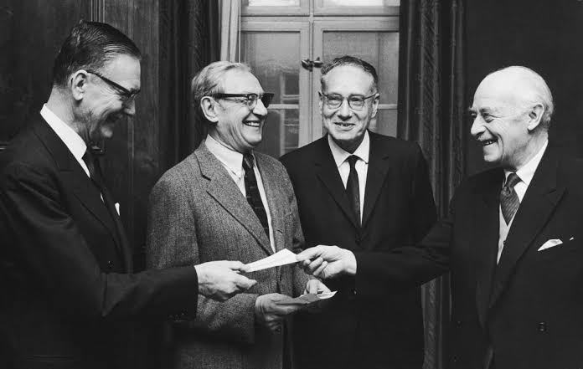
COMT inhibitörleri
Julius Axelrod
May 30, 1912 – December 29, 2004
Medicine laureates Julius Axelrod, Sir Bernard Katz and Ulf Von Euler, Nobel Week in Stockholm, 11 December 1970.
Photo: Keystone/Hulton Archive/Getty Images
Notes:
Catechol-O-methyltransferase was first described in 1958 and performs the deactivation and elimination of catechols, such as norepinephrine and dopamine [141, 142].
Axelrod J, Tomchick R. Enzymatic O-methylation of epinephrine
and other catechols. J Biol Chem. 1958;233:702–5.
Julius Axelrod (May 30, 1912 – December 29, 2004)^{[1]} was an American biochemist. He won a share of the Nobel Prize in Physiology or Medicine in 1970 along with Bernard Katz and Ulf von Euler.^{[2][3][4][5]} The Nobel Committee honored him for his work on the release and reuptake of catecholamine neurotransmitters, a class of chemicals in the brain that include epinephrine, norepinephrine, and, as was later discovered, dopamine. Axelrod also made major contributions to the understanding of the pineal gland and how it is regulated during the sleep-wake cycle.
In 1958, Axelrod also discovered and characterized the enzyme catechol-O-methyl transferase, which is involved in the breakdown of catecholamines.

Slide 40
Perifer
Beyin
COMT inhibitörleri ‘off’ dönemlerini kısaltıp
‘on’ dönemlerini uzatarak hastaların günlük yaşam
aktivitelerindeki performanslarını ve yaşam
kalitelerini arttırılar
Doz sonu kötüleşmelerini engellerler
Uzun etkili 3. jenerasyon COMT inhibitörü opikapon
günde tek doz kullanılabilir.
Entakapon L-dopa ile kombine preparatlar halinde
kullanılmaktadır
3-OMD
3-OMD
COMT
Kan-beyin
bariyeri
COMT
Levodopa
Levodopa
AADC
AADC
Dopamin
MAO
COMT
En sık bildirilen yan etki diyare; Opikapon ile ilaç
kesmeyi gerektirecek şiddette bildirilmemiş
Genel olarak dopaminerjik yan etkileri tetikleyebilir
veya arttırabilirler
Diskinezi en sık bildirilen yan etki
Tolkapon hepatotoksisiteye neden olabilir
DOPAC
3-MT
COMT
MAO
HVA
L- Dopa metabolizması
AADC = aromatik amino asit dekarboksilaz; COMT = katekol-O-metiltransferaz
DOPAC = 3,4-dihidroksifenilasetik asit; HVA = homovanillik asit; MAO = monoamin oksidaz; 3-MT = 3-metoksitiramin; 3-OMD = 3-O-metildopa.
Notes:
Metabolism of levodopa. AADC = aromatic amino acid decarboxylase; COMT = catechol-O-methyltransferase; DOPAC = 3,4-dihydroxyphenylacetic acid; HVA = homovanillic acid; MAO = monoamine oxidase; 3-MT = 3-methoxytyramine; 3-OMD = 3-O-methyldopa.
Cat-echol-O-methyltransferase inhibitors reduce the ‘off’ time, enhance the ‘on’ time, and improve the quality of life and the performance of daily activities. In particular, COMT inhibitors are useful in patients with PD with end-of-dose motor fluctuations [146]. The long-acting third-generation COMT inhibitor opicapone can be administered once a day contraryto the precursor preparations

Slide 41
COMT İ - İlaç etkileşimleri
Yüksek dozlarda entakapon CYP2C9 inhibisyonuna neden olarak CYP2C9 substratı olan ilaçların plazma konsantrasyonlarını yükseltebilir
  Warfarin, antienflamatuar ilaçlar (diklofenak, ibuprofen), antidiabetikler (tolbutamide, glibenklamid), anjiotenzin II tip 1 antagonistleri (sartanlar), amitriptilin, selekoksib, fluoksetin, fluvastatin, tamoksifen, torasemid
Geriatrik hasta popülasyonunda özellikle COMT inhibitörleri kullanılacaksa eğer
karaciğer fonksiyonları test edilmeli
Ağır karaciğer yetersizliği olan hastalarda entakapon yerine opikapon tercih edilebilir
Notes:
Moreover, in-vitro analyzes of entacapone revealed an
inhibition of CYP2C9 but only at high concentrations.
Therefore, plasma concentrations of CYP2C9 substrates can
be elevated using entacapone. Many common drugs used
in geriatric patients are metabolized by CYP2C9, such as
warfarin, anti-inflammatory drugs (diclofenac, ibuprofen),
antidiabetic agents (tolbutamide, glibenclamide), angioten-
sin II type 1 antagonists (sartans), and also amitriptyline,
celecoxib, fluoxetine, fluvastatin, tamoxifen, and torasem-
ide [157]. The most important high-risk interaction occurs
between warfarin and entacapone. An investigation of 12
healthy subjects exhibited a 13% increase of international
normalized ratio values, thus, a potential higher risk of
bleeding [158]. Therefore, international normalized ratio
values should be monitored closely.
In-vitro analyses revealed potential interactions of opi-
capone, in particular as a result of the inhibition of CYP2C8
and CYP2C9, as well as the inhibition of organic anion
transporting polypeptides (OATPs) [159]. The OATPs are
transmembrane transport proteins involved in the elimina-
tion of drugs in the gastrointestinal tract, kidneys, liver, and
blood–brain barrier [160]. Typical substrates of OATP1B1
are statins, repaglinide, sartans (olmesartan, valsartan), enal-
april, benzylpenicillin, capsofungin, fexofenadine, metho-
trexate, and troglitazone [161]. Opicapone can reduce the
elimination of the named substrates by inhibiting OATP1B1.
However, because of high plasma protein binding (99.9%),
these in-vitro effects are not expected to have clinical rel-
evance [159].

Slide 42
Fizik Egzersiz

Slide 43
Notes:
Physical exercise is thought to have beneficial effects on the symptoms of Parkinson’s disease (PD). Irisin is an exercise-induced myokine released into the circulation. We therefore tested whether irisin itself could have a beneficial effect on pathologic α-synuclein (α-syn) accumulation and concomitant neurodegeneration in PD. Here, we show that irisin prevents the accumulation of pathologic α-syn and neuronal cell death by enhancing endolysosomal degradation of pathologic α-syn. Furthermore, elevation of blood irisin levels in mice prevented neurodegeneration and physiological deficits induced by injection α-syn preformed fibrils. These findings would seem to have translational promise as a disease-modifying therapy for treating PD and other neurodegenerative diseases involving pathologic α-syn.

Slide 44
Aerobik (dayanıklılık sağlayan)
  Hafif şiddettte yürüyüş, koşu, bisiklet, yüzme
Güçlendirici
  İstirahat halindekinin 3.0-6.0 katı aktivite (orta)/ hiking, merdiven inme, çıkma
  >6.0 şiddetli egzersiz
Fleksibilite sağlayan (Yoga)
Dengeye yönelik (Tai – chi)
MRI, clinical, and behavioral results converge toward the conclusion that aerobic exercise stabilizes disease progression in the corticostriatal sensorimotor network and enhances cognitive performance
Johansson ME, Cameron IGM, Van der Kolk NM, de Vries NM, Klimars E, ToniI, Bloem BR, Helmich RC (2022)
Aerobic exercise alters brain function and structure in Parkinson’s disease: a randomized controlled trial. Ann Neurol 91, 203-216.
Haftada 150 dakika süreli orta derecede aerobik fizik aktivite
veya 75 dakika süreli şiddetli egzersiz
sağlık için etkili minimum yapılması gereken egzersiz
Notes:
WHO has claimed that 150min of moderate- intensity aerobic physical activity or 75min of vigorous-intensity physical activity per week is effective and higher volumes or intensities of physical activity will bring greater benefits
Objective: Randomized clinical trials have shown that aerobic exercise attenuates motor symptom progression in
Parkinson’s disease, but the underlying neural mechanisms are unclear. Here, we investigated how aerobic exercise
in uences disease-related functional and structural changes in the corticostriatal sensorimotor network, which is
involved in the emergence of motor de cits in Parkinson’s disease. Additionally, we explored effects of aerobic exer-
cise on tissue integrity of the substantia nigra, and on behavioral and cerebral indices of cognitive control.
Methods: The Park-in-Shape trial is a single-center, double-blind randomized controlled trial in 130 Parkinson’s disease
patients who were randomly assigned (1:1 ratio) to aerobic exercise (stationary home trainer) or stretching (active con-
trol) interventions (duration= 6 months). An unselected subset from this trial (exercise, n= 25; stretching, n= 31)
underwent resting-state functional and structural magnetic resonance imaging (MRI), and an oculomotor cognitive con-
trol task (pro- and antisaccades), at baseline and at 6-month follow-up.
Results: Aerobic exercise, but not stretching, led to increased functional connectivity of the anterior putamen with the
sensorimotor cortex relative to the posterior putamen. Behaviorally, aerobic exercise also improved cognitive control.
Furthermore, aerobic exercise increased functional connectivity in the right frontoparietal network, proportionally to t-
ness improvements, and it reduced global brain atrophy.
Interpretation: MRI, clinical, and behavioral results converge toward the conclusion that aerobic exercise stabilizes dis-
ease progression in the corticostriatal sensorimotor network and enhances cognitive performance.

Slide 45
Motor semptomlar
Bradikinezi
Yürüme
Donmalar
Dönüşler
Postür
PH’dan korunma ??
13 yıl takibe dayalı İsveç çalışmasında haftada 6 saatten fazla egzersiz yapanlarda PH gelişme riski
%43 daha az bulunmuş
(LaHue et al., 2016)
Egzersizin yararları
PH semptomları üzerine olumlu etki
Non-Motor semptomlar
Otonom
Kognitif
Uyku
Psikiyatrik
Duyusal
İlaç tedavisi üzerine olumlu katkı
İlaçların etkinliğini arttırmak
Yan etkileri azaltmak
Yürüme ve denge üzerine olumlu etki
Sosyalleşme
Rehabilitatif etkiler
Artan yaşam kalitesi
Notes:
Exercise helps to promote neurogenesis, angiogenesis, metabolism of central nervous system (CNS), as well as the release of growth factors, and also modulates inflammation in CNS
Exercise was first reported to be beneficial for PD in 1992 (LaHue et al., 2016). It was found that men who participated in sports had a lower risk of developing PD in an activity-dependent manner (Sasco, Paffenbarger, Gendre, & Wing, 1992). This finding was further confirmed in almost all subsequent epidemiological studies. Similarly, in the NIH-AARP Diet and Health Study cohort which contained more than 200,000 participants who took part in sustained moderate to severe exercise activity had a 40% lower risk of developing PD than those who were sedentary (LaHue et al., 2016) This study is particularly important because it shows that, even leisure, occupation, family and commuting activities, can reduce the risk of PD.
exercise can facilitate synaptic plasticity in the hippocampus, which is essential for spatial learning by enhancing both short-term potentiation and long-term potentiation (LTP) and increasing the levels of synaptic proteins, glutamate receptors, and neurotrophic factors such as insulin-like growth factor-1 (IGF-1) and brain-derived neurotrophic factor (BDNF)

Slide 46
Tedavi hastaya özel belirlenmeli
Yaşam kalitesini göz önünde bulundurarak tedaviyi geciktirmemek gerekir
Bazı hastalar semptomlara bağlı özürlülük gelişene dek bekle gör yaklaşımını uygun bulabilir
L-dopa her zaman 1. seçim ilaç
L-dopa minimum effektif dozda kullanılmalı
Polifarmasiden kaçınılmalı
Non-motor semptomlar da düzenli olarak sorgulanmalı ve tedavileri planlanmalı
İlaçların etki ve yan etkiler düzenli takip edilmeli
Fizik egzersiz her hastada her evrede önerilmeli
Diyet düzenlenmeli

