Slide 1




ALZHEIMER HASTALIĞI TEDAVİSİNDE MLC 901/601-NURAID’İN ROLÜ
Prof. Dr. Meltem Gülhan HALİL
Hacettepe Üniversitesi İç Hastalıkları Anabilim Dalı,
Geriatri Bilim Dalı

Slide 2
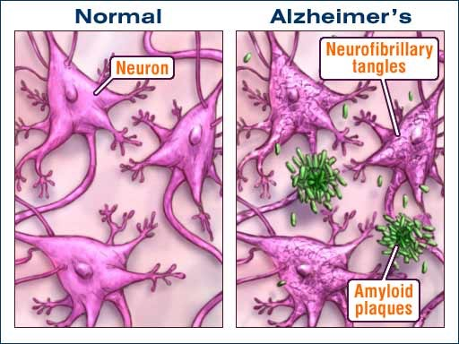
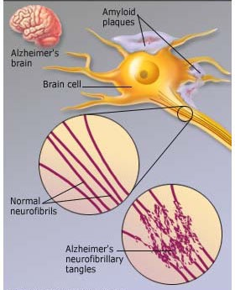
Alzheimer Hastalığı-Amiloid Plaklar ve Nörofibriler yumaklar
Alzheimer brain cells
Notes:
The amyloid plaques are extracellular deposits of beta-amyloid protein (Aβ) with different morphological forms.
Beta Amyloid plays a major role in neurotoxicity and neural function.
Aaccumulation of amyloid plaques in the hippocampus, amygdala, and cerebral cortex can cause stimulation of astrocytes and microglia, damage to axons, dendrites, and loss of synapses, in addition to cognitive impairments.
Tau on the other hand, dissociates from microtubules, leading to their destabilization.
Neurofibrillary tangles are intracellular abnormal filaments of the hyperphosphorylated tau protein that results from a neuronal loss due to large amounts of filamentous tau protein with partial resistance to proteolysis.
NFTs is known to correlate with cognition impairment.

Slide 3
MLC901: Etki Mekanizmaları ve AH için Potansiyel Rolü
Effects of the botanical ingredients of NeuroAiD II on some relevant AD pathological processes
R. Astragali – R. Salvia miltiorrhizae – R. Paeoniae rubra – R. Angelicae sinensis – Carthamus tinctorius – Prunus persica –
R. plolygalae – Rhizoma Acori tatarinowii
(8/9)
R. Astragali – R. Salvia miltiorrhizae – R. Paeoniae rubra – Carthamus tinctorius –
R. plolygalae – Rhizoma Acori tatarinowii
(6/9)
Neuroplasticity
Amyloid
R. Astragali – R. Salvia miltiorrhizae – R. Paeoniae rubra – Chuanxiong –
– Carthamus tinctorius –
Prunus persica –
R. plolygalae –
(7/9)
MLC-901
R. Astragali – R. Salvia miltiorrhizae – R. Paeoniae rubra – Chuanxiong –
R. Angelicae sinensis – Carthamus tinctorius – Prunus persica –
R. plolygalae – Rhizoma Acori tatarinowii
(9/9)
Anti-apoptosis
Tau hypothesis
R. Astragali – R. Salvia miltiorrhizae – R. Paeoniae rubra – Chuanxiong –
R. Angelicae sinensis – Carthamus tinctorius – Prunus persica –
R. plolygalae – Rhizoma Acori tatarinowii
(9/9)
R. Salvia miltiorrhizae –
R. Angelicae sinensis – Carthamus tinctorius – Prunus persica –
Rhizoma Acori tatarinowii
(5/9)
Anti-cholinesterase
Neuroinflammation
Many of MLC901 individual ingredients are reported in the literature to interact
with key processes at play in Alzheimer’s Disease
Source: Scientific literature review

Slide 4
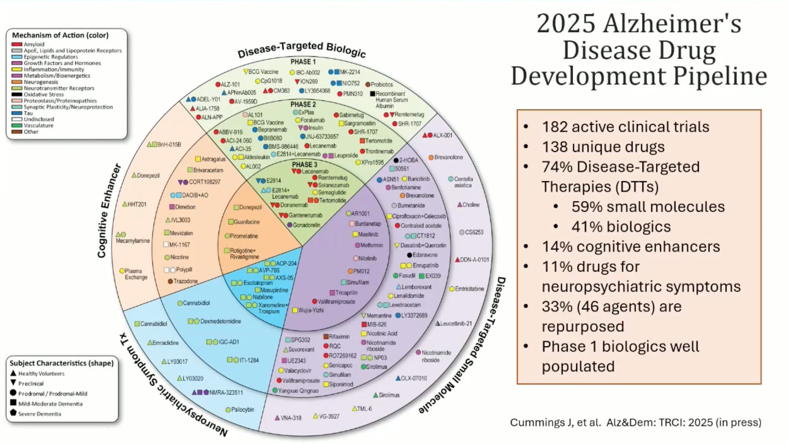
NeuroAiD
AD Drug Development Pipeline 2025
Mechanisms of action of agents in Phase 3 Alzheimer clinical trials as classified using the
Common Alzheimer’s Disease Research Ontology (CADRO) approach
Cummings J, Zhou Y, Lee G, Zhong K, Fonseca J, Cheng F. Alzheimer's disease drug development pipeline: 2023. Alzheimers Dement (N Y). 2023 May 25;9(2):e12385. doi: 10.1002/trc2.12385. Erratum in: Alzheimers Dement (N Y). 2023 Jun 28;9(2):e12407. doi: 10.1002/trc2.12407. PMID: 37251912; PMCID: PMC10210334.

Slide 5
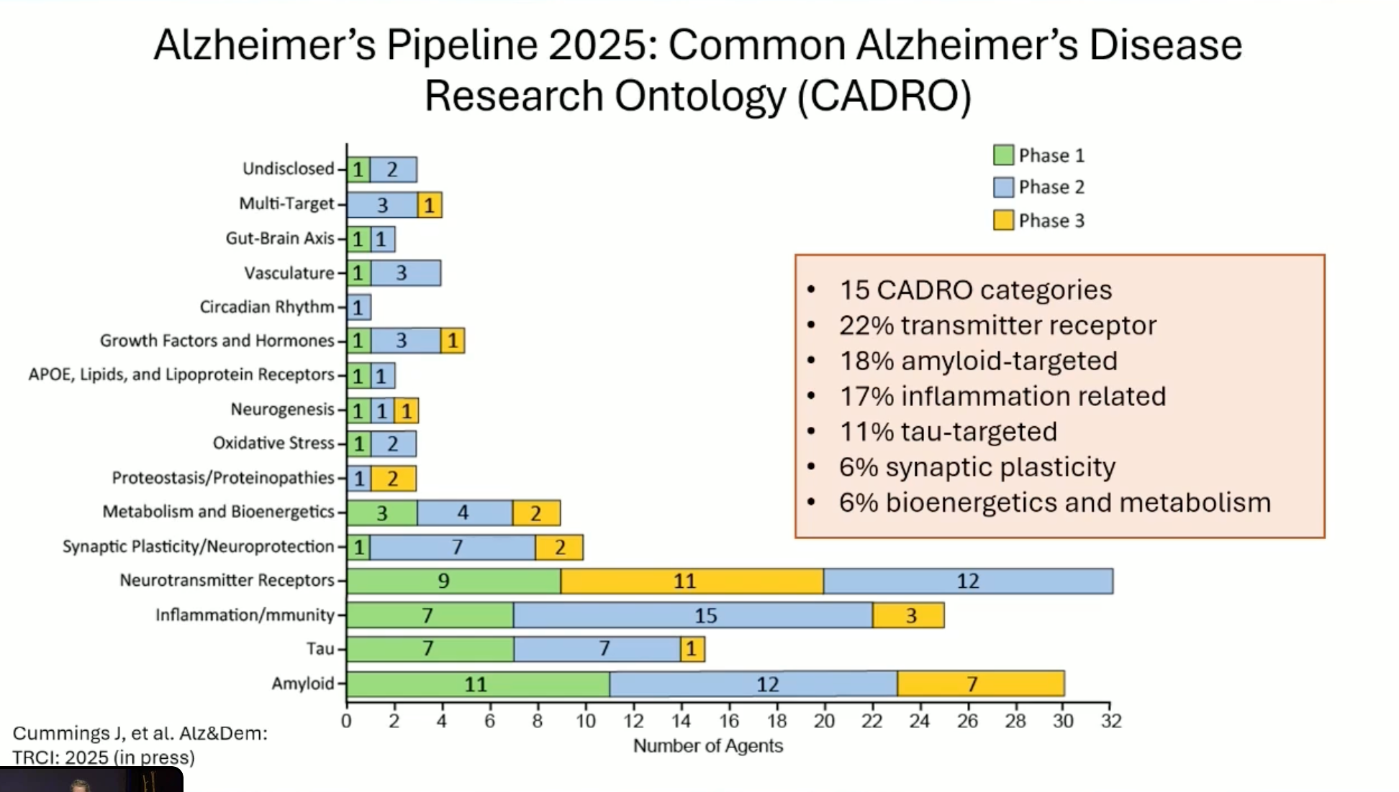
NeuroAiD II (MLC 901) Components and Multimodal MOA in AD
NeuroAiD
Mechanisms of action of agents in Phase 3 Alzheimer clinical trials as classified using the Common Alzheimer’s Disease Research Ontology (CADRO) approach
Cummings J, Zhou Y, Lee G, Zhong K, Fonseca J, Cheng F. Alzheimer's disease drug development pipeline: 2023. Alzheimers Dement (N Y). 2023 May 25;9(2):e12385. doi: 10.1002/trc2.12385. Erratum in: Alzheimers Dement (N Y). 2023 Jun 28;9(2):e12407. doi: 10.1002/trc2.12407. PMID: 37251912; PMCID: PMC10210334.

Slide 6
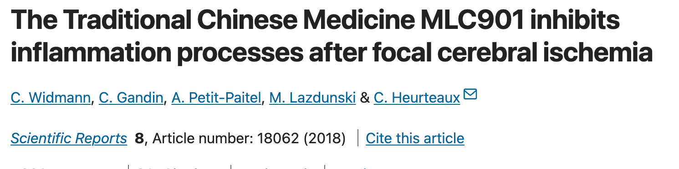
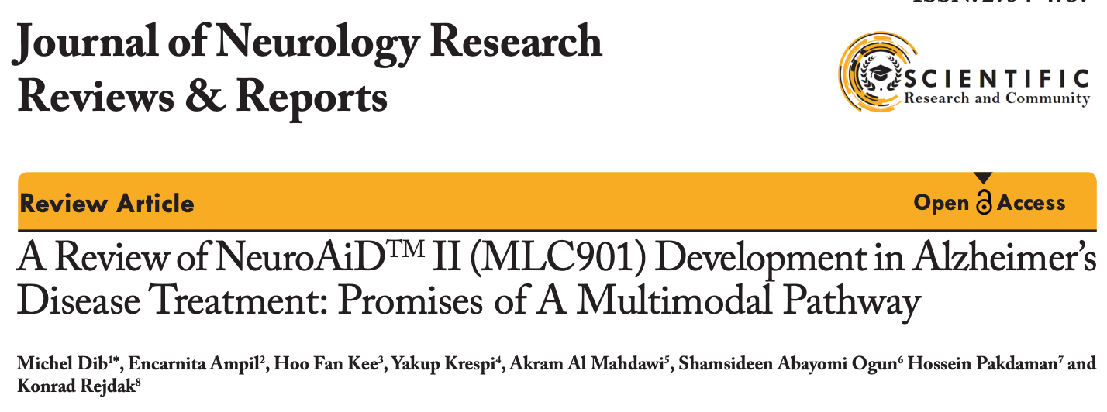
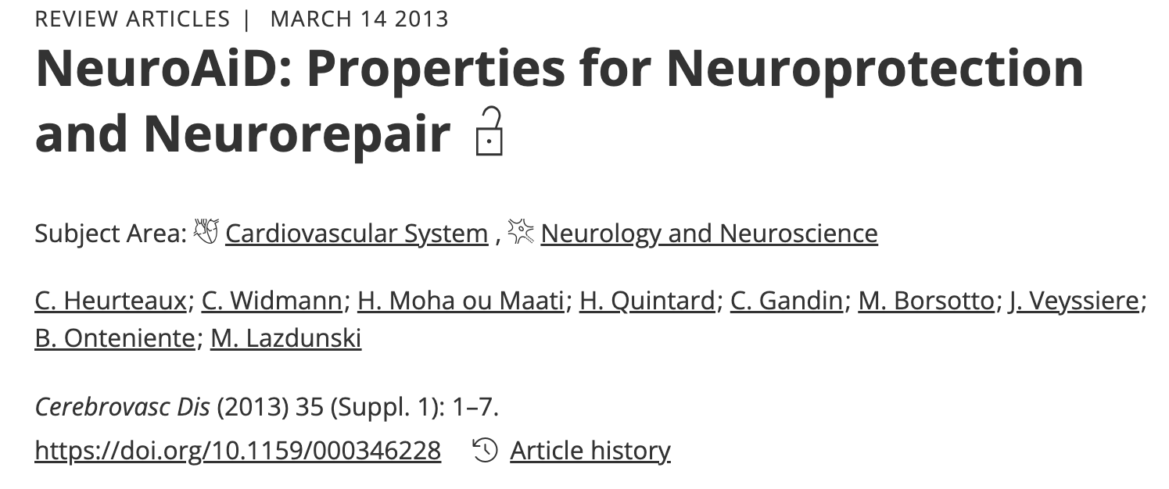
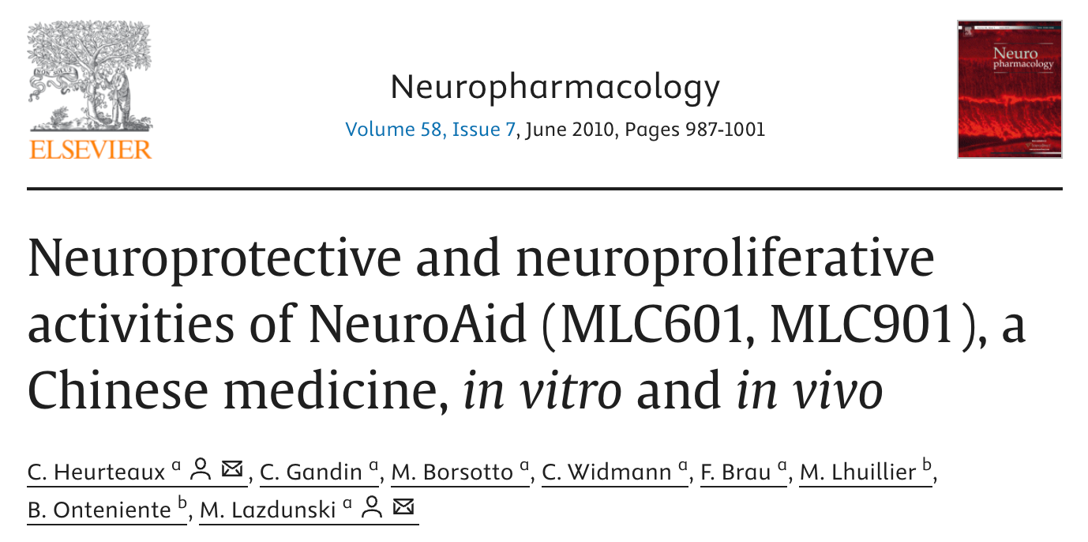
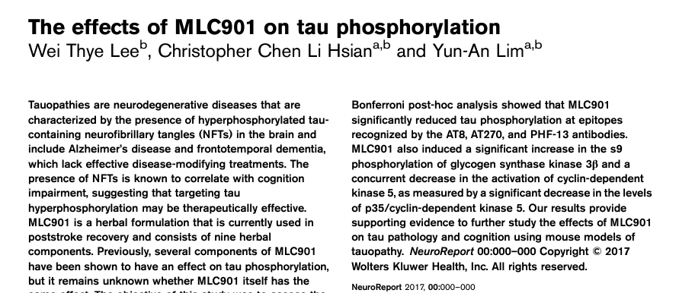
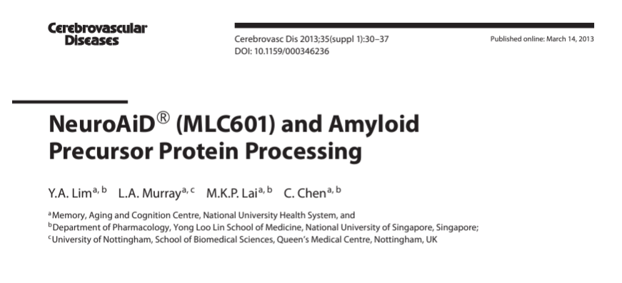
MLC901 multimodal mechanism of action
NeuroAiD II is acting on many of the multiple biological pathways involved in the pathophysiology of Alzheimer’s Disease.
NeuroAiD
CADRO
NeuroAiD
NeuroAiD
NeuroAiD
NeuroAiD
Mechanisms of action of agents in Phase 3 Alzheimer clinical trials as classified using the
Common Alzheimer’s Disease Research Ontology (CADRO) approach
Source: 1, Cummings J, et al. Alzheimer’s disease drug development pipeline: 2024. Alzheimer’s Dement. 2024;10:e12465. https://doi.org/10.1002/trc2.12465

Slide 7
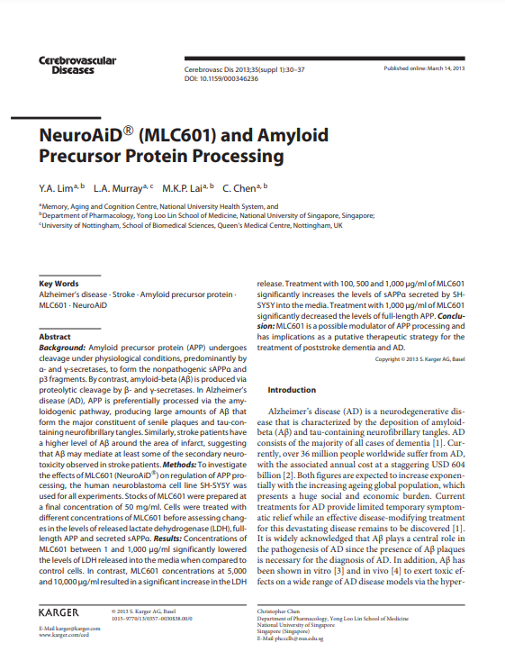
The Role of NeuroAiD in Amyloid Precursor Protein Processing
For training purposes and internal use only
Notes:
This paper talks about the preclinical studies conducted on the effect of NA on amyloid precursor protein

Slide 8
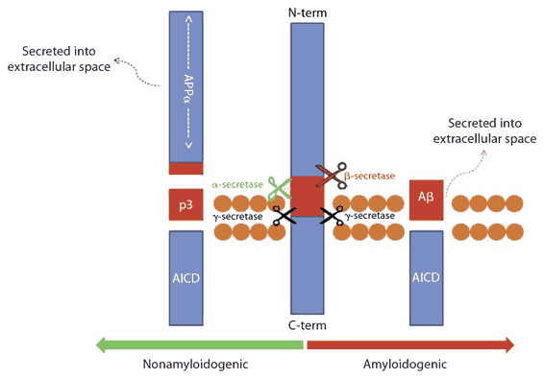
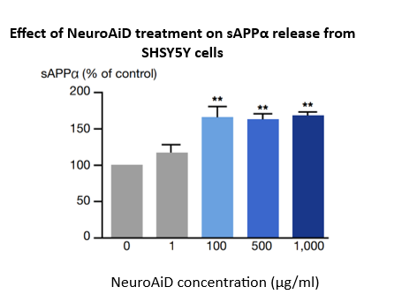

NeuroAiD; Amyloid Precursor Protein(APP)’e etki
**p<0.01
NeuroAiD™ preferentially cleaves APP to sAPP⍺
NeuroAiD™ increased levels of sAPP⍺ and decreases full length levels of APP
Lim YA, Murray LA, Lai MK, Chen C. NeuroAiD® (MLC601) and amyloid precursor protein processing. Cerebrovasc Dis. 2013;35 Suppl 1:30-7. doi: 10.1159/000346236. Epub 2013 Mar 14. PMID: 23548917.
Notes:
In experimental models, it was shown that:
NA preferentially cleaves APP to sAPP⍺ by preventing the action of beta secretase.
NeuroAiD enhances the non-amyloidogenic processing of APP, by preferentially cleaving APP forming soluble sAPPα.
This may help decrease β-amyloid-induced neurotoxicity observed in AD.
At the same time, it also decreased the full length levels of APP
With these two, production of amyloid beta from APP is prevented.

Slide 9
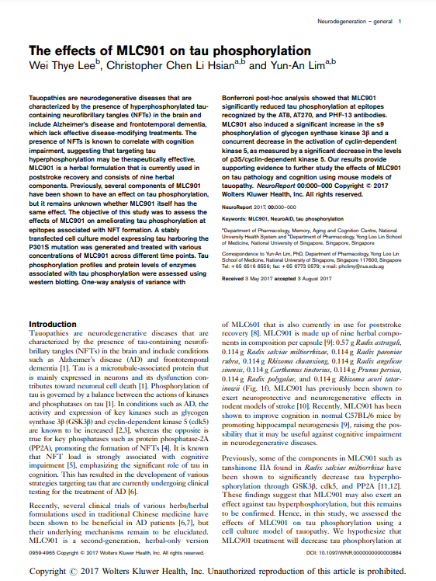
The Role of NeuroAiD on Tau
For training purposes and internal use only
Notes:
What about the effect of NA on tau phosphorylation?
A preclinical study also focused on the role of NA on Tau

Slide 10
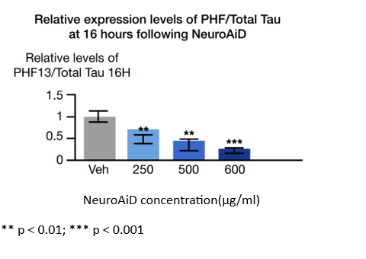
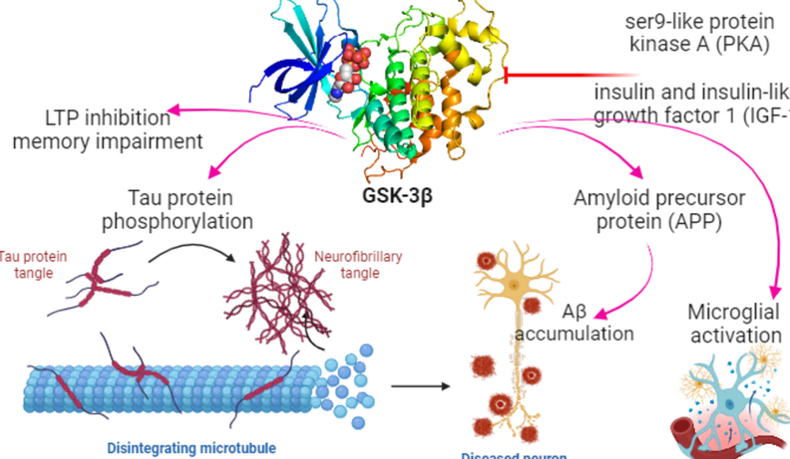

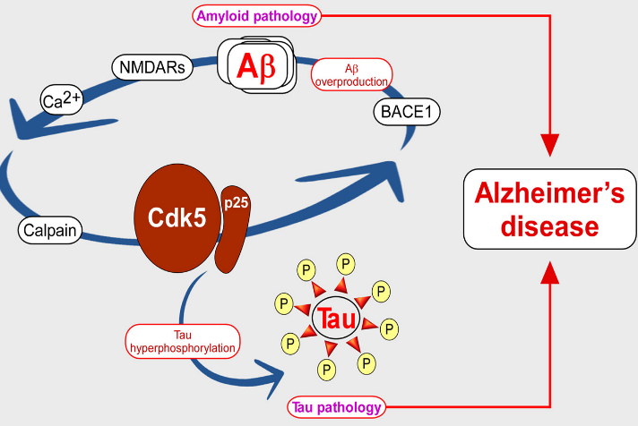

NeuroAiD; Tau üzerine etki
Tau hiperfosforilasyonunda rol oynayan enzimlerin inhibisyonu
glycogen synthase 3β (GSK-3β)
cyclin-dependent kinase 5 (CDK5)
NeuroAiD significantly decreased tau phosphorylation
Lim YA, Murray LA, Lai MK, Chen C. NeuroAiD® (MLC601) and amyloid precursor protein processing. Cerebrovasc Dis. 2013;35 Suppl 1:30-7. doi: 10.1159/000346236. Epub 2013 Mar 14. PMID: 23548917.
Notes:
Phosphorylation of tau protein is governed by a balance between the action of several kinase and phosphatase.
What happens in AD is that,
a hyper-phosphorylated state makes tau lose its biological activity.
hyperphosphorylation of the Tau protein is mediated by several enzyme including:
Glycogen synthase 3β (GSK- 3β),
Cyclin-dependent kinase 5 (cdk5)
Recall: Hyperphosphorylated tau containing neurofibrillary tangles (NFTs) is known to correlate with cognition impairment, suggesting that targeting tau hyperphosphorylation may be therapeutically effective.
NA was found to inhibit the action of these 2 enzymes thus preventing the production of the toxic NFT
NeuroAiD significantly decreased tau phosphorylation and inhibited kinase activities of GSK3β and cdk5
This study assessed Tau phosphorylation profiles and protein levels of enzymes associated with tau phosphorylation using western blotting.

Slide 11
NeuroAiD; AH için multimodal etki
Neuroprotection
Antioxidant
Neuroinflammation Modulation
Multi modal action of NeuroAiD
Anti-amyloid
Anti-hyperphosphorylation
Reduction of AD symptoms &
improvement of cognitive functions
Notes:
This slide summarizes the multimodal action of NA especially in the management of AD
I am pretty sure that you have mastered these various properties.
It’s neuroprotective properties prevent further cell death
It has been shown to modulate inflammation
It plays a role as antioxidant
I will introduce to you another property of NeuroAiD, now its effect in the management of AD.
NeuroAid also has effect in preventing the build up of beta amyloid and NFT
these actions work synergistically and LEAD TO A REDUCTION OF THE SYMPTOMS OF AD AS WELL AS IMPROVEMENT OF COGNITIVE FUNCTIONS.
In preclinical studies, NA II activated ATP-dependent K+ channels thus modulating neuroinflammation (HOW?)
Neuroprotective
Antioxidant
Anti-amyloid
Decrease tau phosphorylation by inhibiting activity of the GSK 3B and CDK5

Slide 12
NeuroAiD; AH Klinik Çalışmalar

Slide 13

AH Güncel Tedaviler
Standar Symptomatic treatment
Long experience of use to improve cognitive symptoms
Tolerability issues
Does not modify disease
Mild to moderate AD
  Galantamine (AChEI)
  Donepezil (AChEI)
  Rivastigmine (AChEI)
Moderate to severe AD
  Memantine (NMDA antagonist)
  Memantine and Donepezil
  Donepezil
  Rivastigmine
  MCI and mild AD
    Aducanumab (monthly infusion for at least 18M) - approved by US FDA in 2021
    Lecanemab (twice monthly infusion for 18 months)- approved by US FDA in 2023
    Donanemab (monthly infusion, for 12 months) - approved by US FDA in 2024
1. https://www.nia.nih.gov/health/how-alzheimers-disease-treated#
2. Walsh S, Merrick R, Milne R, Brayne C. Aducanumab for Alzheimer’s disease? BMJ. 2021;374:n1682 (doi: 10.1136/bmj.n1682).
3. Salloway SP, Sevingy J, Budur K, Pederson JT, DeMattos RB, Von Rosenstiel P et al. Advancing combination therapy for Alzheimer’s disease. Alzheimers Dementia. 2020;6:e12073 (doi: 10.1002/ trc2.12073).

Slide 14
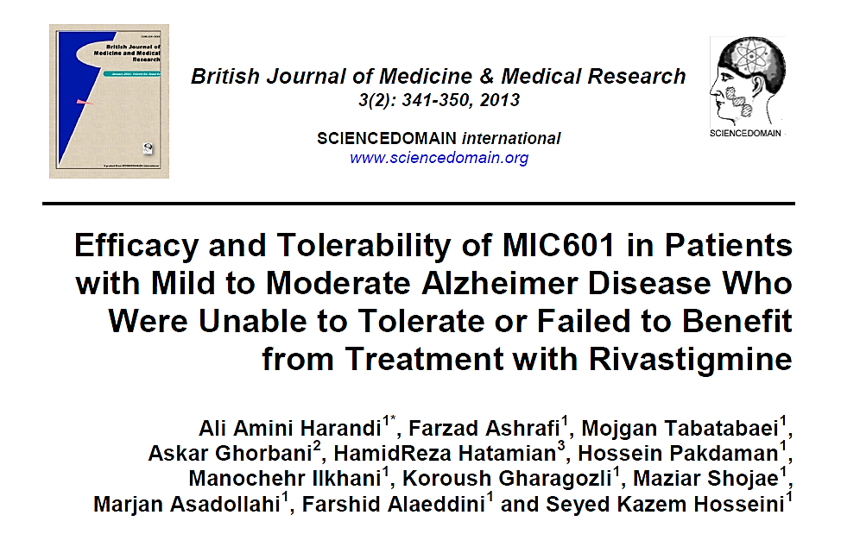
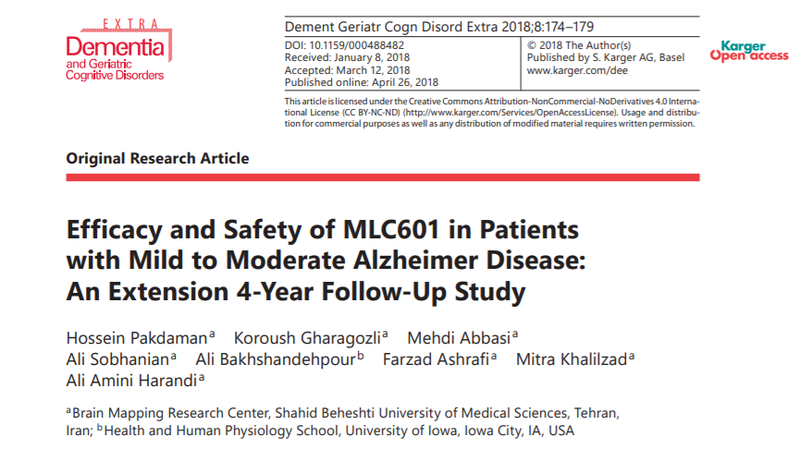
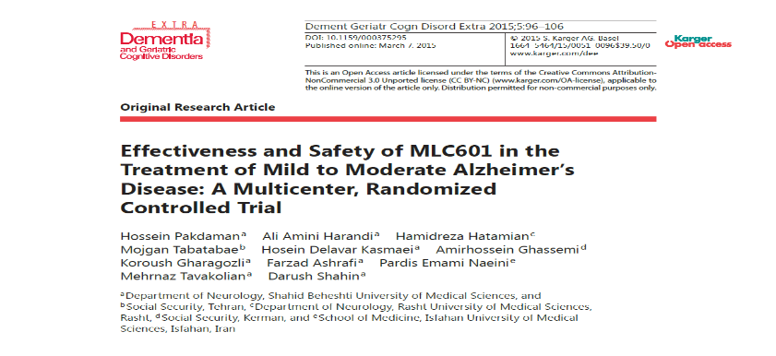
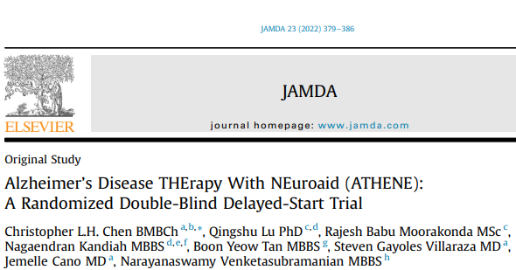
AH Klinink Çalışmalar

Slide 15
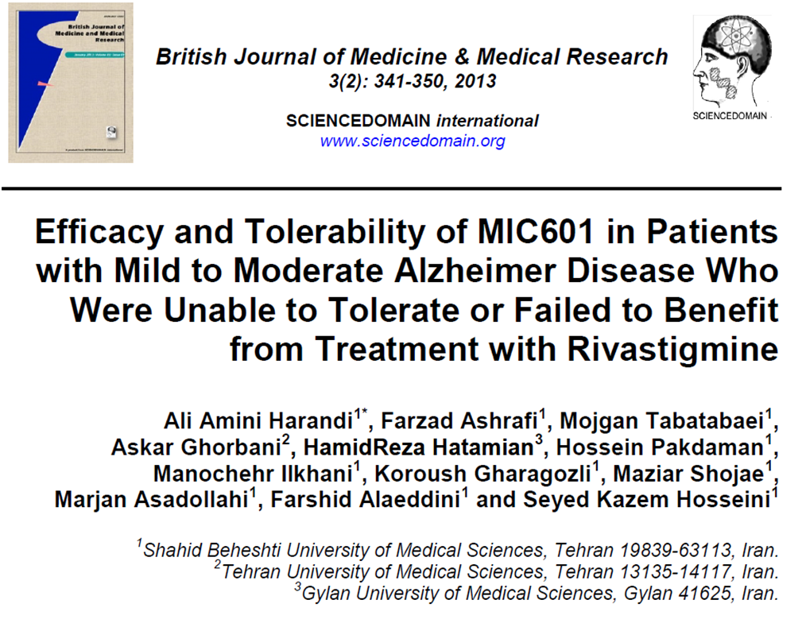
Open-label, pilot study over a period of 18 months
Efficacy and tolerability of NeuroAiD in patients with mild to moderate AD who previously failed to tolerate or benefit from Rivastigmine for 6 months
Outcome assessment:
  MMSE and ADAS-Cog;
  adverse events
Harandi, A. A, et al. (2013). Efficacy and Tolerability of MlC601 in Patients with Mild to Moderate Alzheimer Disease who were Unable to Tolerate or Failed to Benefit from Treatment with Rivastigmine. Journal of Advances in Medicine and Medical Research, 3(2), 341–350

Slide 16
Study Design
Inclusion:
At least 50 years old
Met the criteria for AD according to DSM-IV
Mild to moderate AD (MMSE score 10-24)
Failed treatment with Rivastigmine due to:
  Tolerability
  Non-response on maximum dose of 12 mg/day
Exclusion:
Cognitive impairment attributed to other causes than AD (vascular, frontotemporal, Lewy bodies dementia, Parkinson’s )
Uncontrolled medical condition (hypertension, diabetes, renal or hepatic failure, etc)
124 patients with AD
Rivastigmine
2-12 mg/day for 6 months
MLC 601
1 cap TID
  6th month
  ADAS-Cog
  MMSE
*safety evaluation
  12th month
  ADAS-Cog
  MMSE
*safety evaluation
  18th month
  ADAS-Cog
  MMSE
*safety evaluation
Patients previously
on Rivastigmine
for 6 months
  2 lost to follow-up
  122 completed study
Baseline:
Efficacy:
ADAS-Cog
MMSE
Safety:
Adverse Events
Vital Signs
PE and neurological Examinations
Laboratory tests
Harandi, A. A., Ashrafi, F., Tabatabaei, M., et al. (2013). Efficacy and Tolerability of MlC601 in Patients with Mild to Moderate Alzheimer Disease who were Unable to Tolerate or Failed to Benefit from Treatment with Rivastigmine.
Journal of Advances in Medicine and Medical Research, 3(2), 341–350
Notes:
Read:
Patients who were previously on rivastigmine were shifted to NA
Efficacy was measured by ADAS-Cog and MMSE at baseline, 6,12 and 18 months

Slide 17
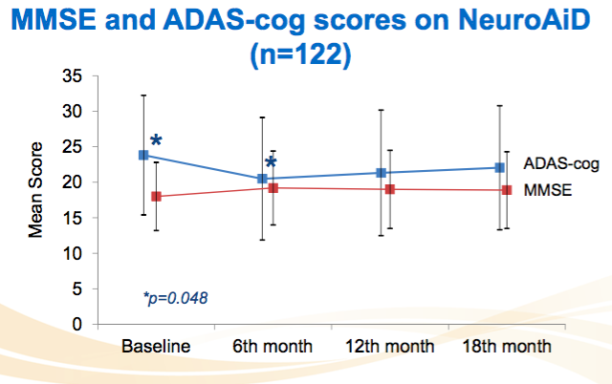
NeuroAiD showed promising effects on cognitive functions
Mean MMSE and ADAS-cog scores from baseline to 18 months in AD patients treated with NeuroAiD
Scale
Baseline
6th month
12th month
18th month
P-value
MMSE
18.0 ± 4.8
19.2. ± 5.2
19.0 ± 5.5
18.9 ± 5.4
0.067
ADAS-Cog
23.2. ± 8.1*
20.0 ±8.3*
20.8 ± 8.5
21.5 ± 8.4
0.048*
*There is a significant difference between the baseline and 6-month
measurements of ADAS-Cog according to repeated measured analysis of all visits.
NeuroAiD improved cognitive function in the first 6M with a stabilization of cognitive decline until 18 M
Harandi, A. A., Ashrafi, F., Tabatabaei, M., et al. (2013). Efficacy and Tolerability of MlC601 in Patients with Mild to Moderate Alzheimer Disease who were Unable to Tolerate or Failed to Benefit from Treatment with Rivastigmine.
Journal of Advances in Medicine and Medical Research, 3(2), 341–350
Notes:
It was interesting to know that this study showed NeuroAiD improved cognitive function particularly the ADAS-Cog scores in the first 6 months and there was stabilization of cognitive decline until 18 months.
Conclusion:
NA showed promising effects on cognitive functions.
These encouraging findings led Dr. Harandi his team to conduct a multicentre randomized trial where MLC601 efficacy and safety was compared to standard AChEIs (Donepezil, Rivastigmine, Galantamine).

Slide 18
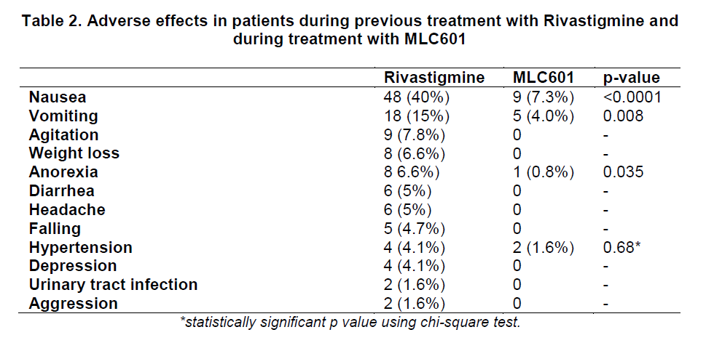
NeuroAiD has favorable safety profile
NeuroAiD showed better tolerability than Rivastigmine
No abnormality or clinically significant changes in haematology, hepatic or renal laboratory results.
Adverse effects in patients during previous treatment with Rivastigmine and during treatment with MLC601
Harandi, A. A., et al. (2013). Efficacy and Tolerability of MlC601 in Patients with Mild to Moderate Alzheimer Disease who were Unable to Tolerate or Failed to Benefit from Treatment with Rivastigmine. Journal of Advances in Medicine and Medical Research, 3(2), 341–350

Slide 19
Limitasyonlar
İlk 6 aydaki etkiler istatistiksel anlamlı, sonrası değil-stabil (ilk 6 ay anlamlılık Adas-cog için, MMSE fark yok)
  10 randomize kontrollü çalışma analizi (Donepezil, Rivastigmin, Galantamin); 6. ayda ADAS-cog fark benzer: -2.7 (%95 CI-3.0 to -2.3)􏰕
  Bir􏰠ks 􏰗J. Cholinesterase inhibitors for A􏰅lzheimer􏰑s disease. Cochrane 􏰀Database Syst Rev. 2006 J􏰗an 25􏰓􏰔 (1􏰕􏰁):CD􏰀0055􏰂3. PM􏰎􏰀􏰁 1643􏰃532.
  Neuroaid 6.ay 􏰅􏰀􏰅ADAS-cog: 􏰱-3.1􏰲±10.1
Kognisyon dışı parametreler yok (davranış problemi, bakımveren yükü, yaşam kalitesi)
Kontrol grubu yok
kör değil (hasta/hekim)
Çalışma boyunca nörogörüntüleme yok (anatomik ve fonksiyonel değişiklikler bilinmiyor)
Hastalık evresine göre değerlendirme yok (hafif-orta)

Slide 20
Kuvvetli yönler
Tolerasyon iyi, Yan etki nedeniyle çalışmadan ayrılan hasta yok; uyum iyi
  Rivastigmin intoleransı yaklaşık %45 (çalışmadaki hastaların rivastigmin kesilme nedenleri %53.2-ilaca yanıtsızlık, %23,3 intolerans, %23.2 yanıtsızlık ve intolerans)
18 ay takip

Slide 21
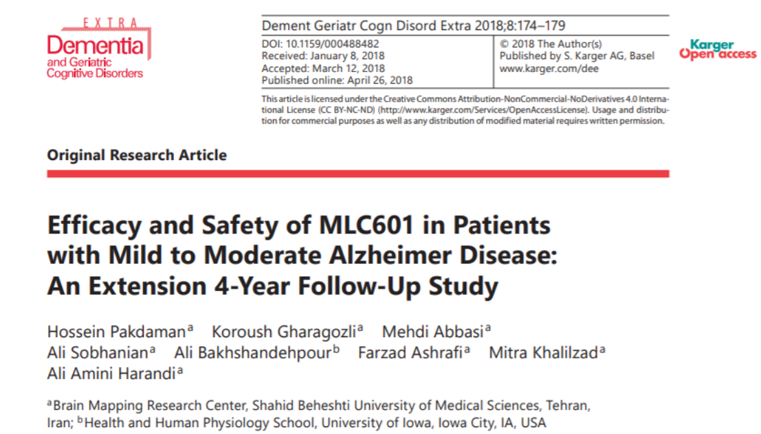
Open-label extension study
Patients with mild-mod AD previously unable to tolerate Rivastigmine who completed treatment with NeuroAiD for 18M
Pakdaman H, et al. Efficacy and Safety of MLC601 in Patients with Mild to Moderate Alzheimer Disease: An Extension 4-Year Follow-Up Study. Dement Geriatr Cogn Dis Extra. 2018 Apr 26;8(1):174-179.

Slide 22
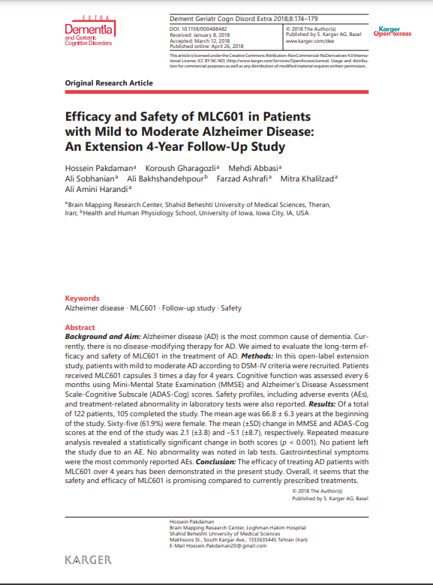
4-Year Extension Follow-up Study
Open-label pilot study
Prospectively followed-up for 4 years patients previously
on Rivastigmine and shifted to NeuroAiD for 18 months
ADAS-Cog and MMSE as well as AEs were assessed every 6 months
During the first 30 months (2.5 years) of treatment, patients experienced almost no worsening of cognitive functions
Conclusion:
The benefits of treating mild to moderate AD patients with NeuroAiD
over 4 years have been demonstrated. Overall, the efficacy of NeuroAiD
is comparable, while it is better tolerated.
Notes:
4-year follow up study:
First study was a follow-up of patients who were previously on Rivastigmine but did not respond and shifted to NeuroAiD for 18 months then prospectively followed up to assess the efficacy and safety of NA for 4 years
Patients received I capsule of NA TID
Efficacy measurement: ADAS-Cog and MMSE- assessed every 6 months to include AEs
105 of the 122 patients competed study; 9 left due to personal reasons while 8 due to medical conditions

Slide 23
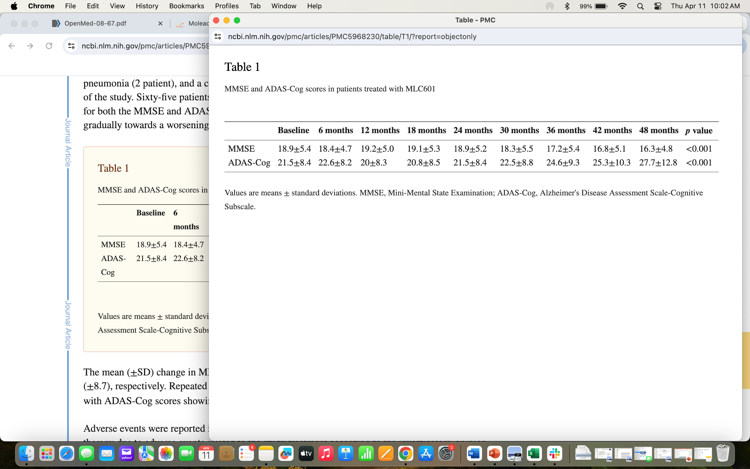
NeuroAiD showed favorable outcomes on cognitive functions
During the first 30 months (2.5 years) of treatment, patients experienced almost no further decline of cognitive functions
MLC 601
1 cap TID
MMSE and ADAS-Cog scores in patients treated with MLC601
Pakdaman H, et al. Efficacy and Safety of MLC601 in Patients with Mild to Moderate Alzheimer Disease: An Extension 4-Year Follow-Up Study. Dement Geriatr Cogn Dis Extra. 2018 Apr 26;8(1):174-179.

Slide 24
NeuroAiD has favourable safety profile
AEs from the 4-year study treated with MLC601
Adverse Event | Patients, n (%) n= 122
Nausea | 3 (2.5)
Anorexia | 2 (1.6)
Bloating | 5 (4.1)
Abdominal cramps | 4 (3.3)
Abdominal pain | 14 (11.5)
Heartburn | 10 (8.2)
Fatigue | 4 (3.3)
Hypersalivation | 1 (0.8)
Constipation | 2 (1.6)
Lightheadedness | 2 (1.6)
Headache | 5 (4.1)
Long-term study showed NeuroAiD is a well- tolerated therapy
for AD
Adverse Events were mild and temporary
GI symptoms were the most common complaints
No abnormalities were reported in lab tests
Pakdaman H, et al. Efficacy and Safety of MLC601 in Patients with Mild to Moderate Alzheimer Disease: An Extension 4-Year Follow-Up Study. Dement Geriatr Cogn Dis Extra. 2018 Apr 26;8(1):174-179.

Slide 25
Kuvvetli yönler
122 hastanın 105 i 4 yıl tamamlıyor
3 yıla uzatılan açık uçlu Donepezil çalışması : Doody RS, et al. Open-label, multicenter, phase 3 extension study of the safety and efficacy of donepezil in patients with Alzheimer disease. Arch Neurol 2001;58:427–433.
  763 hasta; 5 mg alanlarda ADAS-cog değişim 10, 10 mg alanlarda ADAS-cog değişim 12
  Neuroaid çalışması ADAS-cog değişimi daha iyi 2.7
Rivastigmin çalışması: Farlow MR, et al. Rivastigmine: an open-label, observational study of safety and effectiveness in treating patients with Alzheimer’s disease for up to 5 years. BMC Geriatr 2005;5:3.
  37 hasta, 234 hafta izlem
  2/3 hasta çalışmayı tamamlıyor
  Çalışma boyunca ort. ADAS-cog 24.66, bazale göre değişim 8
  Neuroaid çalışması ADAS-cog değişimi aynı haftada daha iyi 5.1, yan etki nedeniyle çalışmayı bırakan hasta yok

Slide 26
Limitasyonlar
Kognisyon dışı parametreler yok (davranış problemi, bakımveren yükü, yaşam kalitesi)
Kontrol grubu yok
kör değil (hasta/hekim)
Çalışma boyunca nörogörüntüleme yok (anatomik ve fonksiyonel değişiklikler bilinmiyor)
Hastalık evresine göre değerlendirme yok (hafif-orta)
Açık uçlu çalışma; iyi yanıt alanlar çalışmaya devam eder; ilaç etkinliğini tam olarak göstermeyebilir. 122 hasta 105 I tamamlıyor, çalışmadan ayrılan 17 hasta;
  9-kişisel neden, 3-SVO, 2-MI, 2-pnömoni, 1-trafik kazası

Slide 27
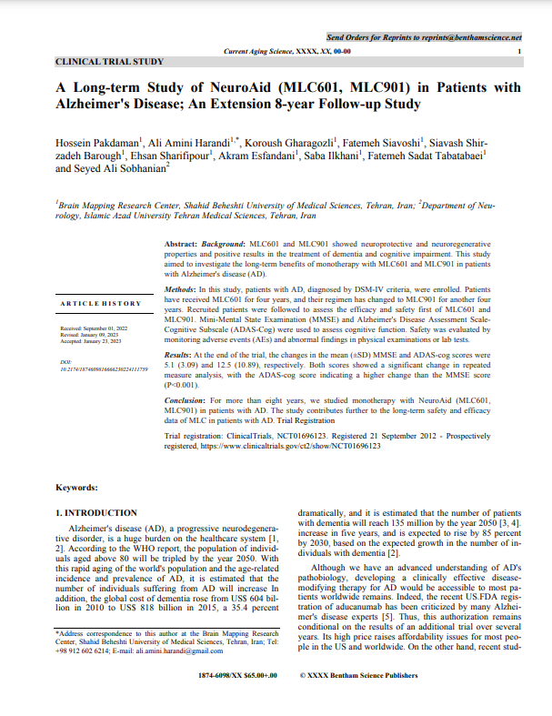
8-Year Extension Follow-up Study
Open-label extension study of patients with mild to moderate
AD who completed treatment with NeuroAiD for 18 months in
an open-label pilot study
Patients received MLC601 for four years and were shifted to MLC901
for another four years
Conclusion:
This was a monotherapy study NeuroAiD in patients with mild to
moderate AD for more than 8 years. This study contributes further
to the long-term safety and efficacy data of NeuroAiD.
Improved Cognitive function was observed in the first 6 months of the regimen and stabilization of cognitive decline was observed over the remaining 12 months.
Notes:
8-year extension study:
Patients who were on MLC601 were shifted to MLC901 and followed up for another 4 years to complete 8 years of MLC601/MLC901

Slide 28
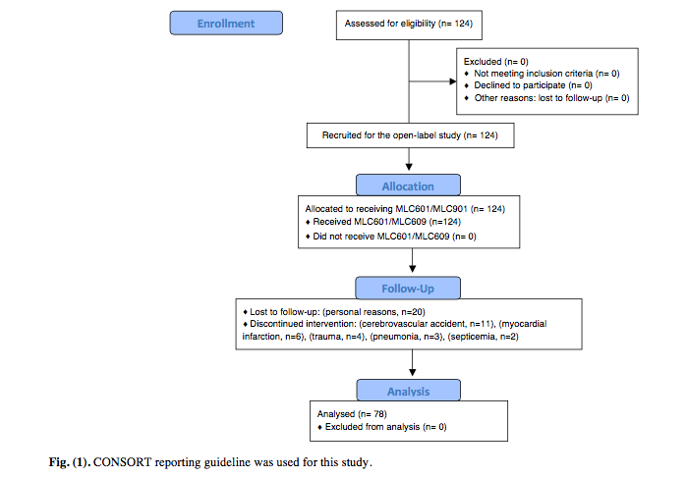

Slide 29
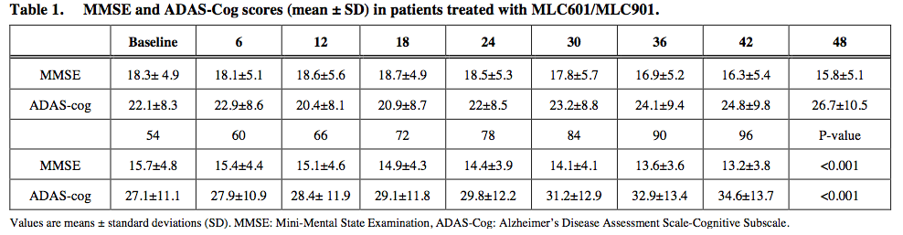

Slide 30
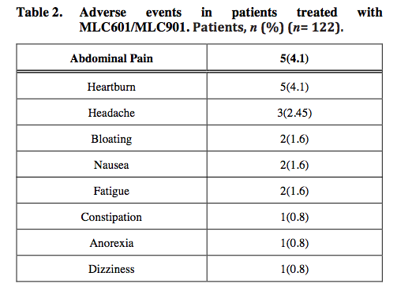

Slide 31
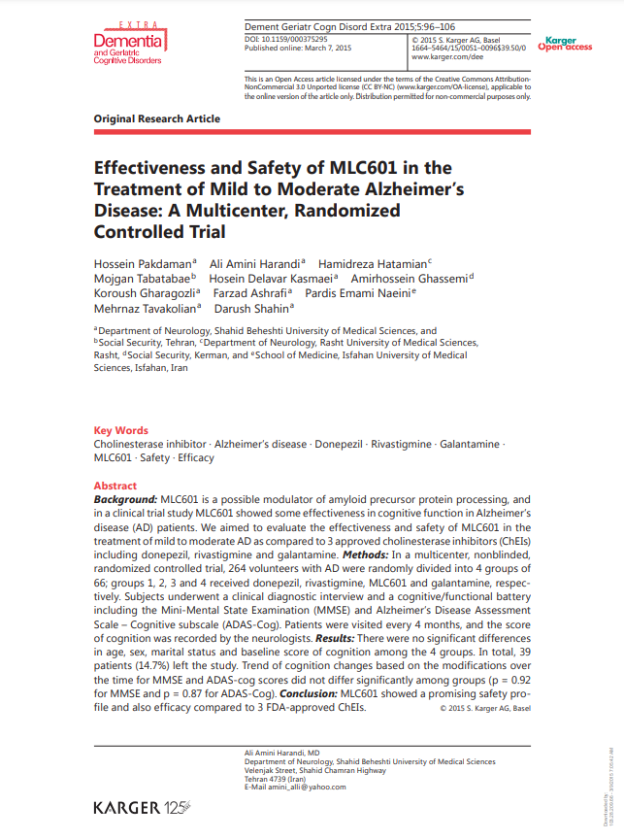
NeuroAiD compared to Acetylcholinesterase Inhibitors
Notes:
This is the next study that looked into……..

Slide 32
NeuroAiD compared to Acetylcholinesterase Inhibitors
Evaluated the safety and efficacy of NeuroAiD in the treatment of mild to moderate AD
compared to Donepezil, Rivastigmine and Galantamine over a period of 16 months
Randomized controlled trial
264 patients were randomly divided in 4 groups
NeuroAiD dose: 1 capsule three times a day
Acetylcholinesterase Inhibitors dose were according to standard dose and tolerability
Outcome Assessments: MMSE and ADAS-Cog scores
Notes:
Randomized controlled trial where 264 patients were divided into 4 groups of 66:
Donepezil
Rivastigmine
Galantamine
NeuroAiD
NeuroAiD dose given: 1 capsule 3 x daily
Other AChEI according to standard dose and tolerability.
Outcome assessments: MMSE and ADAS-cog every 4 months for 16 months
Safety and tolerability evaluations

Slide 33
Study Design
927 volunteers
264 eligible patients
Inclusion:
Mild to moderate AD
Possible diagnosis of AD
>60 years old
MMSE scores ranging from 10 to 26
Exclusion:
Presence of any psychiatric illness
Serious physical illness
Other neurological disease
Hypothyroidism
Diabetes mellitus
Liver or renal disease
Addiction
Other causes of dementia
Previously on AChEI
Donepezil
(n=66)
57 (6.4%)
completed study
264 patients with AD
9 dropouts
Rivastigmine
(n=66)
13 dropouts
53 (80.3%) completed study
264 randomized patients
MLC601
(n=66)
7 dropouts
59 (89.4%) completed study
Galantamine
(n=66)
10 dropouts
56 (84.8%) completed study
Variable
Donepezil
Rivastigmine
MLC601
Galantamine
p value
Total
66
66
66
66
-
age, years
73.2 ±4.7
73.2 ±4.7
71.8 ± 5.7
72.5 ± 5.2
0.375
female
35 (53.0%)
35 (53.0%)
37 (56.1%)
37 (56.1%)
0.759
married
56 (84.8%)
56 84.8%)
58 (87.9%)
57 (86.4%)
0.893
MMSE
17.1 ± 3.1
17.1 ± 3.1
17.7 ±1.6
17.9 ± 1.9
0.303
ADAS Cog
29.6 ±7.7
29.6 ±7.7
27.5 ±4.1
27.3 ± 5.0
0.100
Pakdaman H, Harandi AA, Hatamian H, Tabatabae M, Delavar Kasmaei H, Ghassemi A, Gharagozli K, Ashrafi F, Emami Naeini P, Tavakolian M, Shahin D. Effectiveness and Safety of MLC601 in the Treatment of Mild to Moderate Alzheimer's Disease: A Multicenter, Randomized Controlled Trial. Dement Geriatr Cogn Dis Extra. 2015 Mar 7;5(1):96-106. doi: 10.1159/000375295. PMID: 25873931; PMCID: PMC4386115.
Notes:
This is a snapshot of the study design

Slide 34
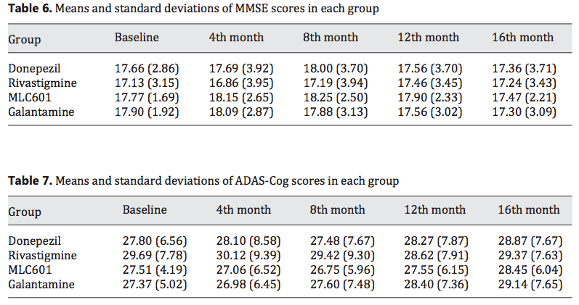

Slide 35
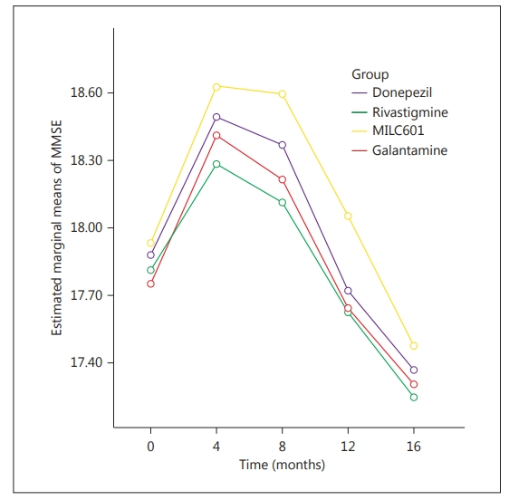
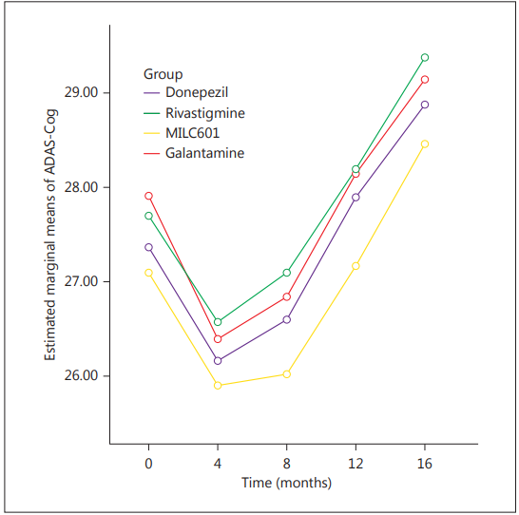
NeuroAiD showed favorable outcomes on cognitive functions
The efficacy of NeuroAiD was comparable to Donepezil, Rivastigmine and Galantamine over 16 months
A - MMSE
B – ADAS-Cog
MLC 601
1 cap TID
Mean changes in (A) MMSE and (B) ADAS-Cog scores from baseline in the 4 groups
Pakdaman H, et al. Effectiveness and Safety of MLC601 in the Treatment of Mild to Moderate Alzheimer's Disease: A Multicenter, Randomized Controlled Trial. Dement Geriatr Cogn Dis Extra. 2015 Mar 7;5(1):96-106.

Slide 36
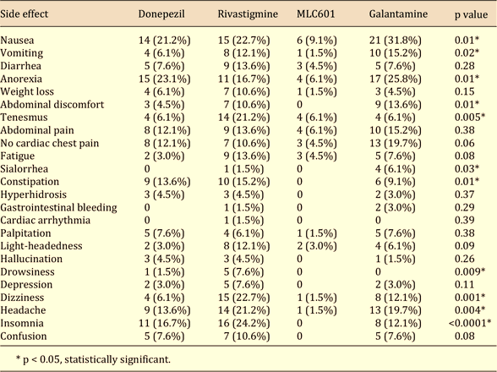
NeuroAiD has favorable safety profile
NeuroAiD showed favorable tolerability profile compared
to Donepezil, Rivastigmine and Galantamine
*p < 0.05, statistically significant
Frequency distribution of side effects in the 4 study groups
Pakdaman H, et al. Effectiveness and Safety of MLC601 in the Treatment of Mild to Moderate Alzheimer's Disease: A Multicenter, Randomized Controlled Trial. Dement Geriatr Cogn Dis Extra. 2015 Mar 7;5(1):96-106.

Slide 37
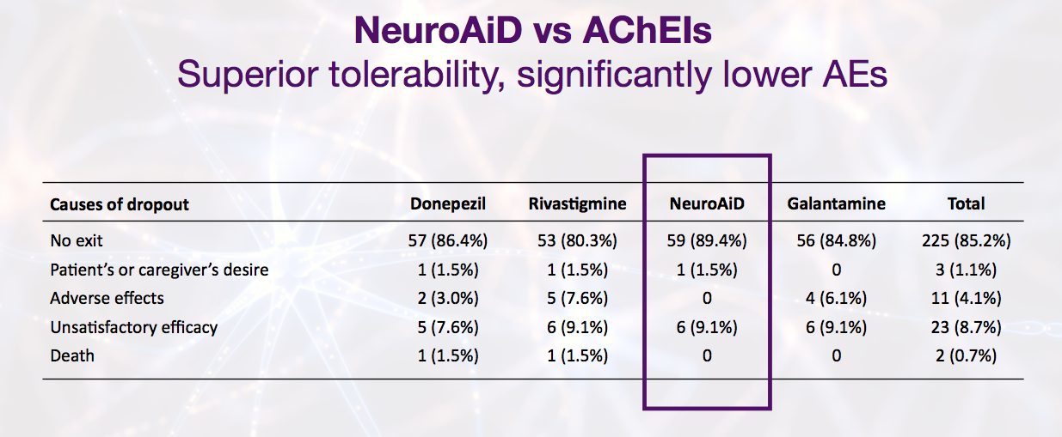
Nuraid; Çalışmadan çıkma oranları daha az

Slide 38
MLC601 vs ACHEI; SONUÇ
Etkinlik:
  16 ay boyunca MLC601 ve AcheI benzer
  Tüm gruplarda kognitif skorlarda ilk 8 ay düzelme, sonra hafif bozulma
Yan etki:
  Donepezilde MLC601’e göre 3.6 kat fazla
  Rivastigminde MLC601’e göre 5.6 kat fazla
Limitasyon:
  Kognisyon dışı sonlanım verisi yok (ADL, yaşam kalitesi, davranış sx vs.)
  Kör değil

Slide 39
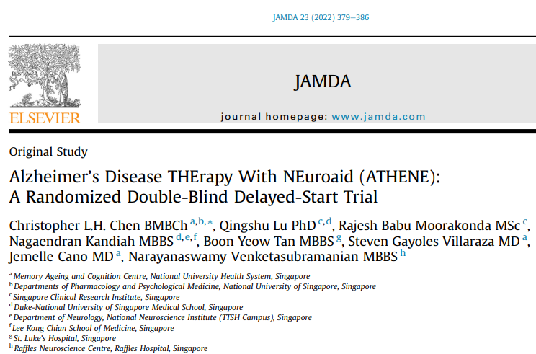
Investigate NeuroAiD safety as add on therapy to standard treatment and its effect on cognition and slowing disease progression.
Outcome assessment:
  Serious adverse events at 6 months
  ADAS-Cog and other assessment scales

Slide 40
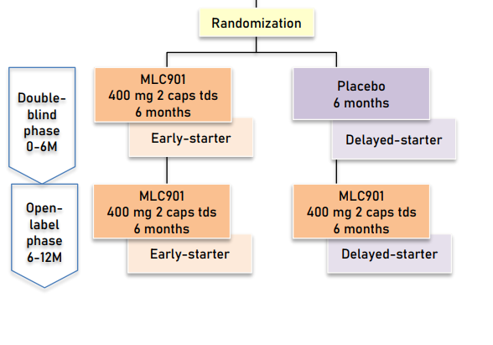
Study Design- ATHENE
125 randomized patients
Inclusion:
≥ 50 years old
Diagnosed with probable AD (NINCDS- ADRDA criteria)
Mild-moderate AD (MMSE 8-26)
Receiving stable dose of AChEI or memantine or both in the past 2 months and have been on treatment for 4 months
Exclusion:
Any serious medical/psychiatric condition
MLC 901
2 cap TID
Chen CLH, et al. Alzheimer's Disease THErapy With NEuroaid (ATHENE): A Randomized Double-Blind Delayed-Start Trial. J Am Med Dir Assoc. 2022 Mar;23(3):379-386.e3.

Slide 41
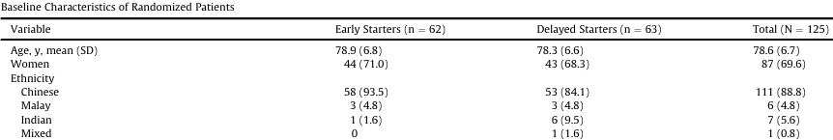
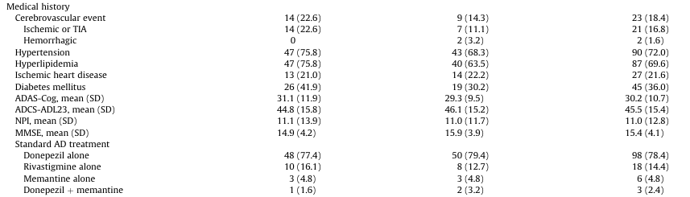
Baseline Characteristics – ATHENE
Chen CLH, et al. Alzheimer's Disease THErapy With NEuroaid (ATHENE): A Randomized Double-Blind Delayed-Start Trial. J Am Med Dir Assoc. 2022 Mar;23(3):379-386.e3.

Slide 42
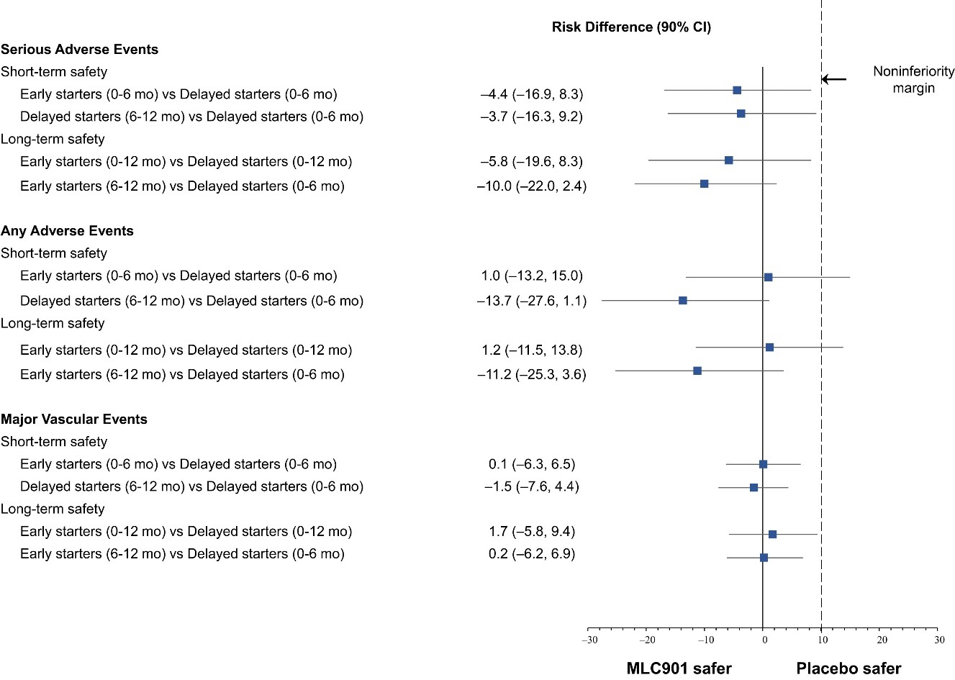
Comparable risks of SAE and AE were observed between early and delayed starters at M6
Risk differences and 90% CI of the proportions of SAE, any AE and major vascular events between early and delayed starters
No significant difference in the risk of SAE between early and delayed starters at Month 6 (NeuroAiD II and placebo: 22.6% vs 27.0%, respectively)
No significant difference in the risk of AE and the occurrence of stroke and vascular events between early and delayed starters throughout the 12-month study period.
Chen CLH, Lu Q, Moorakonda RB, Kandiah N, Tan BY, Villaraza SG, Cano J, Venketasubramanian N. Alzheimer's Disease THErapy With NEuroaid (ATHENE): A Randomized Double-Blind Delayed-Start Trial. J Am Med Dir Assoc. 2022 Mar;23(3):379-386.e3. doi: 10.1016/j.jamda.2021.10.018. Epub 2021 Nov 29. PMID: 34856171.

Slide 43
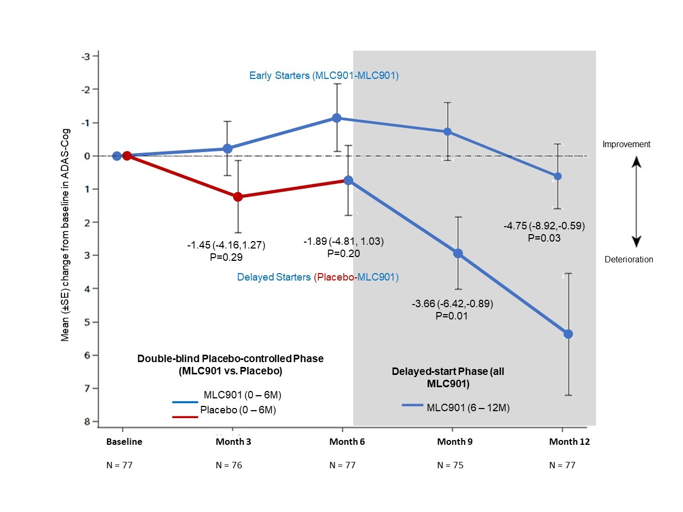
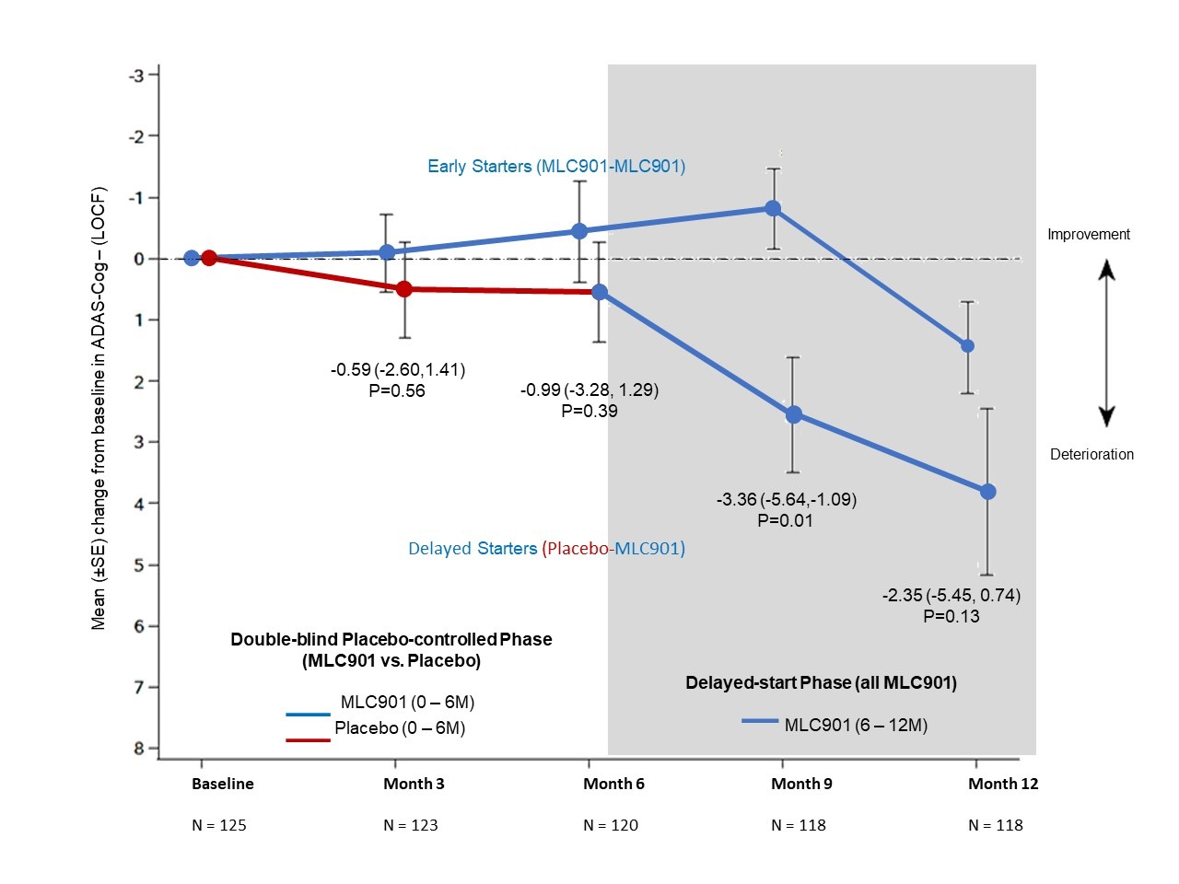
NeuroAiD has shown potential in slowing down AD progression
NeuroAiD has shown potential in slowing down AD progression
Mean change in ADAS-COG (ITT)
Mean change in ADAS-COG (PP)
Disease Modification (slowing progression)
Prolonged symptomatic)
Early starters: Improved over time and peaked at M9.
-3.66
P = 0.01
-4.75
P = 0.03
Chen CLH, et al. Alzheimer's Disease THErapy With NEuroaid (ATHENE): A Randomized Double-Blind Delayed-Start Trial. J Am Med Dir Assoc. 2022 Mar;23(3):379-386.e3.
Notes:
Per protokol grubu: tedaviye uyumu iyi olan grup
Çalışma toplam 125 hastayla başlıyor, 118 ile bitiyor
Uyumu iyi olan hasta sayısı 77

Slide 44
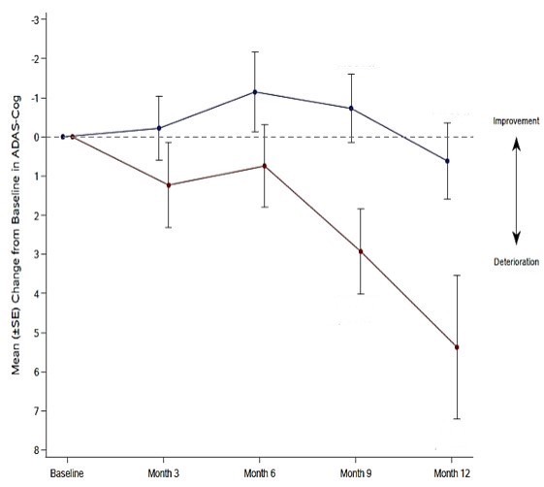
ATHENE Trial: Efficacy as Measured by ADAS-Cog
ATHENE Trial: Efficacy as Measured by ADAS-Cog
Mean change in ADAS-COG (PP)
Disease Modification (slowing progression)
Prolonged symptomatic)
Early Starters (MLC901-MLC901)
Early starters: Improved over time and peaked at M9.
-3.66
P = 0.01
-4.75
P = 0,03
Delayed Starters (Placebo-MLC901)
Delayed starters: Progressive decline till M6.
Rapid decline at M9 and M12.
MD = Mean difference; M = Month
Chen CLH, Lu Q, Moorakonda RB, Kandiah N, Tan BY, Villaraza SG, Cano J, Venketasubramanian N. Alzheimer's Disease THErapy With NEuroaid (ATHENE): A Randomized Double-Blind Delayed-Start Trial. J Am Med Dir Assoc. 2022 Mar;23(3):379-386.e3. doi: 10.1016/j.jamda.2021.10.018. Epub 2021 Nov 29. PMID: 34856171.

Slide 45
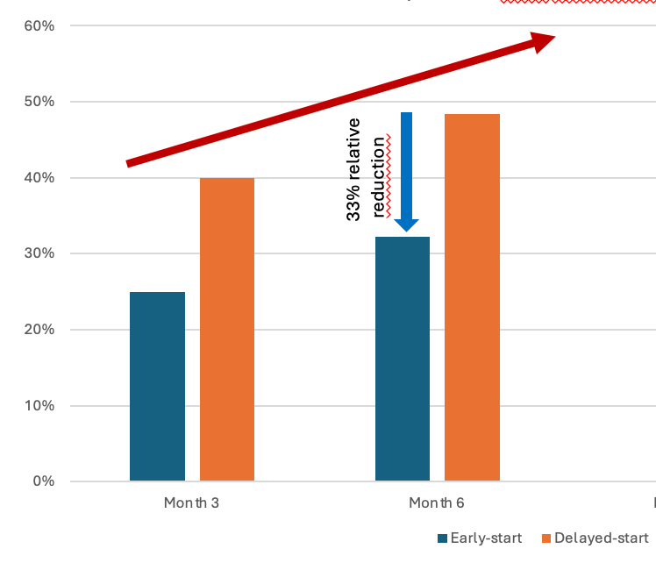
ATHENE : Clinician’s Global Impression of Change (CGIC)
ATHENE: Clinician’s Global Impression of Change (CGIC)
6-month randomized
Double-blind
MLC901 vs placebo
Delayed-start: 6-month placebo
Followed by 6-month MLC901
Placebo
MLC901
placebo
MLC901
NeuroAiD reduces the proportion of patients
who deteriorate (slow down progression)
After switching to NeuroAiD at month 6
Placebo patients tend to stabilize
Chen CLH, Lu Q, Moorakonda RB, Kandiah N, Tan BY, Villaraza SG, Cano J, Venketasubramanian N. Alzheimer's Disease THErapy With NEuroaid (ATHENE): A Randomized Double-Blind Delayed-Start Trial. J Am Med Dir Assoc. 2022 Mar;23(3):379-386.e3. doi: 10.1016/j.jamda.2021.10.018. Epub 2021 Nov 29. PMID: 34856171.

Slide 46
MLC601 add-on therapy; SONUÇ
Etkinlik: Sekonder sonlanım
  Early starter grubunda 9. ve 12. ayda ADAS-cog farkı daha belirgin (özellikle tedaviye uyumu iyi olan per-protokol grubunda)
Yan etki: Primer sonlanım
  Early starter grubunda vasküler risk faktörleri (DM, HT, HL, SV0) daha fazla olmasına rağmen iki grupta olumsuz sonlanımlar benzer, güvenlik profili benzer
      Early starter grubu vasküler risk fazla-MLC901 etkinliğini artırmış olabilir mi????
Limitasyon:
  Süre kısa, 6 aylık 2 periyod
  Popülasyon daha çok Çinli
  12.ayda çalışmadan 14 hastada etkinlik değerlendirmesi yapılamamış, çalışma etkinlik sonuçları değişmiş olabilir

Slide 47
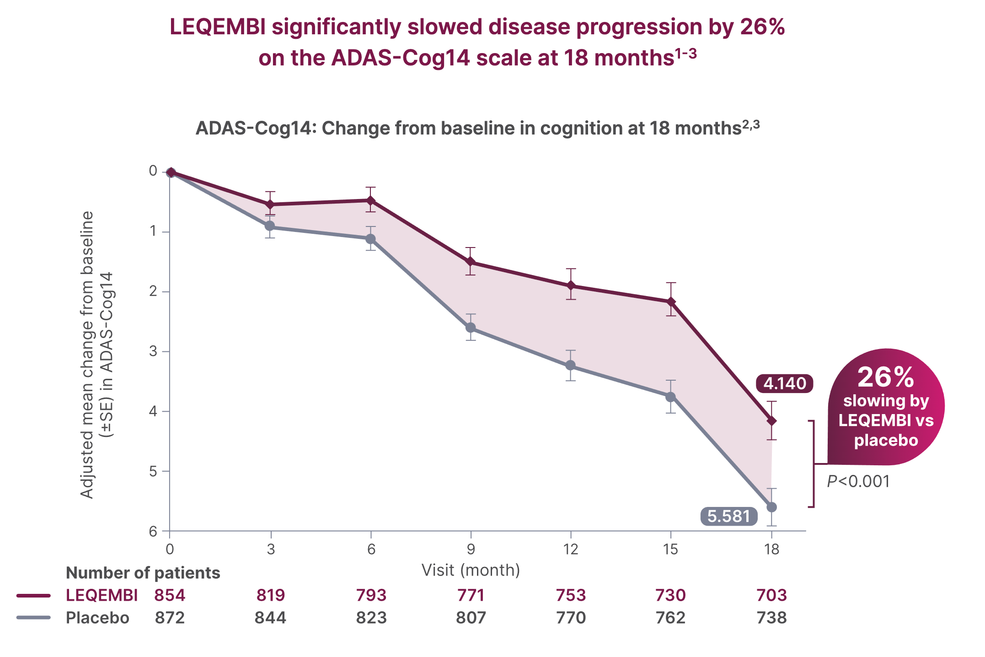
Indirect comparison with Lecanemab study in early AD
ATHENE
CLARITY
At M9-M12, the ADAS-Cog difference early starter vs late-starter is about 3 points
ATHENE study: Mild/moderate AD
ADAS-Cog = 30
MMSE = 15
On top of standard therapy 100%
Good safety
At M9-M12, the ADAS-Cog difference Leqembi vs placebo is about 1.5 points
CLARITY study: Mild dementia 39% - MCI 61%
ADAS-Cog =25
MMSE= 24
On top of standard therapy 52%
ARIA-E or ARIA-H 21%
4/18/25
Source: https://www.leqembihcp.com/about-leqembi/study-2-clarity-ad

Slide 48
3 ana çalışmadaki önemli noktalar (NeuroAiD >500 AH)
Rivastigmin yanıtsız/tolere edemeyen erken-orta AH hastalarda NeuroAiD tek ajan olarak etkili
  124 hasta18 ay izlem – 4 yıla uzatılmış çalışma
1
NeuroAiD tek ajan olara erken-orta AH hastalarda; Donepezil, Rivastigmine ve Galantamin kadar etkili
  264 AH hasta16 ay
2
ATHENE study:erken-orta AH hastalarda standart tedaviye eklenen NeuroAid güvenli ve etkili (progresyonu yavaşlatıyor)
  Erken-geç başlayan– 125 hasta, 1 yıl takip
3

Slide 49


Slide 50
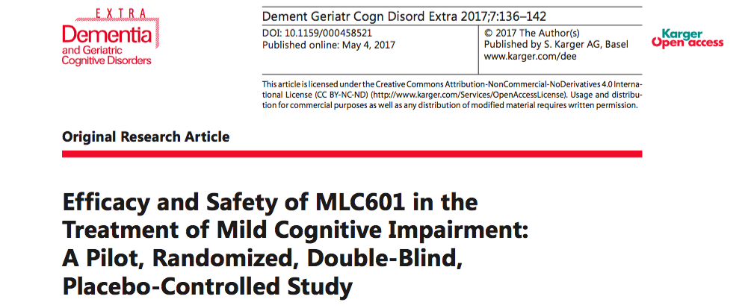
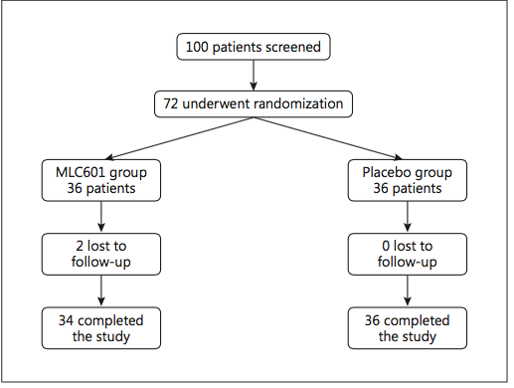

Slide 51
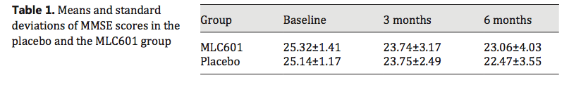


Slide 52


Slide 53


