Slide 1




Sarcopenic Obesity and SOGLI Initiative
Lorenzo M Donini
Department of
Experimental Medicine
Pathophysiology, Food Science and Endocrinology section
Lorenzomaria.donini@uniroma1.it

Slide 2

Faculty/Presenter Disclosure
Faculty: Lorenzo M Donini
Relationships with commercial interests: I currently have, or I have had in the past two years, an affiliation or financial interest with a business corporation(s):
  Grants/Research Support: Danone/Nutricia, Biophytis, Abbott
  Speakers Bureau/Honoraria and other: Nutricia, AKERN, Cosmed
  Consulting Fees: Vivenda, GioService, Federalimentare, Cambridge Food Science

Slide 3
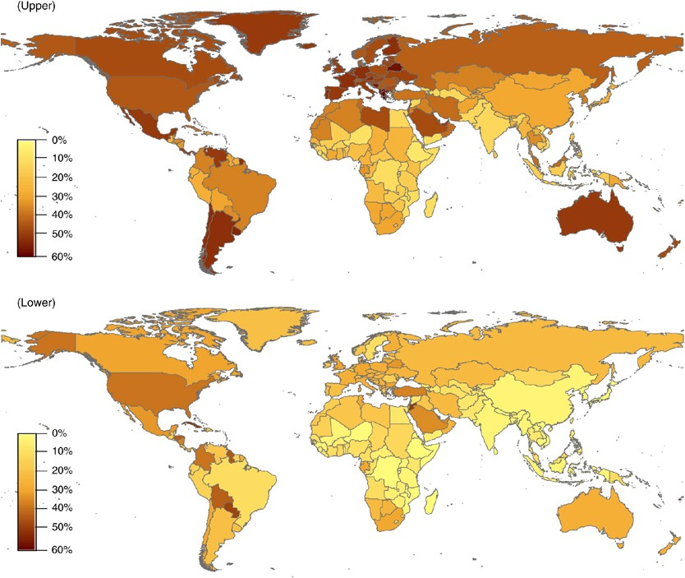

1° Epidemic
Notes:
Convergence of three epidemics

Slide 4
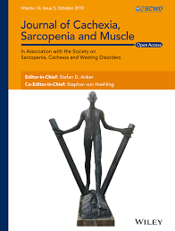
2° Epidemic
Prevalence in
< 60 years: 8-36% (14 articles)
≥ 60 years: 10-27% (167 articless)
Notes:
Background Sarcopenia is defined as the loss of muscle mass and strength. Despite the seriousness of this disease, a single diagnostic criterion has not yet been established. Few studies have reported the prevalence of sarcopenia globally, and there is a high level of heterogeneity between studies, stemmed from the diagnostic criteria of sarcopenia and the target population. The aims of this systematic review and meta-analysis were (i) to identify and summarize the diagnostic criteria used to define sarcopenia and severe sarcopenia and (ii) to estimate the global and region-specific prevalence of sarcopenia and severe sarcopenia by sociodemographic factors.
Methods Embase, MEDLINE, and Web of Science Core Collections were searched using relevant MeSH terms. The inclusion criteria were cross-sectional or cohort studies in individuals aged ≥18 years, published in English, and with muscle mass measured using dual-energy x-ray absorptiometry, bioelectrical impedance, or computed tomography (CT) scan. For the meta-analysis, studies were stratified by diagnostic criteria (classifications), cut-off points, and instruments to assess muscle mass. If at least three studies reported the same classification, cut-off points, and instrument to measure muscle mass, they were considered suitable for meta-analysis. Following this approach, 6 classifications and 23 subgroups were created. Overall pooled estimates with inverse-variance weights obtained from a
random-effects model were estimated using the metaprop command in Stata.
Results Out of 19 320 studies, 263 were eligible for the narrative synthesis and 151 for meta-analysis (total n = 692 056, mean age: 68.5 years). Using different classifications and cut-off points, the prevalence of sarcopenia varied between 10%and 27%in the studies included for meta-analysis. The highest and lowest prevalence were observed in Oceania and Europe using the European Working Group on Sarcopenia in Older People (EWGSOP) and EWGSOP2, respectively. The prevalence ranged from 8% to 36% in individuals <60 years and from 10%to 27% in ≥60 years. Men had a higher prevalence of sarcopenia using the EWGSOP2 (11% vs. 2%) while it was higher in women using the InternationalWorking Group on Sarcopenia (17% vs. 12%). Finally, the prevalence of severe sarcopenia ranged from 2% to 9%.
Conclusions The prevalence of sarcopenia and severe sarcopenia varied considerably according to the classification and cut-off point used. Considering the lack of a single diagnostic for sarcopenia, future studies should adhere to current guidelines, which would facilitate the comparison of results between studies and populations across the globe

Slide 5
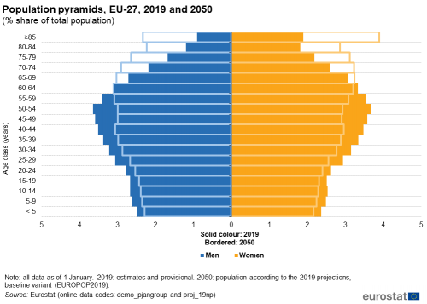
3° Epidemic
Notes:
Ageing Europe — looking at the lives of older people in the EU is a Eurostat publication providing a broad range of statistics that describe the everyday lives of the European Union’s (EU) older generations.
Europeans are living longer than ever before and the age profile of society is rapidly developing. Demographic ageing means the proportion of people of working age in the EU is shrinking, while the number of older people is expanding; this pattern will continue in the next couple of decades, as the post-war baby-boom generation completes its move into retirement.
Such developments are likely to have profound implications, not only for individuals, but also for governments, business and civil society, impacting, among others: health and social care systems, labour markets, public finances and pension entitlements (each of which is covered by subsequent chapters in this publication). However, the focus of this opening chapter is a set of demographic indicators that describe the latest developments for an ageing Europe.

Slide 6
Pathophysiology

Slide 7
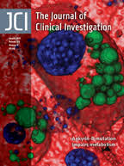
adipose depots expand between muscle fibers or surrounding muscle (intermyocellular and perimuscular adipose tissue: IMAT/PMAT) ⇒ reduced muscle quality
immune cells (macrophages and T cells) infiltrate into IMAT/PMAT ⇒ increased inflammation in skeletal muscle expressing proinflammatory cytokines and chemokines
⇒ insulin resistance (paracrine effect) and T2DM
Notes:
In lean conditions, few immune cells with resting or anti-inflammatory phenotypes reside in skeletal muscle.
As obesity develops and progresses along with expansion of visceral and subcutaneous AT, adipose depots expand between muscle fibers or surrounding muscle, so-called IMAT/PMAT.
In obesity, immune cells including macrophages and T cells infiltrate into IMAT/PMAT and polarize into proinflammatory phenotypes, leading to increased inflammation in skeletal muscle. At the same time, myocytes may become inflamed and express proinflammatory cytokines and chemokines
Obesity is associated with chronic inflammation, which contributes to insulin resistance and type 2 diabetes mellitus.
Under normal conditions, skeletal muscle is responsible for the majority of insulin-stimulated whole-body glucose disposal; thus, dysregulation of skeletal muscle metabolism can strongly influence whole-body glucose homeostasis and insulin sensitivity.
Increasing evidence suggests that inflammation occurs in skeletal muscle in obesity and is mainly manifested by increased immune cell infiltration and proinflammatory activation in intermyocellular and perimuscular adipose tissue.
By secreting proinflammatory molecules, immune cells may induce myocyte inflammation, adversely regulate myocyte metabolism, and contribute to insulin resistance via paracrine effects. Increased influx of fatty acids and inflammatory molecules from other tissues, particularly visceral adipose tissue, can also induce muscle inflammation and negatively regulate myocyte metabolism, leading to insulin resistance.

Slide 8
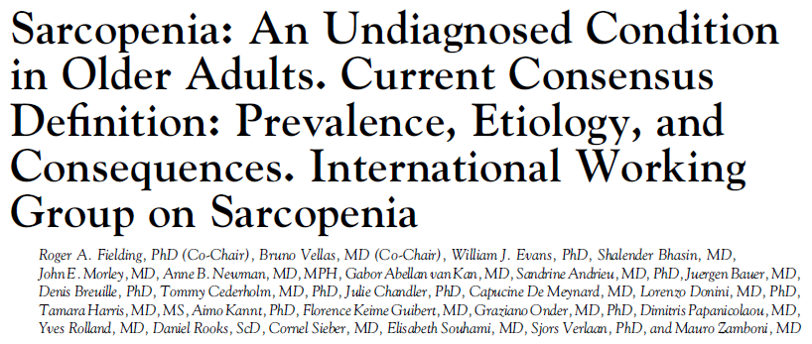
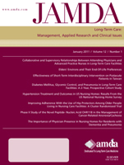
Myosteatosis (IMAT) attenuates the contraction velocity and specific force of individual muscle fiber
⇐ Increased adipocyte-secreted chemokines (MCP-1, CRP) and adipokines (leptin), adipocyte differentiation-related protein (perlipin-2), and adipose tissue-derived PAI-1
reduced muscle quality (reduced strength/cross sectional area)
decrease of the capacity to generate power (= force x speed) (muscle power is more closely related to functional capacity than muscle strength)
Notes:
PLIN2, également connu sous le nom de périlipine 2 ou adipophiline, est une protéine qui joue un rôle dans la formation et la stabilisation des gouttelettes lipidiques dans les cellules. Elle est impliquée dans le stockage des lipides, en particulier dans le foie, et son expression est augmentée dans diverses maladies liées à l'accumulation de graisses, y compris certains cancers.
PAI: inhibiteur de l'activateur du plasminogène 1 aussi appelé PAI-1 pour plasminogen activator inhibitor-1 est le principal inhibiteur du tPA et de l'urokinase, les activateurs du plasminogène et par conséquent la fibrinolyse. C'est une protéine inhibitrice des protéases à sérine.

Slide 9
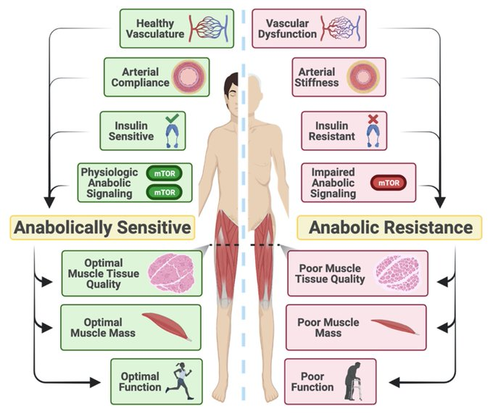
⇐ attenuated effect of dietary EAA in stimulating muscle protein synthesis
Notes:
During the ageing process, there are gradual impairments in vascular function, anabolic signalling, arterial compliance, and insulin sensitivity.
These impairments may ultimately lead and/or contribute to anabolic resistance, or a reduced ability to mount a muscle protein synthetic response to anabolic stimuli.
Over time, anabolic resistance promotes sarcopenia, or the age-related loss in muscle mass and function, resulting in a loss of functional ability and independence in older adults.
Sarcopenia, or the age-related loss of skeletal muscle mass and function, is an increasingly prevalent condition that contributes to reduced quality of life, morbidity, and mortality in older adults.
Older adults display blunted anabolic responses to otherwise anabolic stimuli—a phenomenon that has been termed anabolic resistance (AR)—which is likely a casual factor in sarcopenia development.
AR is multifaceted, but historically much of the mechanistic focus has been on signalling impairments, and less focus has been placed on the role of the vasculature in postprandial protein
kinetics.
The vascular endothelium plays an indispensable role in regulating vascular tone and blood flow, and age-related impairments in vascular health may impede nutrient-stimulated vasodilation and subsequently the ability to deliver nutrients (e.g. amino acids) to skeletal muscle.
Although the majority of data has been obtained studying younger adults, the relatively limited data on the effect of blood flow on protein kinetics in older adults suggest that vasodilatory function, especially of the microvasculature, strongly influences the muscle protein synthetic response to amino acid feedings.
In this narrative review, we examine evidence of AR in older adults following amino acid and mixed meal consumption, examine the evidence linking vascular dysfunction and insulin resistance to age-related AR, review the influence of nitric oxide and endothelin-1 on age-related vascular dysfunction as it relates to AR, briefly review the potential causal role of arterial stiffness in promoting skeletal muscle microvascular dysfunction and AR, and provide a brief overview and future considerations for research examining age-related AR.

Slide 10
Notes:
The mechanisms impairing muscle quality and leading to myofibrosis (MF) and myosteatosis (MS) are incompletely known.
In biopsies of paraspinous muscle (PM) of 16 elderly men undergoing elective vertebral surgery, we histologically determined the area of MF and MS expressed as muscle quality index (MQI), in order to investigate the relation between them, as well as the main predictors of muscle quality.
Total PM area and intermuscular adipose tissue (IMAT) were evaluated by MRI and body composition by DXA.
Circulating fasting glucose, insulin, hs-CRP, leptin, adiponectin and IL-6 were measured and HOMA index calculated.
Quantification of gene expression in PM and in subcutaneous adipose tissue (SAT) overlying the muscle was performed by rt-PCR.
The degree of MS and MF was significantly and positively related to each other and positively associated with BMI, waist, FM and FM% as well as with IMAT.
The area of PM was negatively related with MF even after adjustment for weight.
Leptin was positively associated with MF and MS (through mTOR pathway and oxidative stress as it happens with cardiac muscle and liver??) , whereas hs-CRP to MF.
In backward regression analyses, larger waist and smaller PM area explained 90% of MF variance, whereas leptin about 80% of MS variance. IL-6 expression in SAT was significantly higher in participants with higher MQI values. In PM biopsies we found significantly higher expression of SOCS-3 and a trend toward higher expression of myostatin with greater degrees of MQI. MS and MF are related phenomena that concur to alter muscle quality and both should be considered in further studies on the evolution of sarcopenia.

Slide 11

Mechanisms (and vicious circles) that may explain how obesity can elicit muscle catabolic pathways, together with muscle quality and metabolism impairment (⇐ mitochondrial dysfunction and oxidative stress, inflammation, atherosclerotic altered muscle tissue perfusion) :
physical inactivity as a result of obesity-associated musculo-skeletal complications
selective undernutrition (⇐ energy dense nutrient-poor diets)
axonal degeneration, neuronal hypoexitability, loss of α-motoneurons ⇒ dysregulation in the denervation–reinnervation cycle of motor neurons ⇒ impairments in contractile velocity, muscle synergy, muscle weakness
obesity-related chronic conditions (T2DM, HF, COPD, kidney disease, and cancer)
Notes:
Vicious circle where the determinants of SO may lead to clinical and functional consequences that will worsen SO.

Slide 12
Clinical & functional consequences

Slide 13
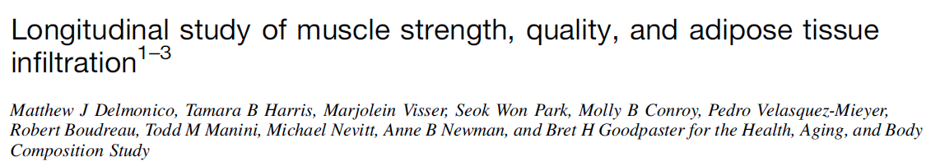
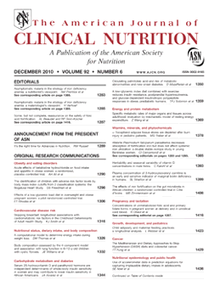
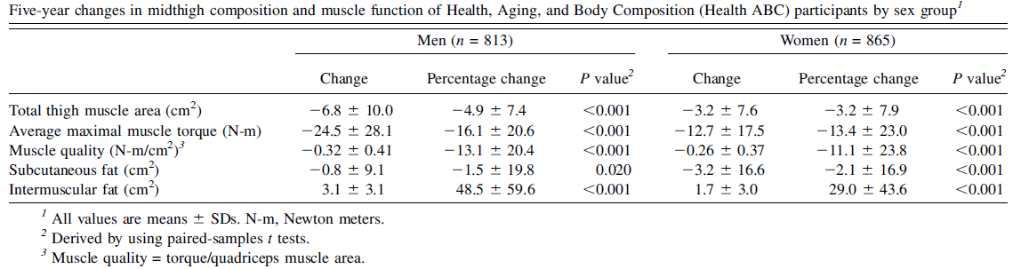
age-related increase in fatty infiltration of muscle (increase in IMF)
IMF of skeletal muscle worsened over 5y regardless of weight and SF changes
the decreases in strength were 2–5 times greater than the loss of muscle size
weight gain did not attenuate the loss of strength with aging
losses in MQ with aging
⇒ impairment of ADL and disability
Notes:
The results of our investigation show for the first time that there is an age-related increase in fatty infiltration of midthigh skeletal muscle in men and women, as indicated by increases in IMF (intermuscular fat).
Moreover, this fatty infiltration of skeletal muscle worsened over 5 y in both men and women regardless of weight changes and changes in subcutaneous thigh adipose tissue.
We also found that the decreases in strength were 2–5 times greater than the loss of muscle size with aging.
In addition, weight gain did not attenuate the loss of strength with aging, despite a small increase in midthigh muscle area.
Together, these findings clearly indicate that progressive muscle weakness and increase in muscular fat infiltration with age occur regardless of changes in muscle mass or SF (subcutaneous fat), implicating losses in MQ (muscle quality) with aging.

Slide 14
Mechanisms connecting SO and Atherosclerosis
insulin resistance ⇒ vasodilation lesion & endothelial dysfunction
proinflammatory status (macrophages, in combination with adipocytes and lipid-infiltrated muscle tissues) ⇒ proinflammatory cytokines & reduced release of protective adiponectin
oxidative stress ⇐ LDL oxidation, cholesterol efflux obstruction, and collagen fiber aggregation in fibroatheroma plaques
coronary artery calcification
myocardial fibrosis
  ⇐ collagen production, myofibroblasts and profibrotic signaling pathways activation
  ⇐ mTOR-S6K1 signaling and TGF-b1-SMAD pathway by activating the renin– angiotensin–aldosterone system
⇒ vasodilation lesion, arterial stiffness and endothelial dysfunction
Notes:
Atherosclerosis, identified as a root pathological contributor to multiple CVDs, is inextricably intertwined with sarcopenic obesity and is primarily driven by the impact of sarcopenic obesity on metabolic health.
This state is characterized by insulin resistance (IR), which induces vasodilation lesion and endothelial dysfunction, thus fueling the advancement of atherosclerosis.
In addition, the proinflammatory status, exacerbated by macrophages infiltrating adipose tissue during the progression of sarcopenic obesity, is another causative factor of atherosclerosis. These macrophages, in combination with adipocytes and lipid-infiltrated muscle tissues, stimulate the secretion of proinflammatory cytokines, particularly TNF-a and IL-6, while reducing the release of protective adiponectin, thereby evoking systemic chronic inflammation that directly damages the vascular endothelium and, in, turn exacerbates IR and atherosclerosis.
Sarcopenic obesity-induced adipokine overexpression can also trigger oxidative stress, forcing low-density lipoprotein oxidation, cholesterol efflux obstruction, and collagen fiber aggregation in fibroatheroma plaques, which, taken together, further deteriorate endothelial dysfunction and aggravate atherogenesis, ultimately provoking multifactorial CVD events, including ischemic heart disease, arrhythmia, and heart failure.
Recent research has revealed an independent correlation between sarcopenic obesity and coronary artery calcification (50), which is typically concomitant with advanced atherosclerosis and has been established as a predictor of impending cardiac events.
The underlying mechanisms may be attributed to the overproduction of ROS, followed by endothelial dysfunction, arterial stiffness, and microvascular damage, highlighting the robust association between sarcopenic obesity and atherosclerosis, and, thereby, CVDs.
Myocardial fibrosis, another well-established cardiac ailment and pathological hazard for a multitude of CVDs, is closely associated with sarcopenic obesity. This is substantiated by robust evidence indicating the roles of overexpressed TNF-a and chronic oxidative stress. These factors stimulate myofibroblasts and activate profibrotic signaling pathways, respectively, thereby promoting collagen production and inducing cardiac fibrosis.
Additionally, the pathological process of sarcopenic obesity may trigger hyperinsulinemia via IR, which drives mTOR-S6K1 signaling (60) and the TGF-b1-SMAD pathway (61) by activating the renin– angiotensin–aldosterone system, eventually leading to activated myocardial fibrosis in conjunction with the inflammatory status.

Slide 15
Notes:
Sarcopenic obesity and oncogenesis, are mediated by mechanisms, such as insulin resistance, type 2 diabetes, inflammation, immune damage, imbalance of adipokines and myokines, and remodeling of the extracellular matrix and the vasculature.
Together, these phenomena correlate with the incidence of several types of cancer, including liver, pancreas, stomach, colorectal, kidney, bladder, endometrium, prostate, breast, non-Hodgkin’s lymphomas and leukemia

Slide 16
MASLD, metabolic dysfunction–associated steatotic liver disease
Notes:
Bidirectional relationship between MASLD and skeletal muscle and the impact of exercise on pathogenic pathways and liver histology.
Skeletal muscle insulin resistance, myosteatosis, and sarcopenia all converge on the liver to drive the progression of MASLD.
Reciprocally, multiple pathways feed back from the liver to influence the function, quality, and quantity of skeletal muscle.
Both aerobic and resistance exercises have widespread benefits in all 3 domains of muscle pathology. Exercise is also able to improve steatosis and reduce surrogate markers of fibro inflammation.
Abbreviations: ANGPTL3, angiopoietin-like protein 3; ASCs, adipose stromal cells; DNL, de novo lipogenesis; HFREP1, hepatocyte derived fibrinogen-related protein 1; LCET2, leukocyte cell–derived chemotaxin 2; MASH, metabolic dysfunction–associated steatohepatitis; MASLD, metabolic dysfunction–associated steatotic liver disease; NEFA, nonesterified fatty acids; TLR, toll-like receptor.

Slide 17
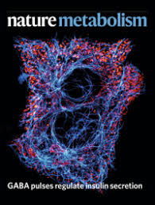
Individuals with SO and sarcopenia have an increased risk of cognitive impairment.
Muscle-secreted myokines such as irisin and cathepsin B are associated with improved brain functions:
  genetic deletion of the exercise-induced membrane protein FNDC5/irisin impairs cognitive function in exercise, ageing and AD;
  irisin is the active portion in that it can restore cognitive function;
  irisin may exert its effects through astrocytes and/or microglia, targeting neuroinflammation directly (and not the formation or removal of amyloid plaques).
Notes:
FNDC5: Fibronectin type III domain-containing protein 5,
we evaluate whether irisin, the secreted part of the exercise hormone FNDC5, confers these beneficial effects on cognitive function. We demonstrate that
genetic deletion of Fndc5/irisin impairs cognitive function in exercise, ageing and AD. Furthermore, we show that the cleaved, circulating part of the hormone, called irisin, is the active moiety in that it can restore cognitive function. Most importantly, we show that peripheral application of irisin, which leads to elevated central levels of irisin, is sufficient to rescue the cognitive decline in two distinct mouse models of AD—even after the development of substantial pathology.
irisin may exert its effects through astrocytes and/or microglia.
irisin does not specifically target the formation or removal of amyloid plaques, but rather targets neuroinflammation directly, we are optimistic that irisin’s beneficial effects in neurodegeneration are generalizable beyond AD.
Identifying secreted mediators that drive the cognitive benefits of exercise holds great promise for the treatment of cognitive decline in ageing or Alzheimer’s disease (AD). Here, we show that irisin, the cleaved and circulating form of the exercise-induced membrane protein FNDC5, is sufficient to confer the benefits of exercise on cognitive function. Genetic deletion of Fndc5/irisin (global Fndc5 knock-out (KO) mice; F5KO) impairs cognitive function in exercise, ageing and AD. Diminished pattern separation in F5KO mice can be rescued by delivering irisin directly into the dentate gyrus, suggesting that irisin is the active moiety.
In F5KO mice, adult-born neurons in the dentate gyrus are morphologically, transcriptionally and functionally abnormal. Importantly, elevation of circulating irisin levels by peripheral delivery of irisin via adeno-associated viral overexpression in the liver results in enrichment of central irisin and is sufficient to improve both the cognitive deficit and neuropathology in AD mouse models. Irisin is a crucial regulator of the cognitive benefits of exercise and is a potential therapeutic agent for treating cognitive disorders including AD.

Slide 19
The Sarcopenic Obesity Clinical Leadership Initiative (SOGLI)

Slide 20
SO is considered a pathology in which the clinical and functional consequences are worse beyond either condition alone due to synergistic and negative action that characterizes the combination of these two situations.
The prevalence, however, is very variable due to the criteria adopted to define SO in the different studies, and there was therefore no way to understand the epidemiological impact of SO.
Notes:
All the papers from the beginning have defined SO as a pathology in which the clinical and functional consequences were worse beyond either condition alone
The pathogenesis of SO in fact highlights the synergistic and negative action that characterizes the combination of sarcopenia and obesity
The prevalence, however, was very variable in the different studies and there was therefore no way to understand the epidemiological impact of SO
The first act of SOGLI (even if it wasn't called that yet) was therefore to decide in 2018 that it was time to meet the challenge

Slide 21
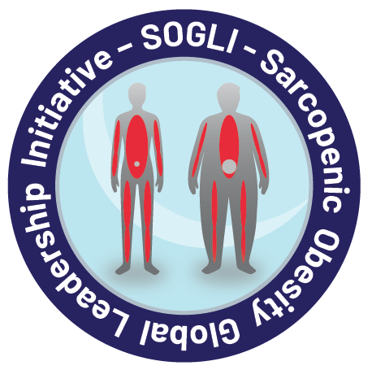

Slide 22


***
**
*
**
*
N=2070 (86.9% from 2018)
* 2018: SO: Time to meet the challenge. Barazzoni R et al, Clin Nutr & Obes Facts
** 2020: Critical appraisal of definitions and diagnostic criteria for sarcopenic obesity based on a systematic review. Donini L et al, Clin Nutr
*** 2022: Definition and Diagnostic Criteria for Sarcopenic Obesity: ESPEN and EASO Consensus Statement. Donini L et al, Clin Nutr & Obes Facts

Slide 23
The Sarcopenic Obesity Clinical Leadership Initiative (SOGLI)
Definition and diagnostic criteria for Sarcopenic Obesity

Slide 24
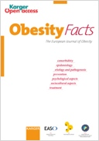

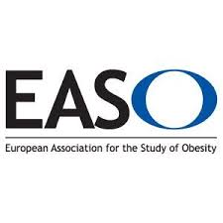
537 citations for Obes Facts + 273 citations for Clin Nutr version
(Published: 23/02/22; Scopus, 08.10.2025)
Notes:
Last year we gathered around more than 30 researchers from all over the world dealing with SO and coming from different experiences in different fields: nutrition, obesity, gerontology, sarcopenia
An algorithm for the diagnosis of SO was published and since then …

Slide 25
«SO is defined as the co-existence of obesity and sarcopenia”
[Agreement (agree + strongly agree) = 100%]
SO is characterized by the combination of:
  high body fat (ectopic fat in skeletal muscle should be adequately considered, when available, potentially also for prognostic purposes)
  AND
  low skeletal muscle mass (most importantly appendicular muscle mass) accompanied by low muscle function.
Notes:
In 2022 the SOGLI promoted a consensus conference for the definition and the diagnostic criteria of SO
A 100% agreement was reached on the definition you can see.
The expert panel pointed out the necessity to consider ectopic fat …. And the reduction of muscle function accompanying the the reduction of skeletal muscle mass
Obesity is characterized by excessive production and diminished capacity to store lipids, leading to ectopic fat accumulation in skeletal muscle in the form
intramuscular adipose tissue (IMAT) and
intramyocellular accumulation of lipids (IMCL: triacylglycerol, ceramide, and diacylglycerol)

Slide 26
Notes:
First step to have a common base in research and clinical fields to study SO
We are sure that different questions will arise and that probably in a few years we have to modify or integrate the algorithm

Slide 27
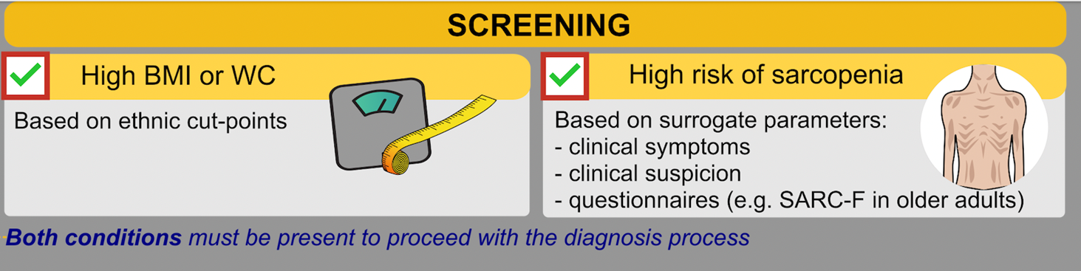
in all subjects at risk (e.g. older adults with obesity, subjects who have had rapid increases or decreases in weight and/or weight cycling, subjects with obesity who have a comorbidity for chronic diseases) by HCP not necessarily expert in the field of obesity and / or sarcopenia (e.g. GPs).
tools that are easy to find and use in any healthcare environment
maximizing sensitivity to capture individuals in different settings
[Agreement (agree + strongly agree) = 77.4%]

Slide 28
Clinical Symptoms or Suspicion to screen for SO
Age ≥ 70 years
History of:
  Repeated falls
  Weakness, exhaustion
  Fatiguability
  Progressive movement limitations
Recent acute diseases
  Hospitalization
  Major surgery/trauma
  Immobility
  Food intake <50% for two weeks
  Weight loss or rapid weight gain
  Bariatric surgery or restrictive diet
Chronic Diseases
  Heart failure
  Kidney disease (particularly RRT)
  Liver disease (NASH, cirrhosis)
  Bowel failure/dysfunction
  Respiratory disease
  Neurologic/neurodegenerative
  Cognitive impairment
  Depression
  Organ transplantation
  Endocrine disorders
  Osteoarthritis
  Cancer

Slide 29
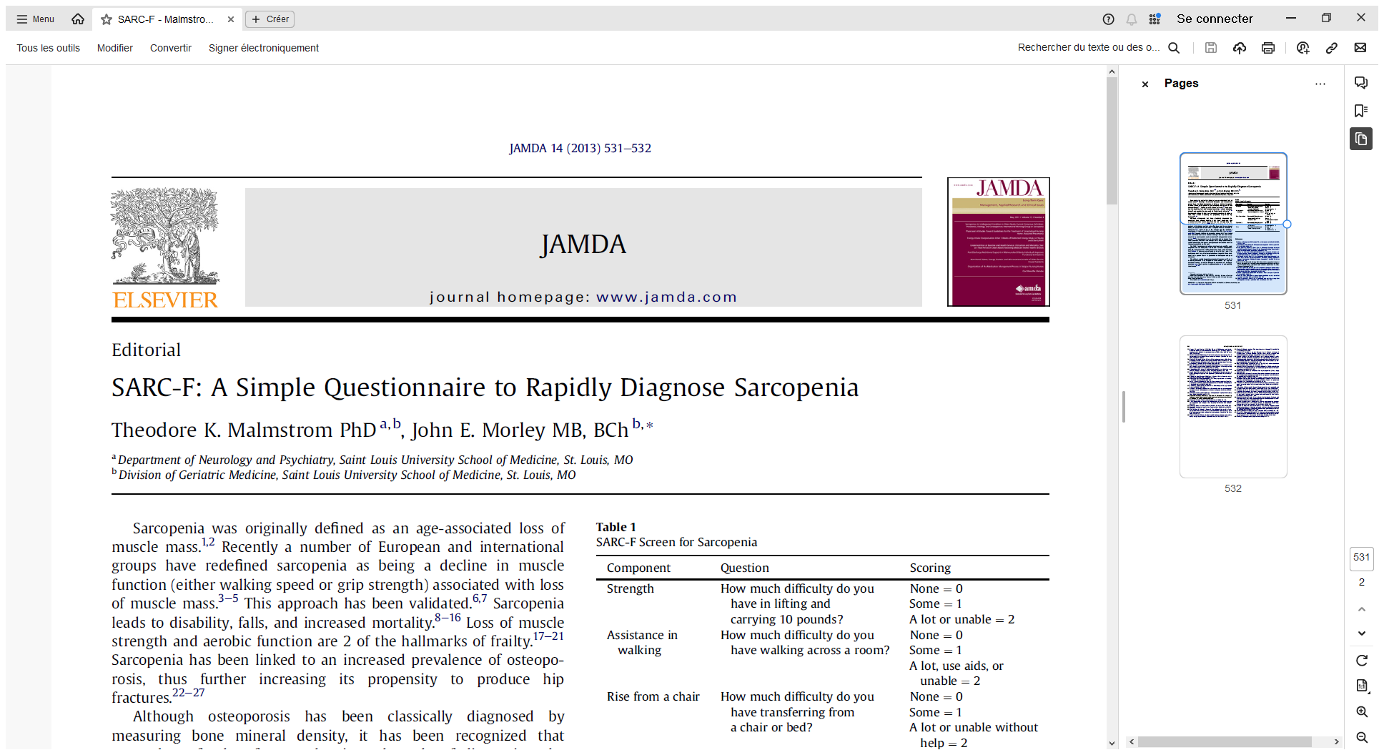
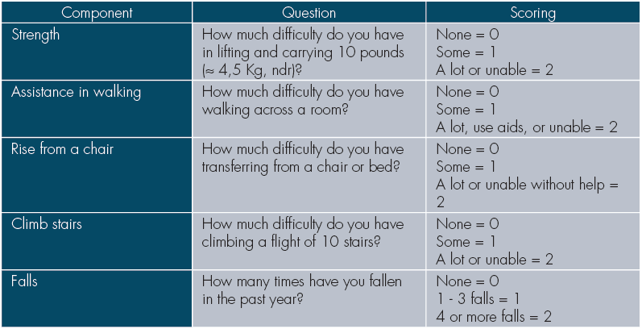
Score: 0-10; score ≥ 4 is predictive of sarcopenia and poor outcomes.

Slide 30
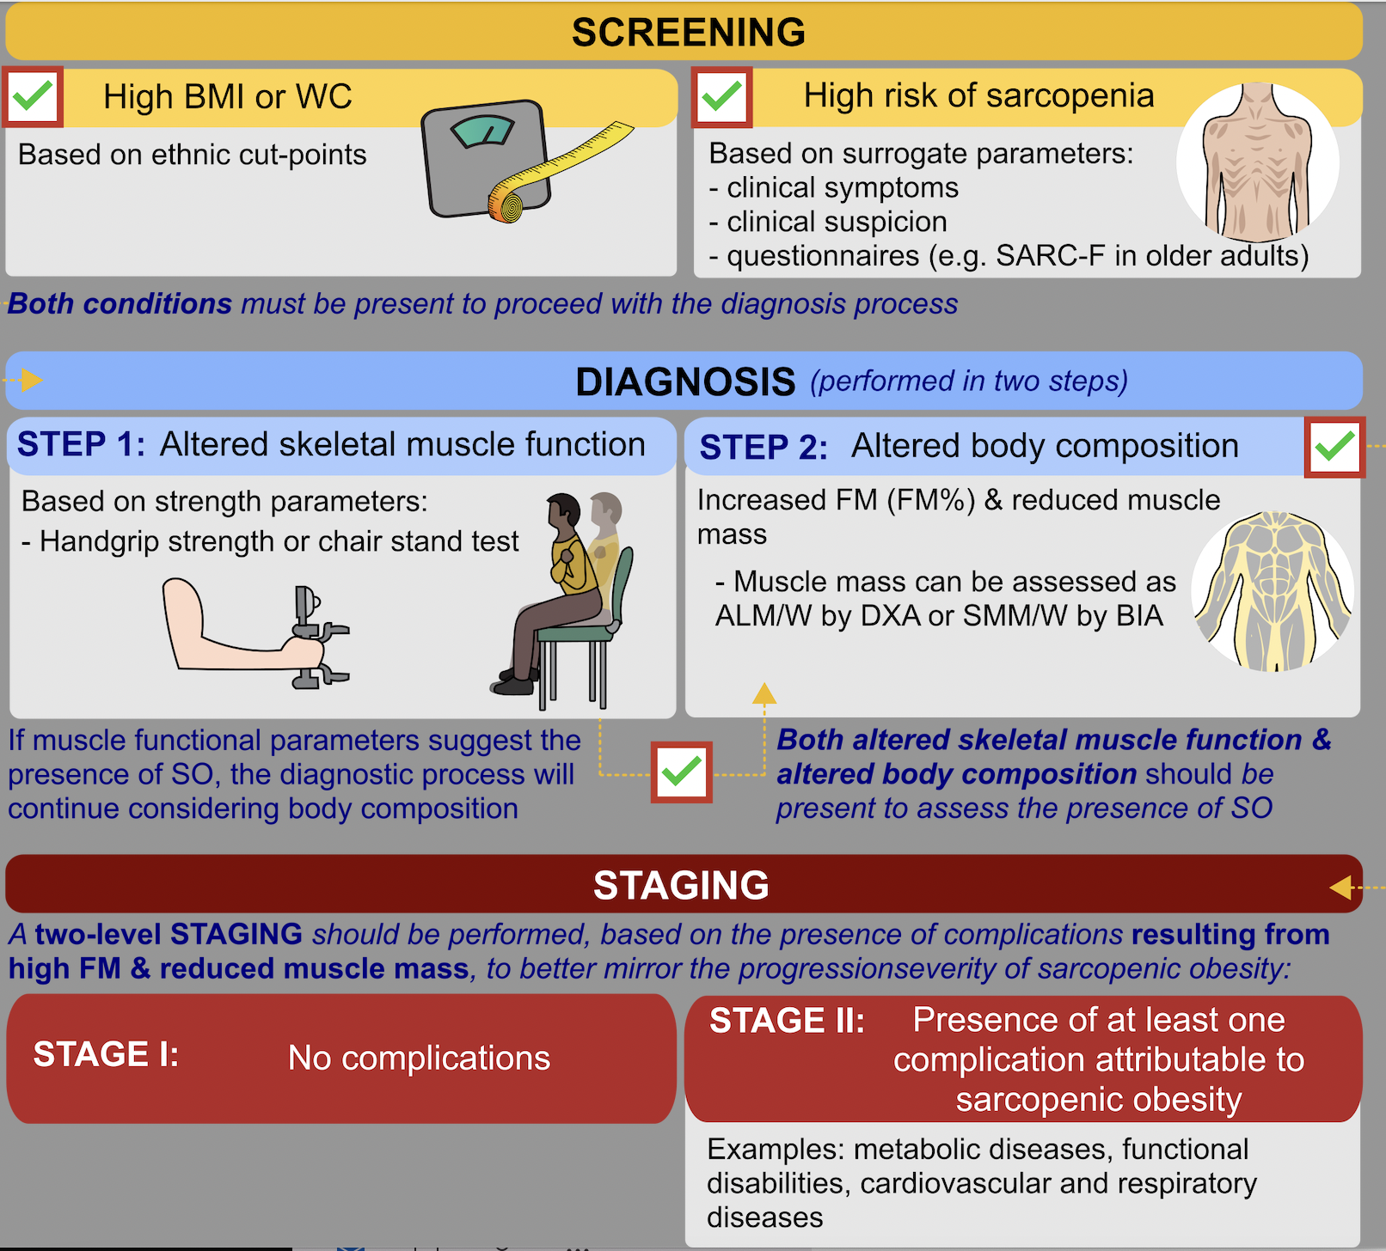
It should always follow positive screening.
It will be performed at a specialist level with access to technique, devices and methodologies for body composition measurements.
[Agreement (agree + strongly agree) = 83,8%]
Cut points for different populations are available in Gortan Cappellari G, et al. Clin Nutr. 2023 May;42(5):687-699. doi: 10.1016/j.clnu.2023.02.018

Slide 31
Diagnosis
Aspects to be considered
SO is more frequently present in older adults, but not necessarily limited to this older age category.
SO may be a PRIMARY condition or SECONDARY (e.g. in the presence of chronic diseases).
The two categories of OBESITY and SARCOPENIA should be considered in the context of SO that needs to be considered as a unique clinical condition, different from sarcopenia or obesity alone.
For clinical utilization, we do not have at the moment enough data to suggest and support an integrated index for SO definition.

Slide 32
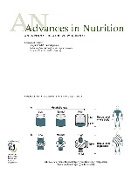
CAPACITY-LOAD model
Model 1: body composition phenotype model:
  low adiposity-high muscle mass (LA-HM),
  high adiposity-high muscle mass (HAHM)
  low adiposity-low muscle mass (LA-LM),
  and HA-LM
Model 2:Truncal FM / ASM
Model 3:FM/FFM
Metabolic load
Metabolic capacity
Notes:
“The capacity-load model predicts that NCD risk can be modelled as a consequence of interactive associations between two broad traits, metabolic capacity and metabolic load. Metabolic capacity relates to numerous components of organ size and function that have long-term implications for the capacity for homoeostasis. Metabolic load refers to a variety of factors that challenge homeostasis, including components of lifestyle (e.g., dietary glycaemic load, sedentary behaviour, smoking, infectious disease) as well as the level of body fat and its distribution”.
he model assigns a negative effect on physiological function to FM and TrFM and a positive effect to FFM and ASM.

Slide 33
Diagnosis
Questions for the future
do we have to consider gait speed and eventually which test will be used (4m, 6m, 6-minute or 400m walk test, Timed get Up and Go) ?
obesity in SO diagnosis should be defined as increased FM% of total body weight or as FMI ?
distribution of FM (subcutaneous vs visceral) should also be taken into account measuring waist circumference or using DXA with visceral fat analyser ?
Notes:
Questions asked

Slide 34

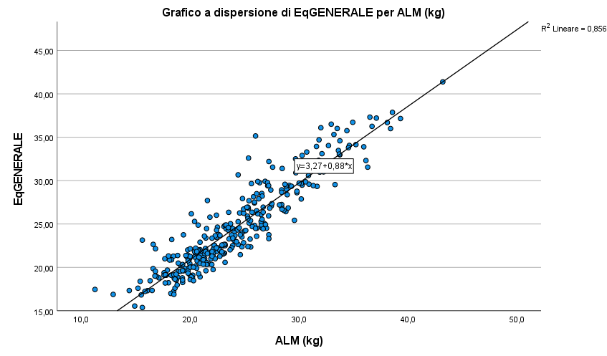
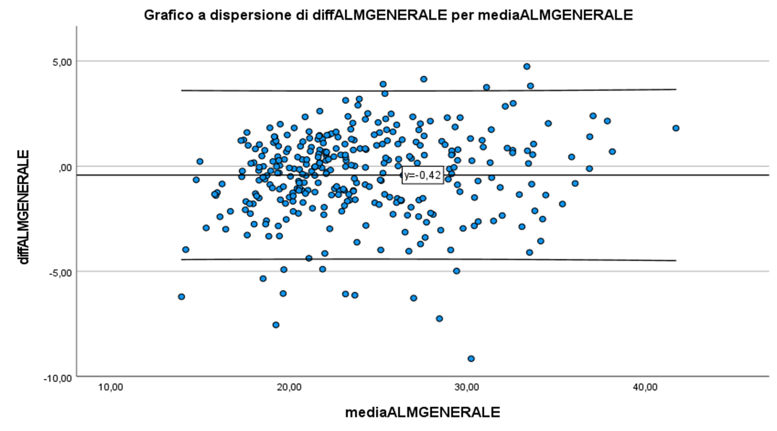
Predicting ALM with BIA among adult patients with obesity
(Proposed for publication to Clin Nutr)
NCT06545435
BIA
 |  |  | all variables in a block |  | stepwise procedure
model |  |  | R2 | R2adj | R2 | R2adj | variables into the equation
1 | all the variables statist. associated with ALMKG at univariate analysis (weight > BMI; RI > Rz) | Age, weight, WC, MAC, CC, RI, Xc, sex | 0,889 | 0,879 | 0,882 | 0,877 | weight, sex, WC, RI
2 | all the variables statist.. associated with ALMKG at univariate analysis (weight > BMI; ZI > Z) | Age, weight, WC, MAC, CC, ZI, Xc, sex | 0,889 | 0,879 | 0,882 | 0,877 | weight, sex, ZI, WC
Bland-Altman plot
DXA
Diff betweeen DXA (ALM Kg) & BIA eq results
Average of DXA (ALM kg) vs BIA equation results
Notes:
Develop and cross-validate novel BIA equations predicting appendicular soft tissue masses [appendicular lean mass (ALM) and fat mass (AFM)] in a sample of Caucasian adult subjects affected by obesity;
A Bland–Altman plot (difference plot) is a method of data plotting used in analyzing the agreement between two different assays.
The vertical axis shows the differences between the two measurements (i.e. the measurement error)
The horizontal axis shows the arithmetic means of the two measurements. In fact, assuming that the two measurements are equivalent, the best estimate of the true value of the measurement is represented by the arithmetic mean of the two measurements.
the two lines at the top and bottom delimit a band that represents the limits of the confidence interval of the mean of the differences. The position of these two lines can be calculated as: mean of the differences ±1.96×SD
The points on the graph that fall within the confidence interval indicate statistically congruent results, while the points located outside the extremes of the confidence interval represent cases in which the two methods are not congruent.
However, the fact that there is statistical congruence between the two measurements does not necessarily mean that the two methods are interchangeable. In fact, this graph evaluates the size of the differences by building a confidence interval calculated on the mean difference, but it does not tell us whether for practical purposes the size of these intervals is acceptable or not. The definition of what is meant by acceptable limit, or what the maximum size of the confidence interval must be so that the two measurements can be considered interchangeable, must in fact be defined a priori based on theoretical, clinical, biological or other considerations on the phenomenon being analyzed.

Slide 35
Prevention & therapeutic approach to SO

Slide 36
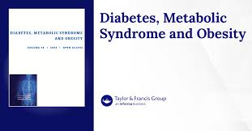
The protocols for the STEP (semaglutide) and SURMONT (tirzepatide) trials involved the administration of AOMs as adjuncts to regular lifestyle counselling sessions including:
  healthy, balanced diet with a moderate caloric deficit (eg, 500 kcals per day) and an adequate protein intake (1g/Kg adjBW)
  exercise regime (eg, at least 150 minutes of moderate-intensity physical exercise per week).
  behavioural strategies (recording of diet and activity using a diary or smartphone app)
Hence, the overwhelmingly positive outcomes reported must be at least partially attributable to the traditional approach to obesity management.
Jastreboff AM, Aronne LJ, Ahmad NN, et al. Tirzepatide once weekly for the treatment of obesity. N Engl J Med. 2022. 387(3):205–216. doi:10.1056/NEJMoa22060386
Wilding JPH, Batterham RL, Calanna S, et al. Once-weekly semaglutide in adults with overweight or obesity. N Engl J Med. 2021;384(11):989. doi:10.1056/NEJMoa2032183

Slide 37
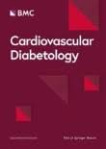
195 adults with obesity and without diabetes lost 12% in body weight.
Four-arm RCT of one-year treatment with:
Placebo
moderate-to-vigorous exercise (> 150 min/week of moderate-intensity or 75 min/week of vigorous-intensity aerobic physical activity or an equivalent combination of both),
GLP-1 RA liraglutide 3.0 mg/day
combination (exercise + liraglutide).
Notes:
Background Identifying and reducing cardiometabolic risks driven by obesity remains a healthcare challenge. The metabolic syndrome is associated with abdominal obesity and inflammation and is predictive of long-term risk of developing type 2 diabetes and cardiovascular disease in otherwise healthy individuals living with obesity. Therefore, we investigated the effects of adherent exercise, a glucagon-like peptide 1 receptor agonist (GLP-1 RA), or the combination on severity of metabolic syndrome, abdominal obesity, and inflammation following weight loss.
Methods This was a randomized, double-blinded, placebo-controlled trial. During an 8-week low-calorie diet (800 kcal/day), 195 adults with obesity and without diabetes lost 12% in body weight. Participants were then evenly randomized to four arms of one-year treatment with: placebo, moderate-to-vigorous exercise (minimum of 150 min/week of moderate-intensity or 75 min/week of vigorous-intensity aerobic physical activity or an equivalent combination of both), the GLP-1 RA liraglutide 3.0 mg/day, or a combination (exercise + liraglutide). A total of 166 participants completed the trial. We assessed the prespecified secondary outcome metabolic syndrome severity z-score (MetS-Z), abdominal obesity (estimated as android fat via dual-energy X-ray absorptiometry), and inflammation marker highsensitivity C-reactive protein (hsCRP). Statistical analysis was performed on 130 participants adherent to the study interventions (per-protocol population) using a mixed linear model.
Results The diet-induced weight loss decreased the severity of MetS-Z from 0.57 to 0.06, which was maintained in the placebo and exercise groups after one year. MetS-Z was further decreased by liraglutide (− 0.37, 95% CI − 0.58 to − 0.16, P < 0.001) and the combination treatment (− 0.48, 95% CI − 0.70 to − 0.25, P < 0.001) compared to placebo.
Abdominal fat percentage decreased by 2.6, 2.8, and 6.1 percentage points in the exercise, liraglutide, and combination groups compared to placebo, respectively, and hsCRP decreased only in the combination group compared with placebo (by 43%, P = 0.03).

Slide 38
The combination of exercise and GLP-1RA (liraglutide) was the most effective weight loss strategy while preserving bone health.
Liraglutide treatment alone reduced BMD at clinically relevant sites more than exercise alone despite similar weight loss.
Notes:
IMPORTANCE A major concern with weight loss is concomitant bone loss. Exercise and glucagonlike peptide-1 receptor agonists (GLP-1RAs) represent weight loss strategies that may protect bone mass despite weight loss.
OBJECTIVE To investigate bone health at clinically relevant sites (hip, spine, and forearm) after diet induced weight loss followed by a 1-year intervention with exercise, liraglutide, or both combined.
DESIGN, SETTING, AND PARTICIPANTS This study was a predefined secondary analysis of a randomized clinical trial conducted between August 2016 and November 2019 at the University of
Copenhagen and Hvidovre Hospital in Denmark. Eligible participants included adults aged 18 to 65 years with obesity (body mass index of 32-43) and without diabetes. Data analysis was conducted from March to April 2023, with additional analysis in February 2024 during revision.
INTERVENTIONS After an 8-week low-calorie diet (800 kcal/day), participants were randomized to 1 of 4 groups for 52 weeks: a moderate- to vigorous-intensity exercise program (exercise alone), 3.0 mg daily of the GLP-1 RA liraglutide (liraglutide alone), the combination, or placebo.
MAIN OUTCOMES AND MEASURES The primary outcome was change in site-specific bone mineral density (BMD) at the hip, lumbar spine, and distal forearm from before the low-calorie diet to the end of treatment, measured by dual-energy x-ray absorptiometry in the intention-to-treat population.
RESULTS In total, 195 participants (mean [SD] age, 42.84 [11.87] years; 124 female [64%] and 71 male [36%]; mean [SD] BMI, 37.00 [2.92]) were randomized, with 48 participants in the exercise
group, 49 participants in the liraglutide group, 49 participants in the combination group, and 49 participants in the placebo group. The total estimated mean change in weight losses during the study was 7.03 kg (95%CI, 4.25-9.80 kg) in the placebo group, 11.19 kg (95%CI, 8.40-13.99 kg) in the exercise group, 13.74 kg (95%CI, 11.04-16.44 kg) in the liraglutide group, and 16.88 kg (95%CI, 14.23- 19.54 kg) in the combination group. In the combination group, BMD was unchanged compared with the placebo group at the hip (mean change, −0.006 g/cm2; 95%CI, −0.017 to 0.004 g/cm2; P = .24) and lumbar spine (−0.010 g/cm2; 95%CI, −0.025 to 0.005 g/cm2; P = .20). Compared with the exercise group, BMD decreased for the liraglutide group at the hip (mean change, −0.013 g/cm2; 95% CI, −0.024 to −0.001 g/cm2; P = .03) and spine (mean change, −0.016 g/cm2; 95%CI, −0.032 to −0.001 g/cm2; P = .04).
CONCLUSIONS AND RELEVANCE In this randomized clinical trial, the combination of exercise and GLP-1RA (liraglutide) was the most effective weight loss strategy while preserving bone health. Liraglutide treatment alone reduced BMD at clinically relevant sites more than exercise alone despite similar weight loss.

Slide 39
The Sarcopenic Obesity Clinical Leadership Initiative (SOGLI)
Definition and diagnostic criteria for Sarcopenic Obesity
Ongoing initiatives

Slide 40
Notes:
These are the topics SOGLI has discussed over the last four years.
SOGLI is a think tank that seeks to enhance research and improve clinical practice in the field of SO.
The next episode is in November, and we hope to take a further step in this direction.

Slide 41

Transversal consensus group on low muscle mass (GLIS, GLIM, SOGLI)
First informal meeting at ESPEN 2023
Rocco Barazzoni, Tommy Cederholm,
Alfonso Ceuz-Jentoft, Lorenzo M Donini, M Cristina Gonzalez, Kristina Norman, Marjolein Visser
Chair: Mette Svendsen, Lorenzo M Donini
Obesity in Older Adults & Sarcopenic Obesity (SO3A)
Notes:
At the moment, due the transversal nature of the SO concept, three different initiatives are involved in the discussion concerning SO
Transversal group aimed at aligning the three different initiatives (GLIM, SOGLI and GLIS) since the (operationalization) translation of low MM concept into clinical practice for malnutrition, sarcopenic obesity as well as sarcopenia to support its use in clinical practice and research,

Slide 42
Notes:
Finally WHO is addressing SO in the Europe and published a fact sheet on this topic.
On the 1° of April there will be a meeting in Copenhagen involving ESPEN, EASO, WONCA (World organisation of family doctors) and EFAD (Eur Fed of Associations of Dietitians) to define next steps and opprtunities for collaboration.

Slide 43
Papers promoted or inspired by the SOGLI
Barazzoni R, Bischoff S, Boirie Y, et al. Sarcopenic Obesity: Time to Meet the Challenge. Obes Facts. 2018;11(4):294-305. doi: 10.1159/000490361 & Clin Nutr. 2018 Dec;37(6 Pt A):1787-1793. doi: 10.1016/j.clnu.2018.04.018
Donini LM, Busetto L, Bauer JM, et al. Critical appraisal of definitions and diagnostic criteria for sarcopenic obesity based on a systematic review. Clin Nutr. 2020 Aug;39(8):2368-2388. doi: 10.1016/j.clnu.2019.11.024.
Poggiogalle E, Parrinello E, Barazzoni R, et al. Therapeutic strategies for sarcopenic obesity: a systematic review. Curr Opin Clin Nutr Metab Care. 2021 Jan;24(1):33-41. doi: 10.1097/MCO.0000000000000714.
Donini LM, Busetto L, Bischoff SC, et al. Definition and diagnostic criteria for sarcopenic obesity: ESPEN and EASO consensus statement. Clin Nutr. 2022 Apr;41(4):990-1000. doi: 10.1016/j.clnu.2021.11.014
Gortan Cappellari G, Guillet C, Poggiogalle E, et al; SOGLI Expert Panel. Sarcopenic obesity research perspectives outlined by the sarcopenic obesity global leadership initiative (SOGLI) - Proceedings from the SOGLI consortium meeting in rome November 2022. Clin Nutr. 2023 May;42(5):687-699. doi: 10.1016/j.clnu.2023.02.018. & Obes Facts. 2022;15(3):321-335. doi: 10.1159/000521241.
Prado CM, Batsis JA, Donini LM, et al. Sarcopenic obesity in older adults: a clinical overview. Nat Rev Endocrinol. 2024 May;20(5):261-277. doi: 10.1038/s41574-023-00943-z
Pinel A, Guillet C, Capel F, et al. Identification of factors associated with sarcopenic obesity development: Literature review and expert panel voting. Clin Nutr. 2024 Jun;43(6):1414-1424. doi: 10.1016/j.clnu.2024.04.033
Gortan Cappellari G, Zanetti M, Donini LM, Barazzoni R. Detecting sarcopenia in obesity: emerging new approaches. Curr Opin Clin Nutr Metab Care. 2024 Sep 1;27(5):402-409. doi: 10.1097/MCO.0000000000001062

Slide 44
In the pipeline
Predicting appendicular lean soft tissue with bioelectrical impedance analysis among adult patients with excessive adiposity. Poggiogalle E, Pozza Santos L, Batsis J et al (submitted to Clin Nutr)
Current application and future directions for the Sarcopenic Obesity Global Leadership Initiative (SOGLI) Diagnostic Algorithm: Minnetti M, Pierantozzi G, Aubertin-Leheudre M, et al (in preparation, final revision by the authors)
Operations manual for the implementation of the SOGLI algorithm in the diagnosis of sarcopenic obesity. Pinto A, Frigerio F, Ballesteros-Pomar MD et al (in preparation, final revision by the authors)

Slide 45


The Italian Society of Obesity (SIO) project for an
e-registry for Sarcopenic Obesity
Disease registries gather insights in natural history and clinical aspects of diseases and allow comparison between different treatments prescribed for the same indication.
Financed by PRIN-RPNI (Research Project of National Interest) - Ministry of Education, University and Research (MIUR)– prot 202229ET3S
“Clinical implementation of ESPEN-EASO criteria for diagnosis and staging of sarcopenic obesity”
Notes:
From the previous analysis two main considerations emerge
There is the necessity to have prospective studies. The data we can get from datasets collected for other purposes may be useful to raise some questions and to imagine the way we have to pursue in the future
We need to standardise the procedures adopting similar procedures, devices and predictive equations in particular for body composition and functional parameters.
Based on these considerations the SIO decided to collect data on SO sbj in a disease registry.
Disease registries gather insights in natural history and clinical aspects of diseases and allow comparison between different treatments prescribed for the same indication.
Adressed to: HCP & researchers, institutional stakeholders
First steps: Physician/research groups engagement; Data quality (standardization of procedures); Economic sustainability (research grants)

Slide 46
Conclusion
Obesity is characterized by excessive production and diminished capacity to store lipids, leading to ectopic fat accumulation in skeletal muscle in the form of intramuscular adipose tissue (IMAT) and intramyocellular accumulation of lipids (IMCL: triacylglycerol, ceramide, and diacylglycerol).
Inflammation, oxidative stress, insulin resistance, anabolic resistance, disorders in myokines secretion, endocrine dysfunction are involved in the pathophysiology of SO and in its clinical & functional consequences.
The consequences of SO are represented, in particular, by functional impairments, metabolic and cardiovascular diseases, MASLD, cognitive impairment leading to frailty and increased mortality.
The SOGLI proposed an algorithm for the diagnosis of SO that is now considered the reference procedure.
There is the need for RCT assessing the best therapeutic approach

