Slide 1
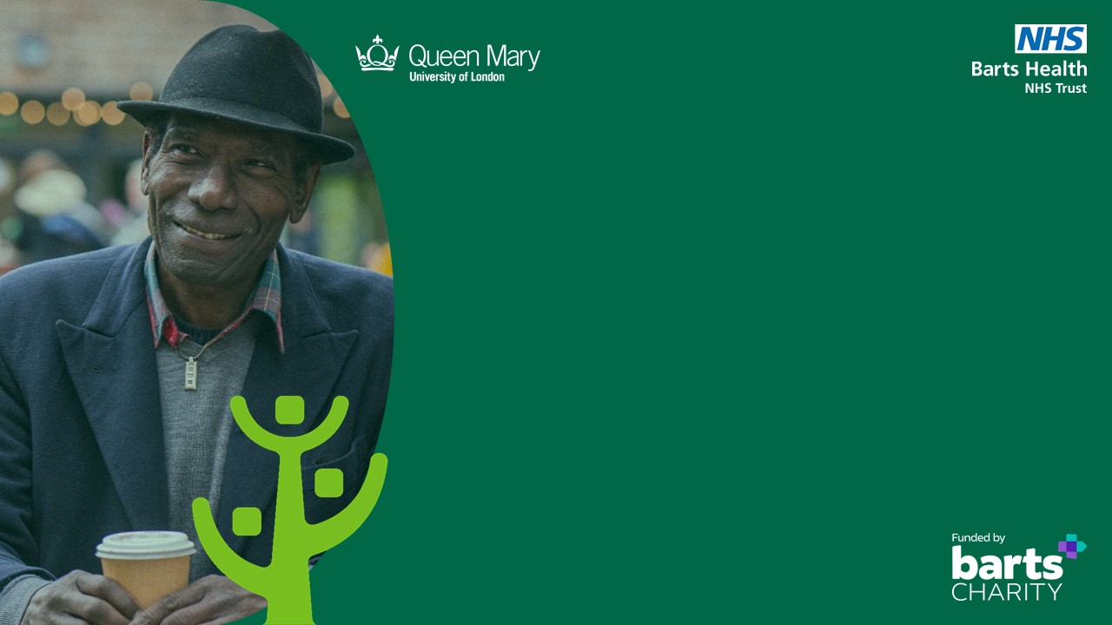


Current Approaches and the future in palliative care
(of older people)
Adam Gordon
Professor of Care of Older People
adamgordon1978.bsky.social

Slide 2
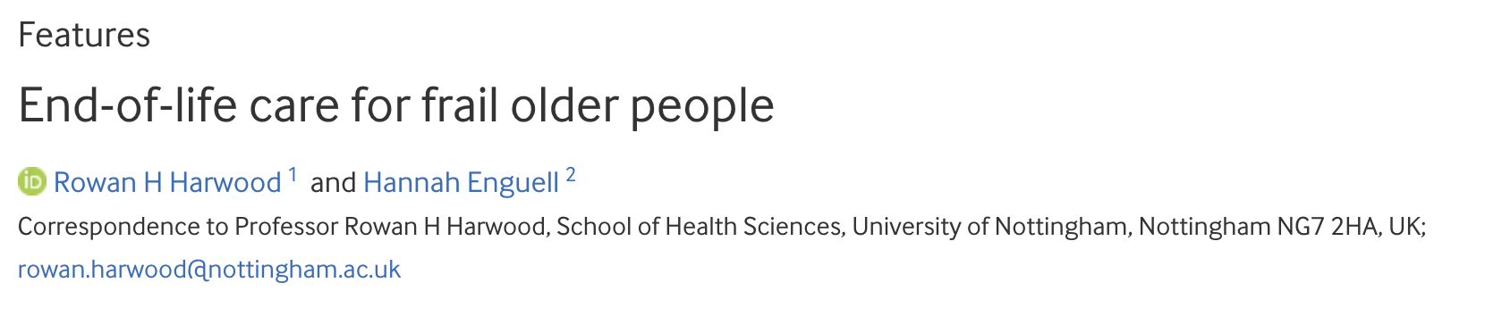
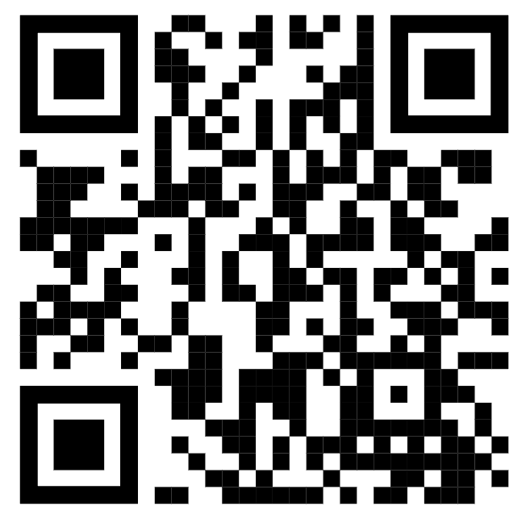
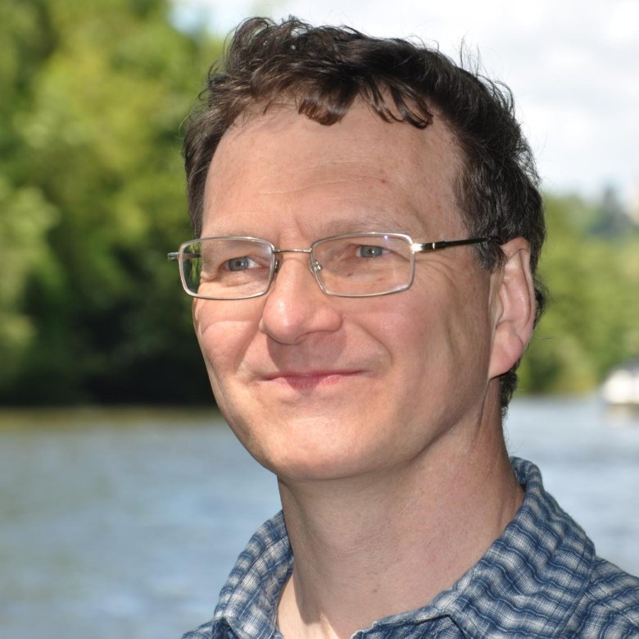
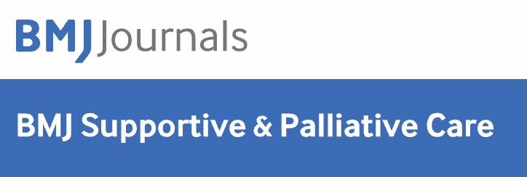

Slide 3
What I want to talk about….
A good death - some broad principles
Specific frameworks
Encompassing frailty in prognostication and palliation
The role of culture and religion
Ways forward

Slide 4
A “good” death
Treated as an individual with dignity and respect
Without pain or other symptoms
In familiar surroundings
With family and friends

Slide 5

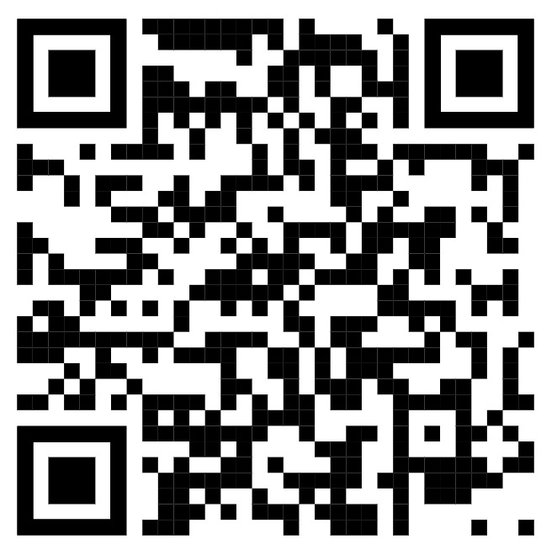
Discussions as end of life approaches
Assessment, Care Planning and Review
Coordination of care
Delivery of high quality services in different settings
Care in the last days of life
Care after death
Step 1
Step 2
Step 3
Step 4
Step 5
Step 6
Open, honest
Communication
Identifying
triggers for
discussion
Agreed care
Plan
Regular review
of needs &
preferences
Assessing needs
of carers
Coordination of
individual patient
care
Rapid response
services
Acute hospitals
Care homes
Extracare
housing
Hospices
Community
hospitals
Prisons
Secure
hospitals
Hostels
Ambulance
services
Recognising the
dying phase
Reviewing
preferences
Support for
patient and
carer
Recognition of
wishes
regarding
resuscitation
Recognising needs
after death
Timely verification
and or burial
as needed
Care and support
of family including
bereavement
support

Slide 6
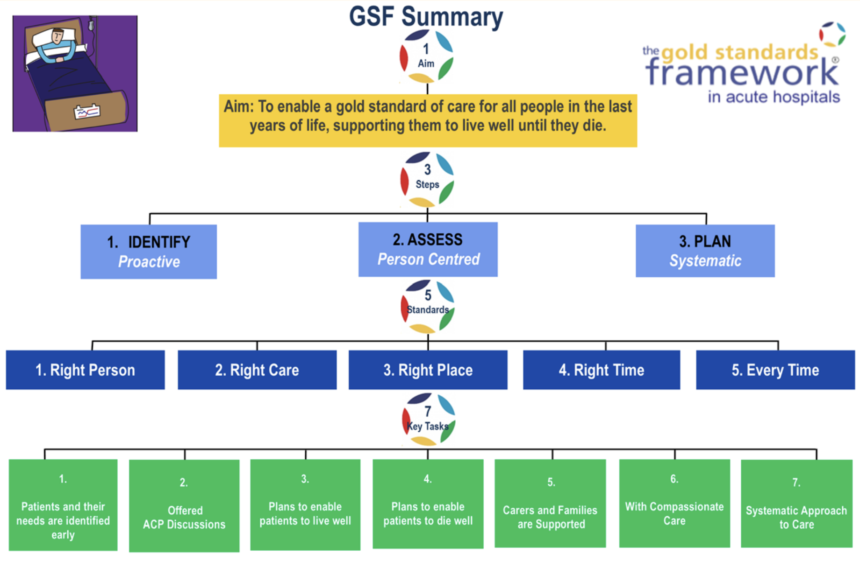
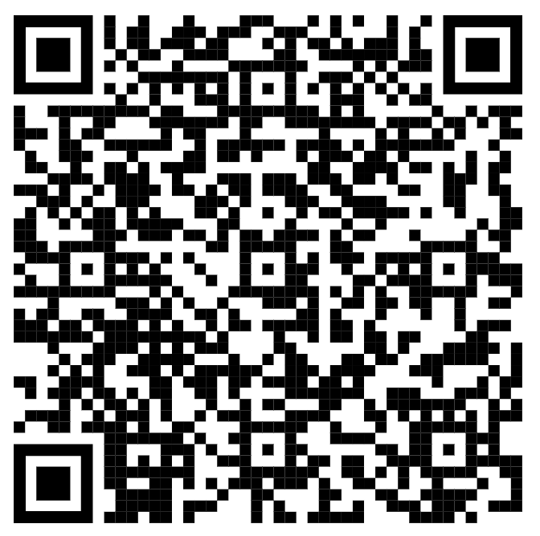

Slide 7
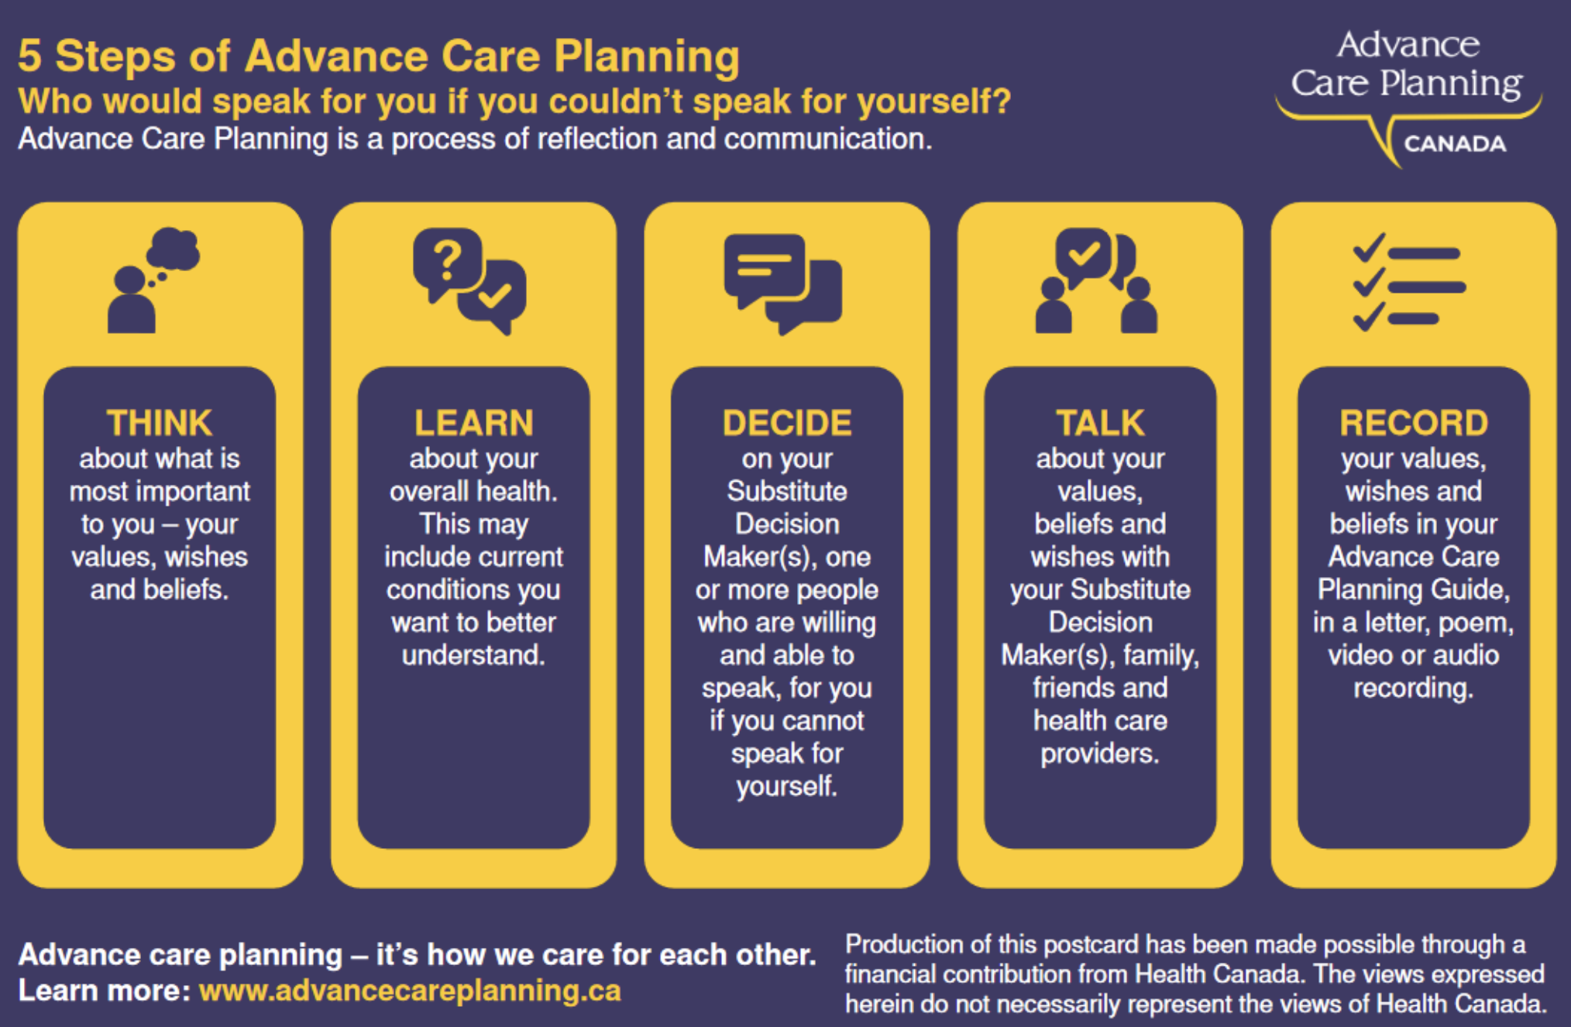

Slide 8

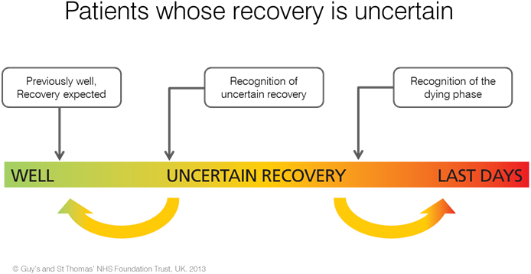

Slide 9
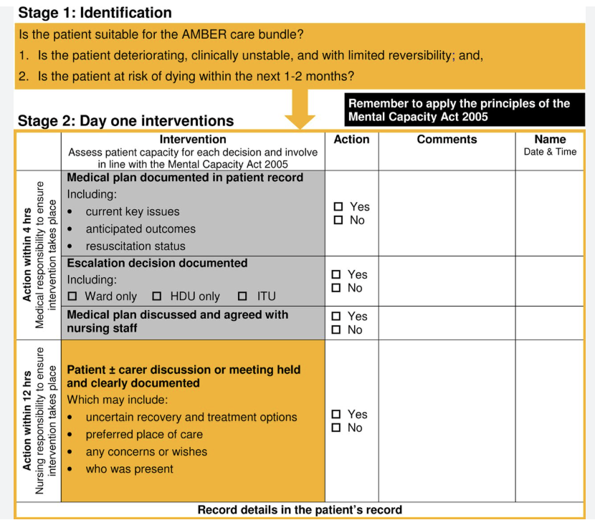
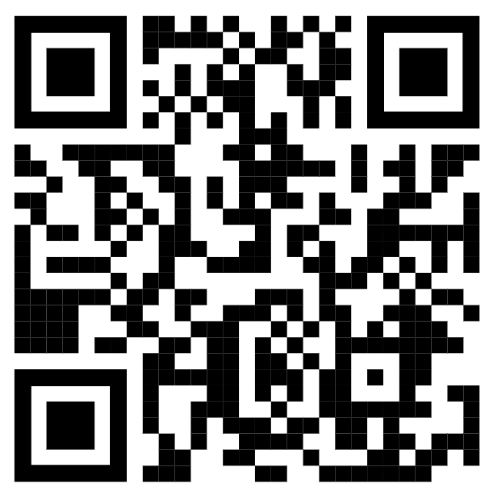

Slide 10


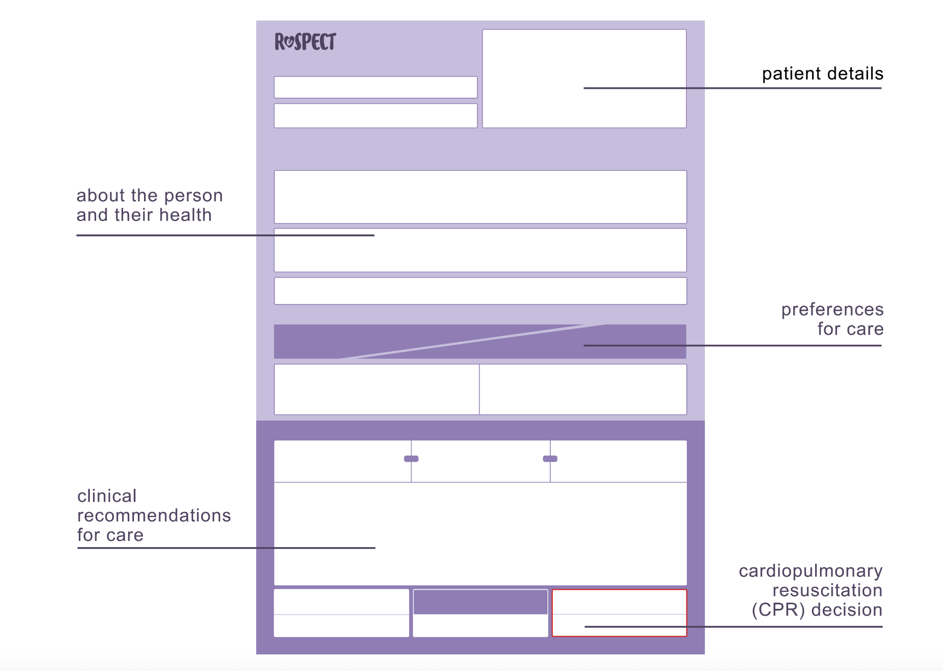
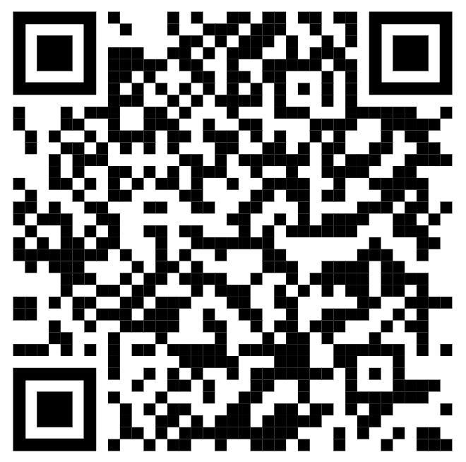

Slide 11

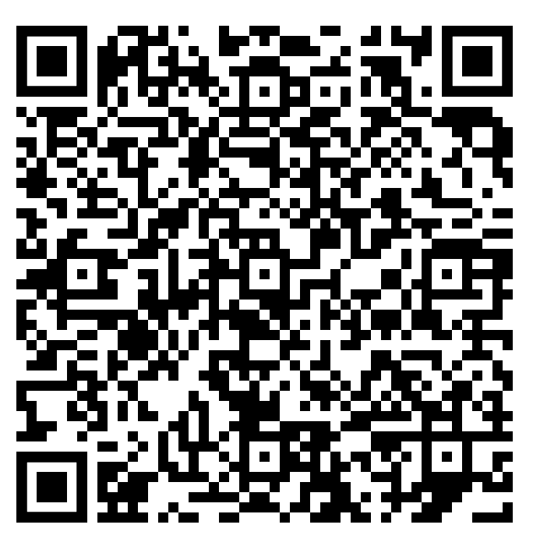
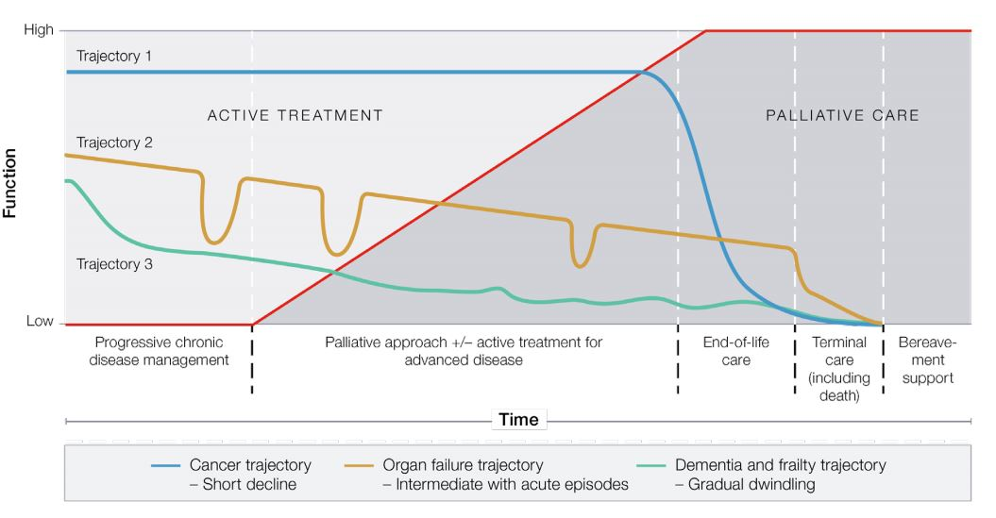

Slide 12
Would I be surprised if this person were dead at 1 year?
Would I be surprised if this person were alive at 1 year?
You can deal with both realities at once.

Slide 13
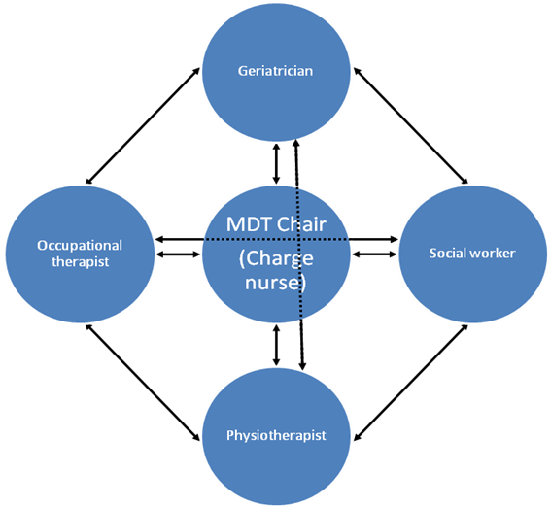
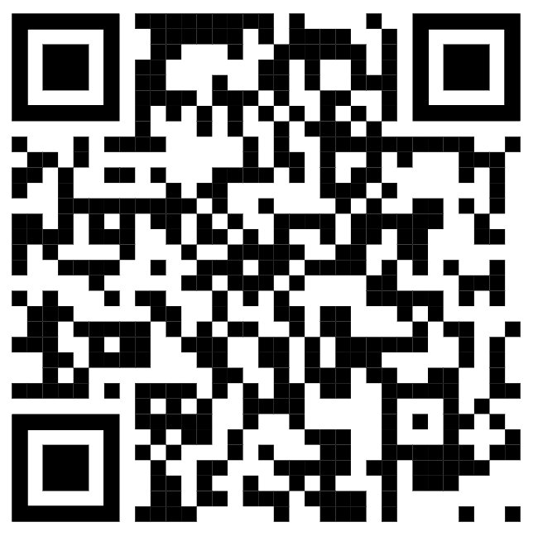
Assessment
Stratified problem list
Bespoke Management Plan
Goals
Physical
Psychological
Functional
Social
Environmental

Slide 14

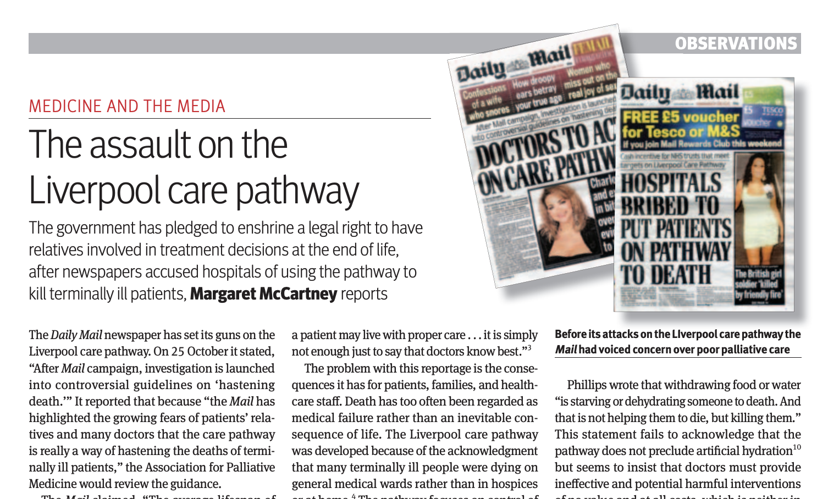
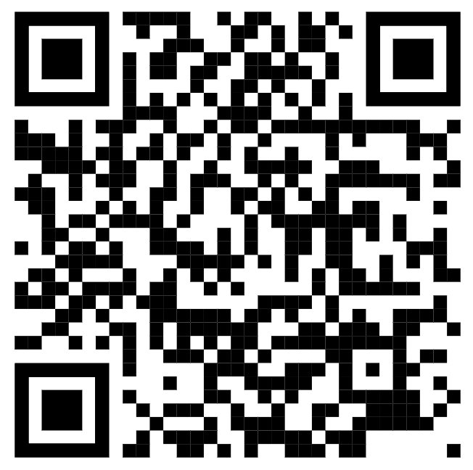

Slide 15
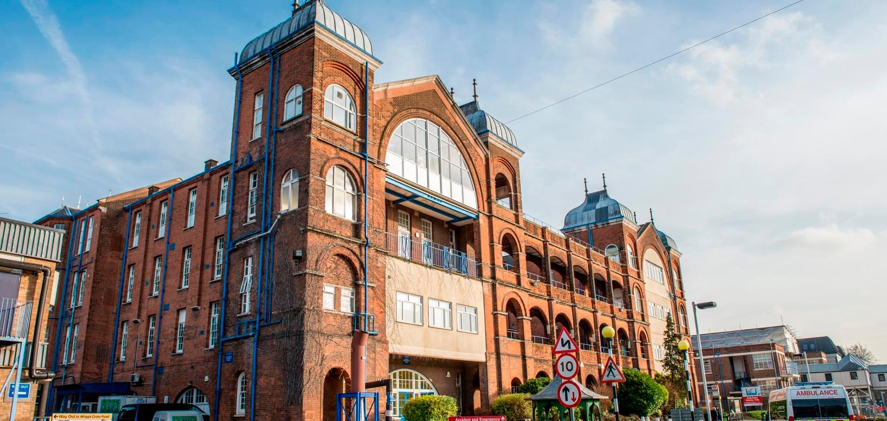
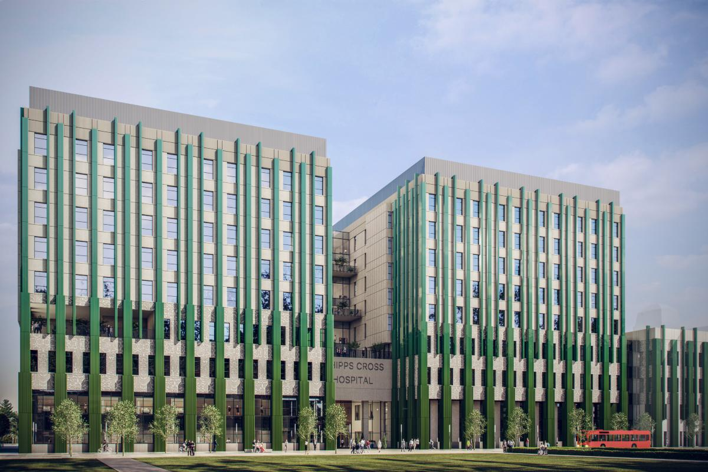

Slide 16
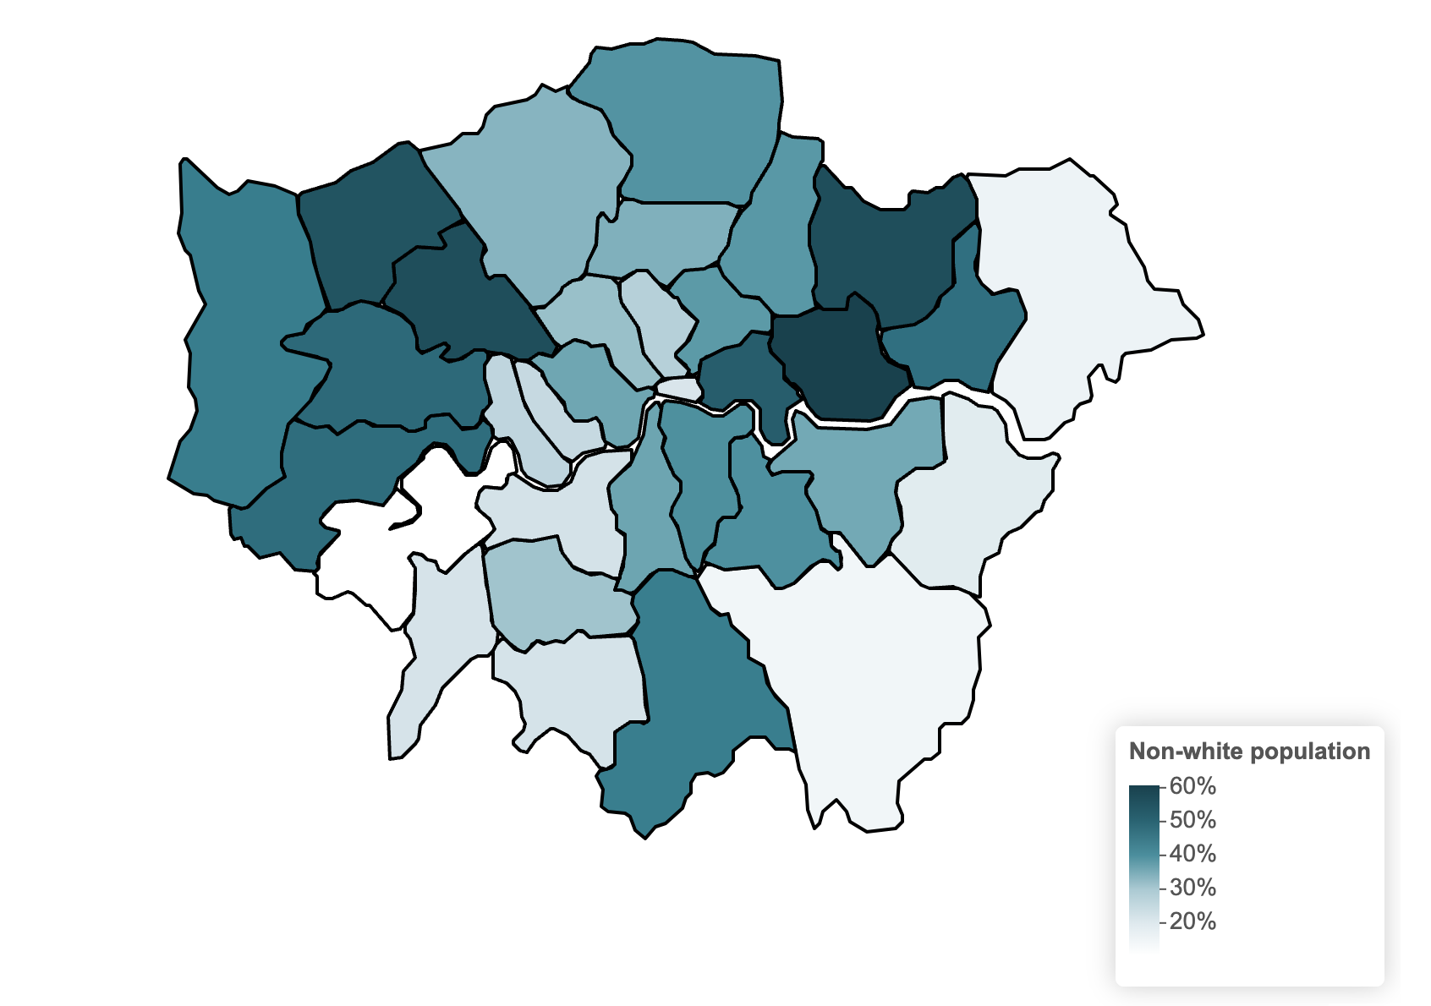

Slide 17
A recent case
Globally renowned Sunni scholar and jurist – strictly observant wife and family.
89 years old – clinical frailty score 4.
Teenage son.
Acutely unwell in hospital for days with worsening pneumonia and multi-organ failure.
Seen by Intensive Care team – transfer to intensive care deemed “futile”.
Followers queueing down the corridor.

Slide 18
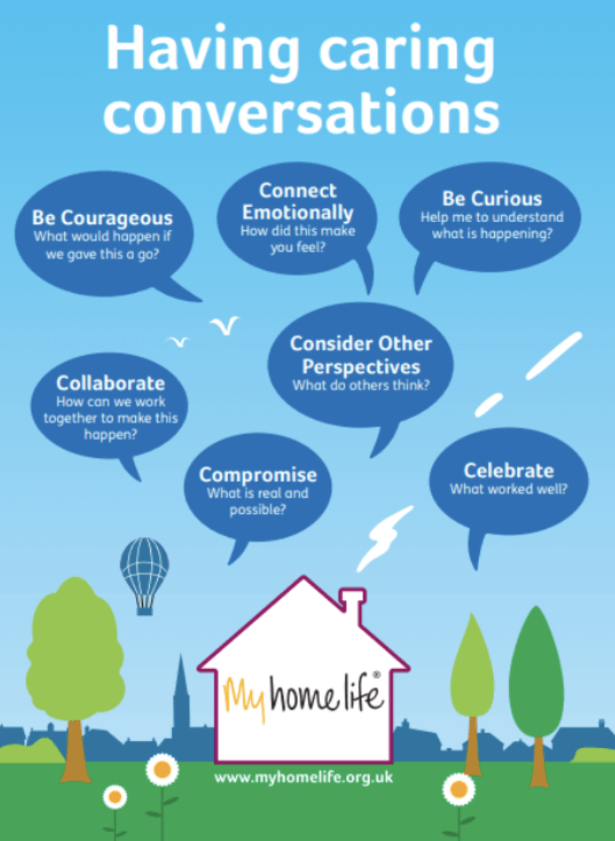

Slide 19
A “good” death
Treated as an individual with dignity and respect
Without pain or other symptoms
In familiar surroundings
With family and friends

Slide 20
What next? (also my take home messages)
We know what good palliative care looks like.
  We need to roll out the principles of good palliative care ever more widely.
Holding uncertainty, and the possibility of recovery, is essential for palliative care in frailty.
  This will help us avoid the errors of the past (cf the Liverpool Care Pathway)
Death has spiritual and religious dimensions but is also a shared human experience.
  We need to find ways to focus on this whilst respecting cultural differences.

